Slide 1
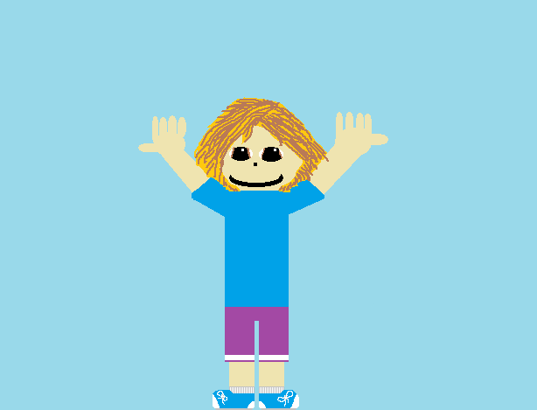
Stella Goes to The Zoo
Written and Illustrated
By: Alicia Acker

Slide 2
Stella Goes to the Zoo
Written, Published and Illustrated By Alicia Acker

Slide 3
Copyright © 2015 by Alicia Acker
All rights reserved. This book or any portion thereof may not be reproduced or used in in any manner whatsoever without the express written permission of the publisher except for the use of brief quotations in a book review.
First Printing, 2015
IBSN 0-203-601-11847-7
Sparkles and Cupcakes Publishing
11 Sparkle Street
Rosemary, NS
www.Sparkles_and_Cupcakes.ca
Edited By: Jamie Fehr and Emma Swansburg
Get a full colour copy here: http://tcdsbstaff.ednet.ns.ca/scroache/Book%20Buddy%20Books/book_buddy_book_index.htm

Slide 4
This book is dedicated to Stella, the best book buddy ever.

Slide 5
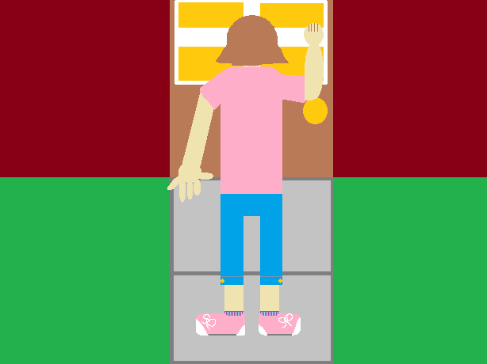
One day, Alicia went to Stella’s house to take Stella to the zoo! Once Alicia was at Stella’s house, she knocked on the door. Then Stella opened the door.

Slide 6
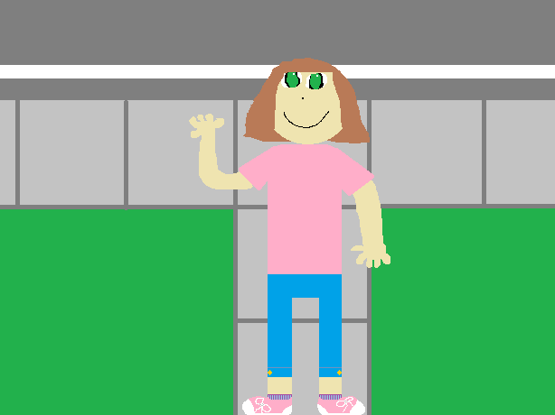
Alicia said, “Hi Stella! I’m here to take you to the zoo!” and waved.

Slide 7
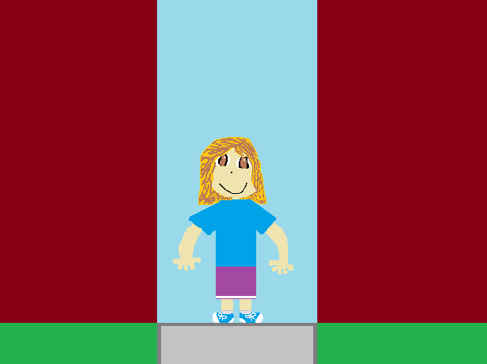
Then Stella said, “Hi Alicia! Ok! Let’s go!” and walked out the door with Alicia.

Slide 8
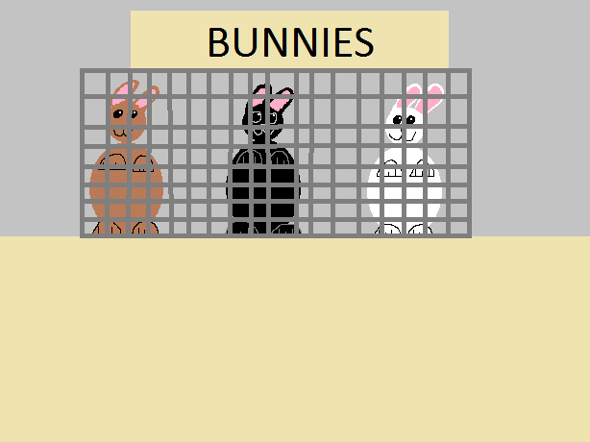
Once they got to the zoo, Stella saw some bunnies. “How many bunnies is there, Stella?” Alicia asked. “What color is this bunny?” Alicia asked, as she pointed at all 3 bunnies one after the other.

Slide 9
Then, Stella saw a frog. “What color is it Stella? What does a frog say, Stella?” Alicia asked.
Ribbit! Ribbit!

Slide 10
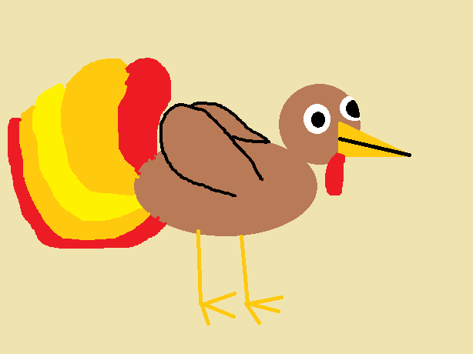
The last animal Stella saw was a turkey. “What color is it, Stella? What does a turkey say, Stella?” Alicia asked.
Gobble! Gobble!

Slide 11
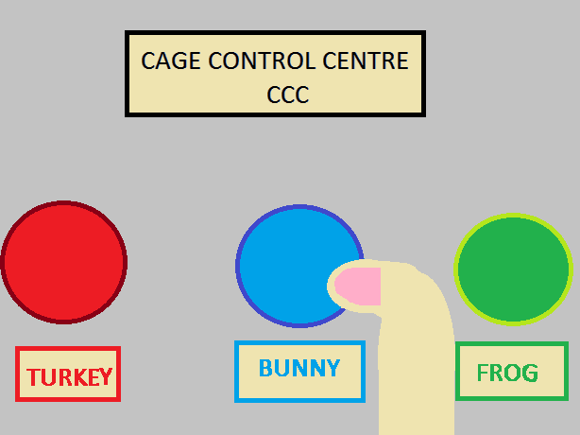
Stella was a little bored, so she decided to let ALL of the animals out. “Stella, NO!” Alicia screamed.

Slide 12
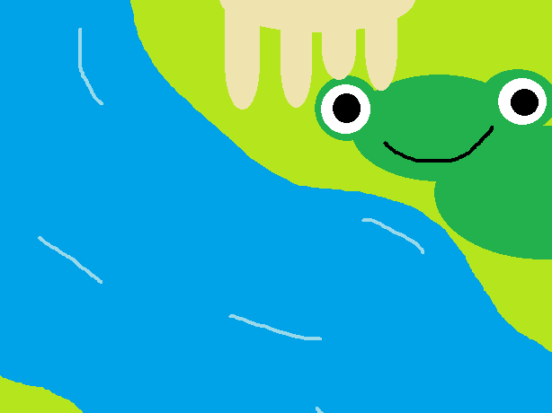
So Stella and Alicia tried to get all of the animals back in their cages. Alicia got the frog and the turkey back in their cages. Stella put all 3 bunnies back in their cages.

Slide 13
Then a cashier came over and rewarded them with chocolate ice cream for helping get the animals back in their cage.

Slide 14
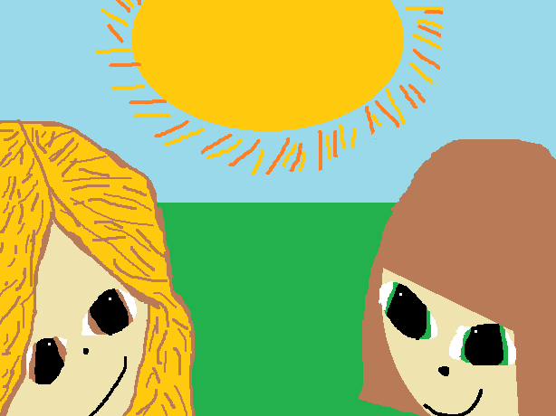
Alicia looked at Stella. Stella said, “Best day EVER!” So they went home. They never found out who let the animals out, and they lived happily ever after.

Slide 15
About the Author
Alicia Acker was 11 years old when she wrote her first book (which was this book.) She is 11 years old and her birthday is November 10th, 2003. She has gone to both the district and regional Science Olympics and won silver at both. She lives in Ingomar, Nova Scotia, with her parents, her brother, and her 2 cats. Her favorite colour is pink.
She really enjoyed writing this book for her favorite book buddy, Stella.

Slide 16
Comments!
Jamie: AWESOME!
Aurora: good job!!!!
Peter: Good Book and Pictures!!!!
Gabe: Nice job drawing that ice cream.
Emma: “Great book!”

Slide 17
Alicia takes Stella to the Zoo… what kind of crazy and exciting things will happen?

