Slide 1
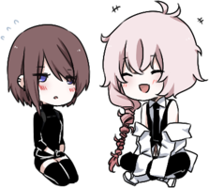
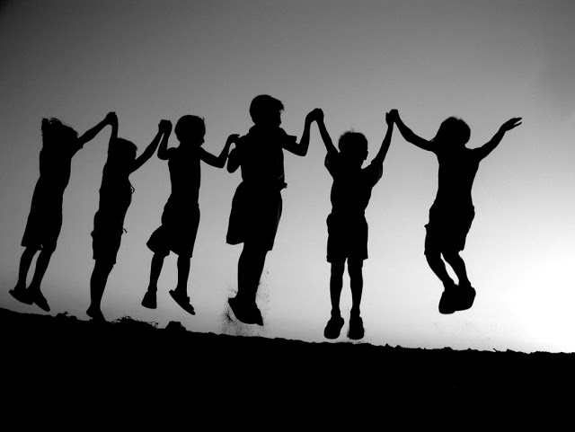
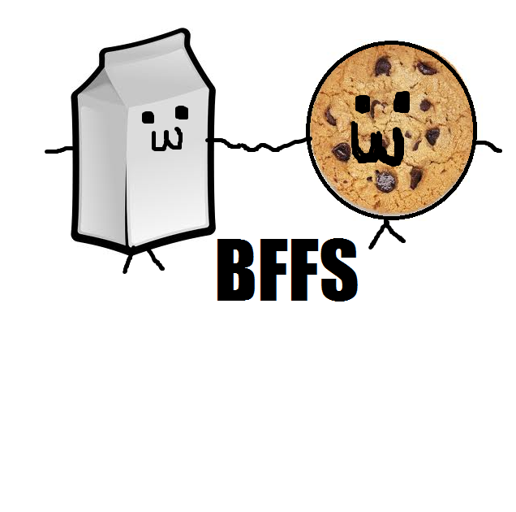
Allie finds some friends!
Author: Jessica Hemeon

Slide 2
Copyright
© 2015 Jessica Hemeon
All rights reserved do not damage unless Jessica gives you permission
Fairy Flyers, Shelburne Rd., The Valley www.FairyFlyers.com
Printed in Nova Scotia Canada
First printing
ISBN number 0-203-612-54141-2
Editor:Makaila Chapman

Slide 3
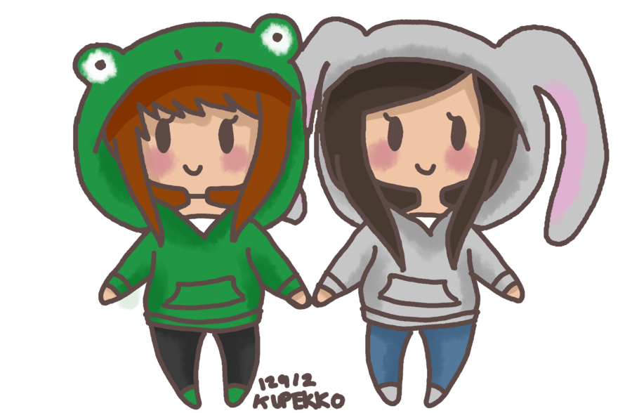
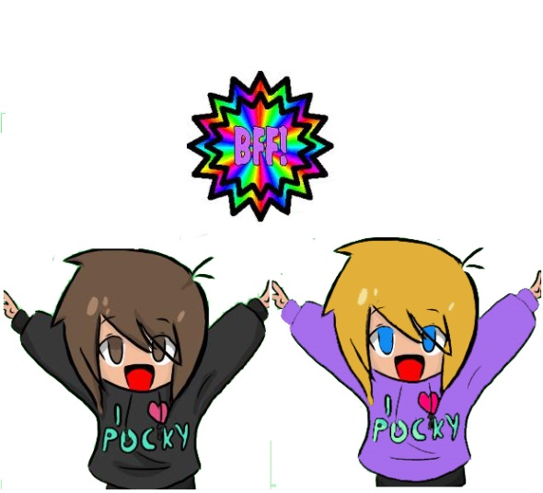
Allie finds some friends!

Slide 4
This book is dedicated to Allie Stanley foe being the best book buddy ever
<3

Slide 5
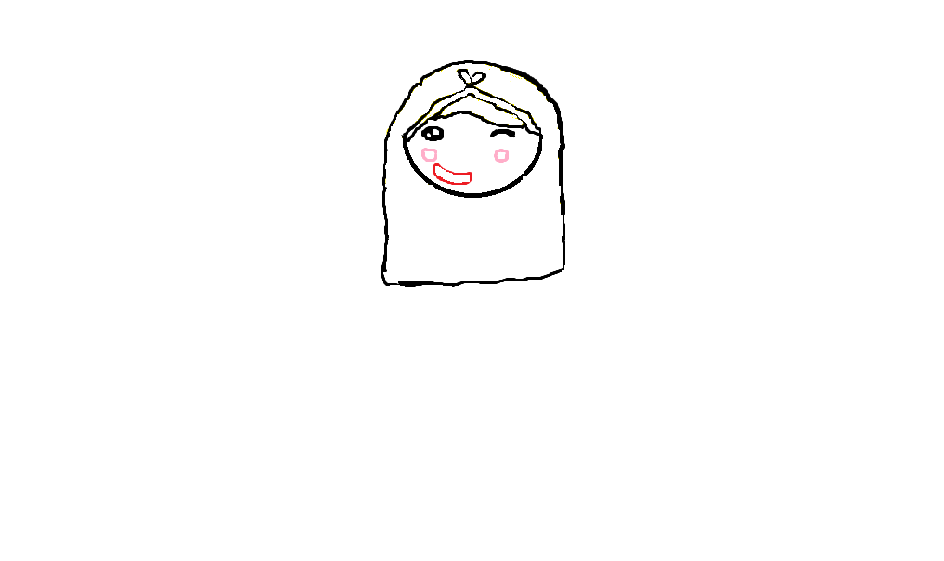
One day in a pretty yellow castle on the top of a big hill, there was a pretty princess named Allie

Slide 6
“Mom? Said Allie when am I going to school?”. “Tomorrow,” said her mom.

Slide 7
“Ok,” said Allie, “I can’t wait but… I'm a little scared,” she said to herself.

Slide 8
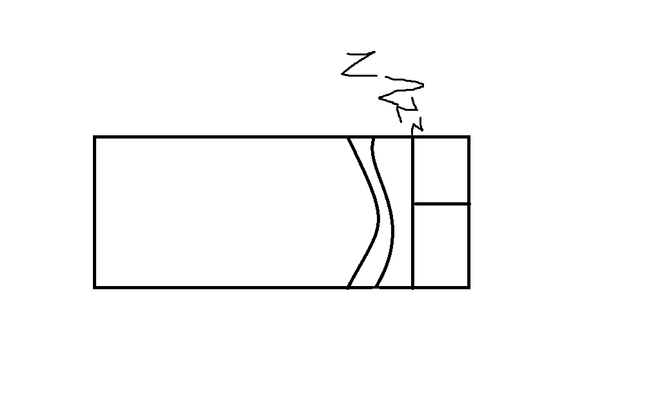
“I'm going to bed, mom “said Allie “Ok goodnight,” said her mom.

Slide 9
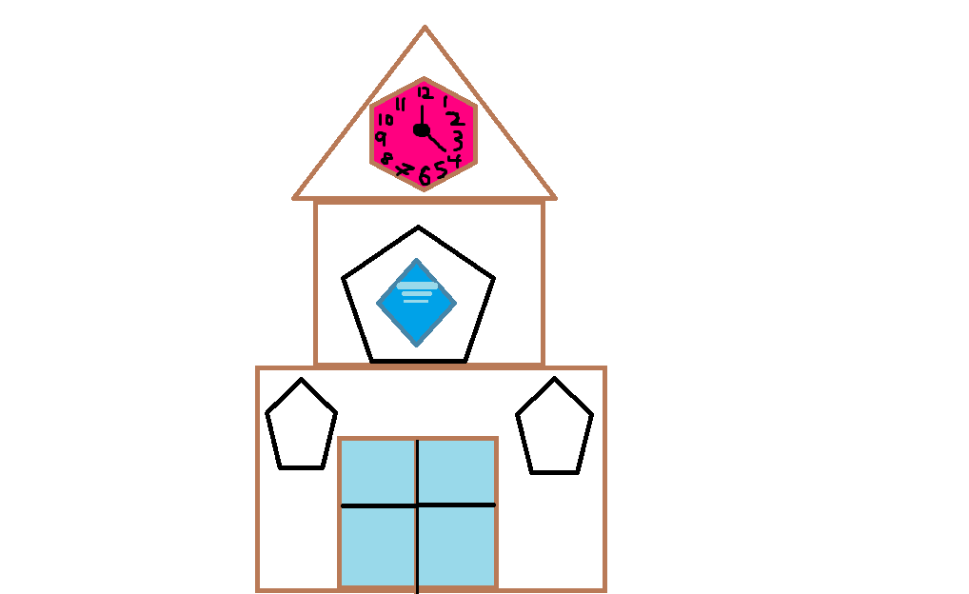
“Goodnight.” Allie gave her mom a hug and went to bed. The next morning Allie woke up and got into her prettiest blue dress and went to school.

Slide 10
At the school there were a lot of animals. She didn’t know she could talk to animals. It was an only animal school but they let her in. All of the animals were playing with their friends but… Allie didn’t have any. but suddenly a green unicorn a blue turtle and a lion with rainbow stripes came to her. Their names were Jessica, Sadie and Aurora. They were very popular and pretty .

Slide 11
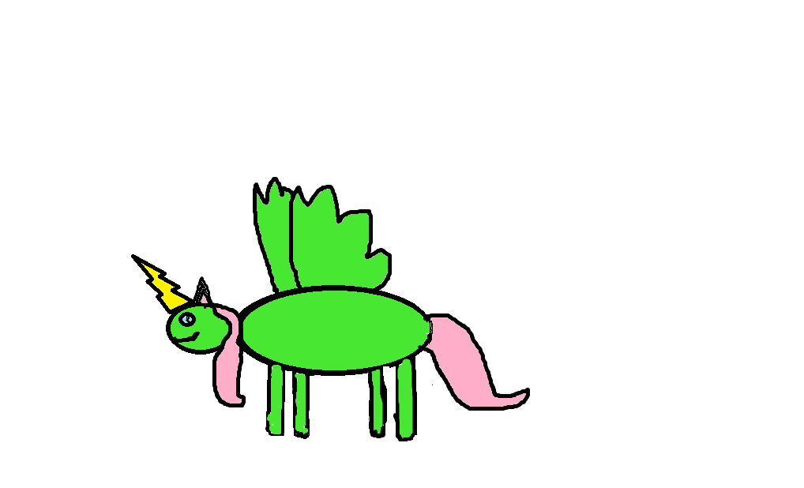
“What’s your name?” said Jessica “ My name is Allie” she said.

Slide 12
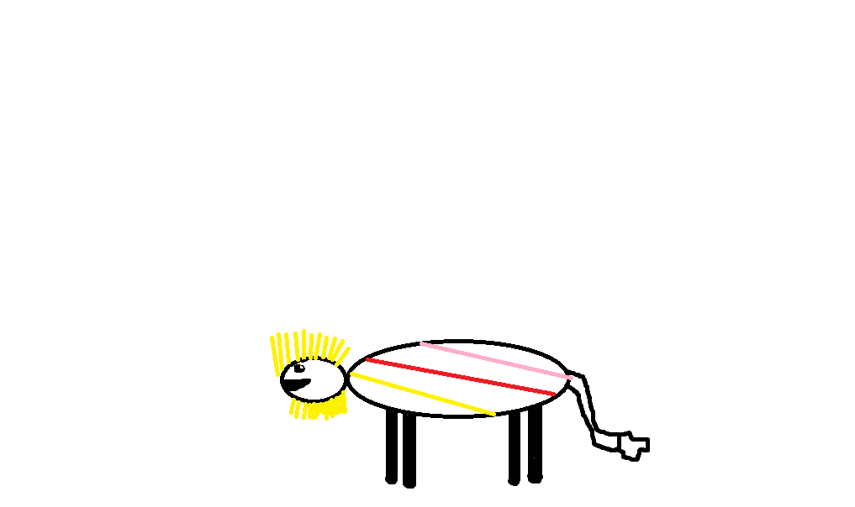
“that’s a nice name” said Sadie “thank you” said Allie.

Slide 13
“your welcome “said Sadie they went inside and got to sit beside each other .

Slide 14
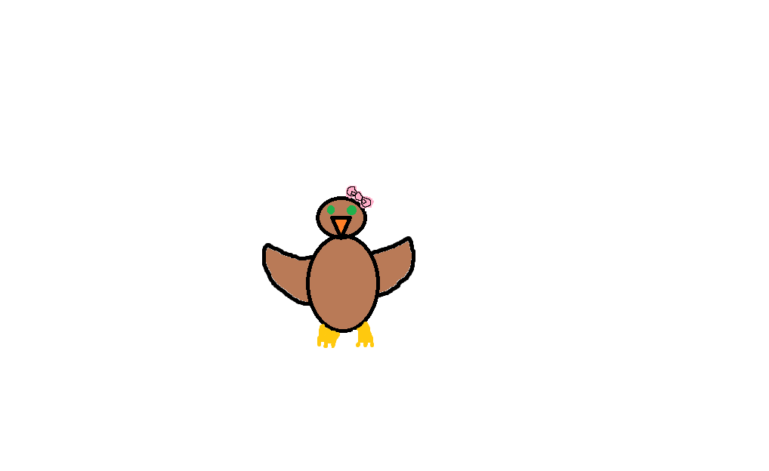
“Hello class I am Mrs. Avery Owl” ”Hello Mrs. Avery owl” said the class.

Slide 15
“So today we are going to get to know each other” said Mrs. Avery.

Slide 16
“Can I start?” said Allie “That would be great!” said Mrs. Avery.

Slide 17
“ok hi my name is Allie I am 5 years old and I love I-spy books” Allie said.

Slide 18
Everyone clapped she felt like she had been there her whole life she made lots of new friends that day. She went home and she was happy she told her mom all about what a great day she had she loved her school and her friends.

Slide 19
Autobiography
Jessica Ann Hemeon was born in Bridgewater she lives in a family of four Her Mother,Father,Brother and Jessica. She has 5 animals two dogs and three cats. She loves her family.

Slide 20
Comments
Amiya: pretty long but other then that an altogether good story!
Christina: A really good book!
Desirae: Awesome!
Jasmine: Great book for kids!
Bella: Great book!

