Slide 1
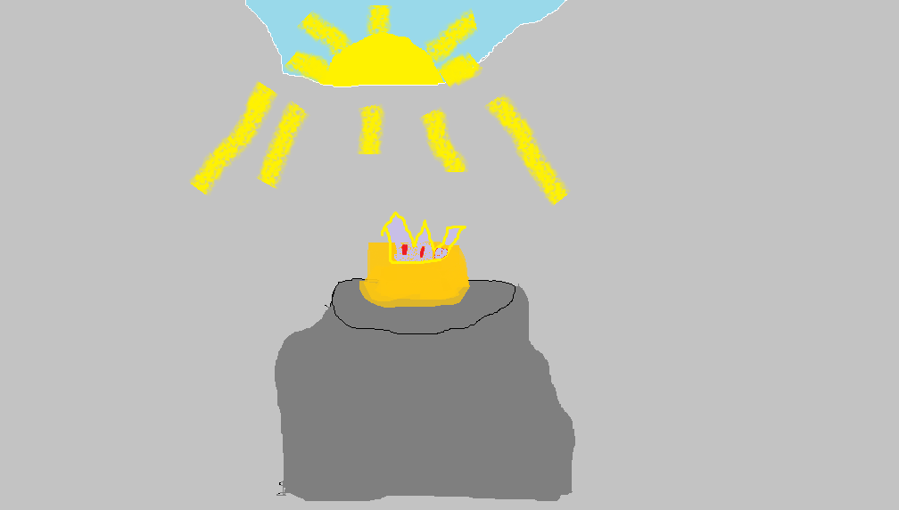
UNICORN ADVENTURE BY AURORA

Slide 2
Once upon a time there were five magic unicorns. They all had names Allie, Phoxine, Page and Jess.

Slide 4
Allie was a unicorn with bright pink fur and a white horn.
One day
Allie wanted to go on a adventure with her five best friends . Allie got all her friends Jess, Phoxine, Page and Aurora .Allie is the princess of a kingdom called Unicorns.
Her friends walk to the Cave of Friendship with her Five minutes later at the Cave of Friendship the five unicorns enter .

Slide 5
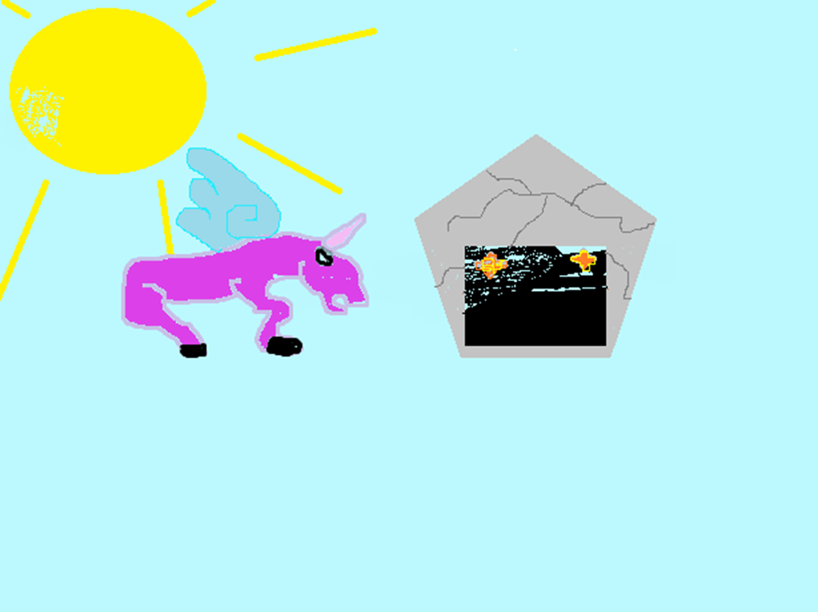

Slide 6
The five unicorns went through the stages of the Cave of Friendship. Stage 2, they had to go though the Dragon of Hope Page. Pegasi used her flower reef to make the dragon as kind as a kitten.

Slide 7
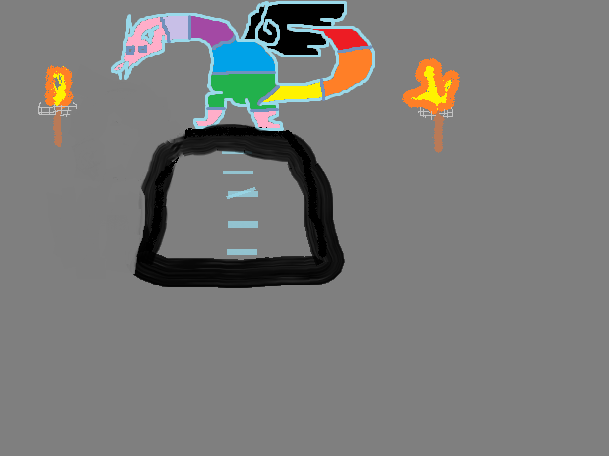
Dragon of friendship

Slide 8
Stage 3 they meet the Golem of Friendship, the last guardian of the Friendship Cave. The only way to get past the Golem is to use the Power of Teamwork.

Slide 9
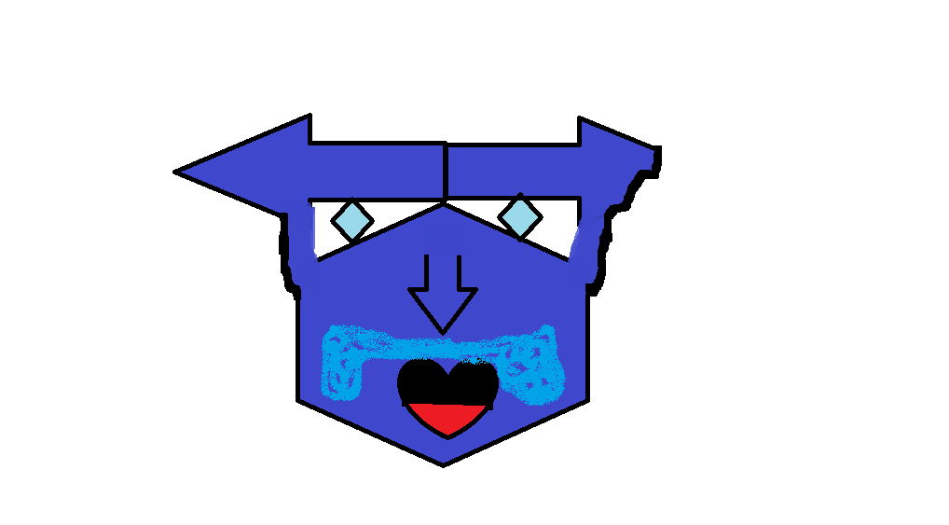
Golem of Friendship

Slide 10
After the Golem of Friendship wearing a flower reef Allie walked to the place where the Unicorn Crown was place. She picked it up, put it on, and she became a Pegasi queen.

Slide 13
Copyright 2015
ISBN 0-360-613-9000
Editor-Dylan Nickerson
Compny by epic supersayin inc
Can find coloured book at homework page mr. Roache

Slide 14
About the Author
Aurora Nickerson was 12 when she made this
Book. She got the idea from her book buddy Ally. Her book buddy Ally loved unicorns.
Birth: Yarmouth, Oct, 22, 2002
I like dragon and video games.

Slide 15
Comments
Gabriel-awesome Golem moustache
Peter-AWESOME GOLEM!!!!!!!!!!!!!!!!!!!!!!!!
Sadie-AWESOME UNICORN !!!!!!!!!!!!!!!!!!!
Jess-AWESOME book!!
Dylan- cool book☺☺

