Slide 1
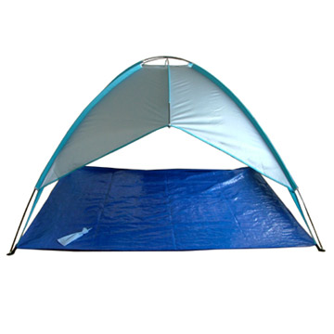
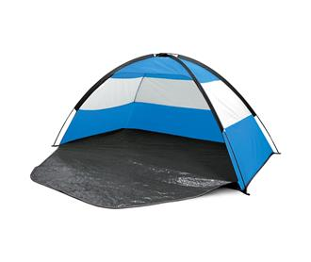

Slide 2
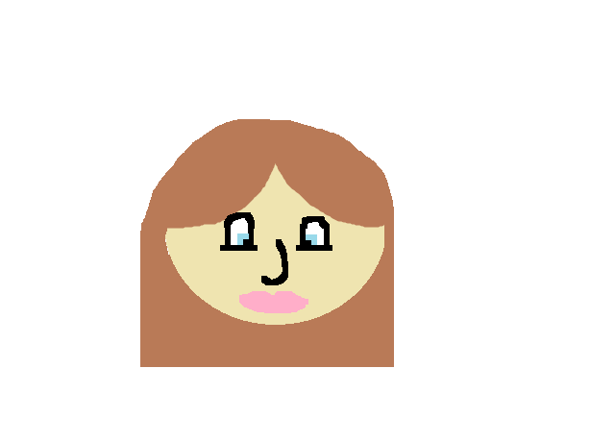
This book is dedicated to Amaya for being the best book buddy.

Slide 3
The Camping Trip. Author: Desirae Nickerson Goodwin Publisher: Desirae Nickerson Goodwin

Slide 4
Copyright
Copyright © 2015 by Desirae Nickerson Goodwin
All rights reserved. No part of this publication may be reproduced, distributed, or transmitted in any form or by any means, including photocopying, recording, or other electronic or mechanical methods, without the prior written permission of the publisher, except in the case of brief quotations embodied in critical reviews and certain other noncommercial uses permitted by copyright law. For permission requests, write to the publisher, addressed “Attention: Permissions Coordinator,” at the address below.
The camping trip.
07 Commission St
NS, Canada
www.thecampingtripbooks.com
Find colour copy at: http://tcdsbstaff.ednet.ns.ca/scroache/Book%20Buddy%20Books/book_buddy_book_index.htm
ISBN 0-203-616-12345-3
Editor: Jasmine Nickerson

Slide 5
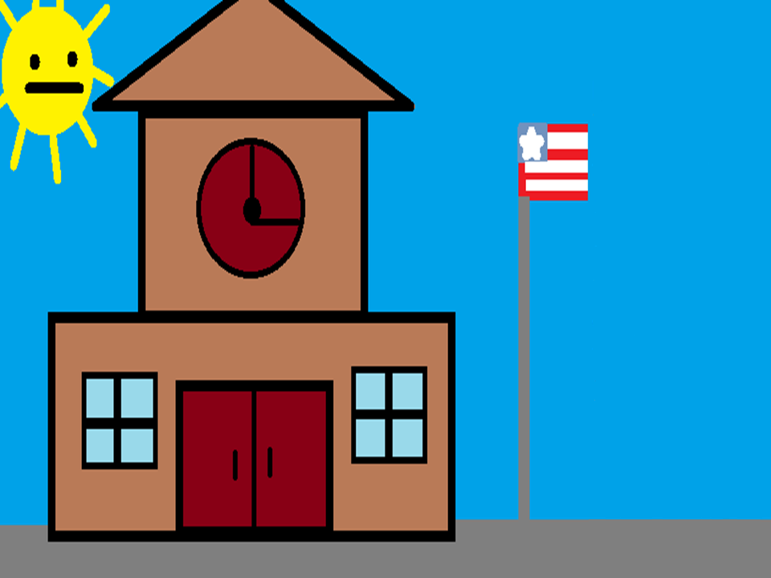
There are 6 girls named Desirae, Amaya, Makaila, Jasmine, Tori, Sarah and a bear named Brownie. The girls do not know.

Slide 6
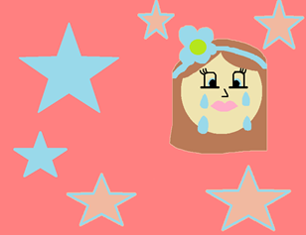
The 6 girls were at school and Tori said, “Guys, can’t you wait until we go camping, it’s going to be awesome!” All the girls said, “I know we can’t wait to go home and pack” Amaya said, “How long are we going to be at the camp site?” Tri said, “Like 2 days, why?” Amaya said, “Because um… I’m scared to go alone.”

Slide 7
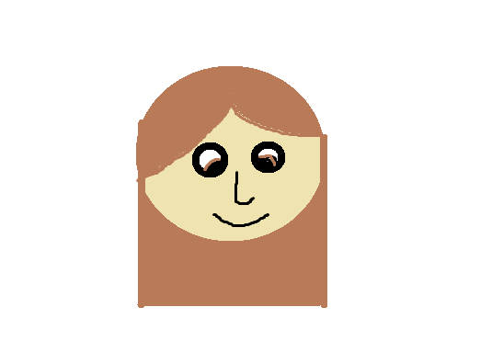
Everyone said, “You are not going to be alone, you us and Melissa.” “Ok, I mean I don’t like being alone without my mom,” said Amaya. “oh, but you will have fun with us won’t you?” “Yea, I will.

Slide 8
“Well I have to go to class. Bye, see you guys after school.” “Bye” everyone said to each other.

Slide 9
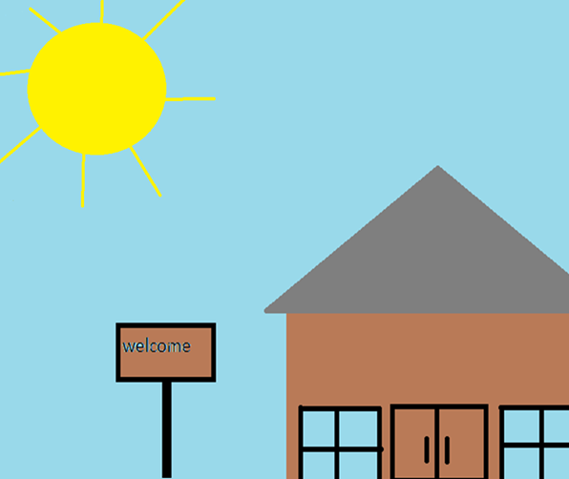
After school everyone packed for the trip. Tori and her mom went and got everyone to go to the camping site. When they got there they unpacked all of their stuff and set up the tent.

Slide 10
Melissa told the girls to go and get firewood in the woods. The girls went deep into the woods and Tori and Amaya said, “I think we are lost.” Desirae and Makaila said, “We do too.” Sarah and Jasmine said, “No, we aren’t “Yes, we are!” said Tori, Amaya, Desirae, and Makaila

Slide 11
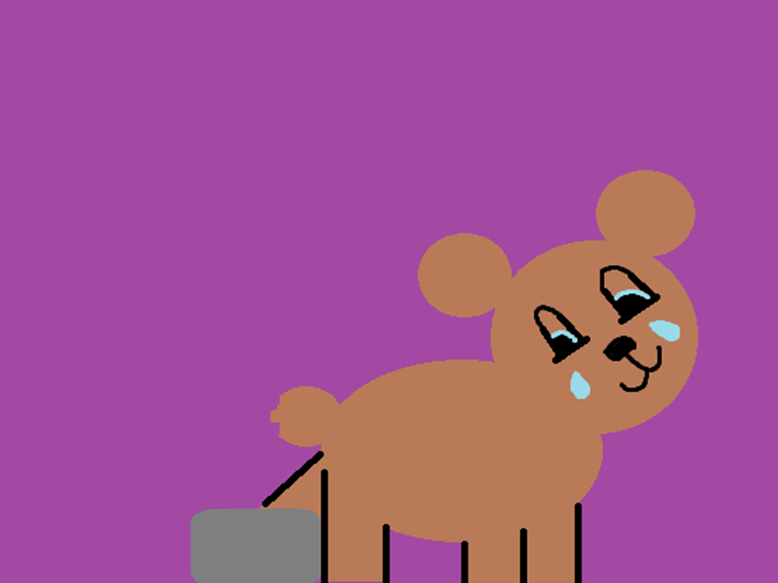
Then the girls looked around to see if they saw the campsite, but the girls couldn’t. Then Amaya saw someone crying and she walked closer and she yelled, “OH, MY GOODNESS, IT’S A BEAR!” The 5 girls came over to Amaya and saw the bear. The bear was crying because her leg was stuck under a rock

Slide 12
The girls help the bear get out and the bear said, “Thank you.” “It’s ok, what’s your name?” said the 6 girls. “Oh! My name is Brownie.” “That’s a nice name.” said Amaya. Desirae said, “Ok, we don’t have time to talk we have to get back to the campsite.” “I can run around and look for the campsite.” “Ok, thank you, Brownie.” everyone said

Slide 13
Brownie ran around and looked and looked for the campsite. After an hour Brownie found the campsite and returned to the 6 girls and said, “I found the campsite.” The 6 girls said, “Yay, we can go back to the campsite.” So all the girls and the bear ran to the campsite.

Slide 14
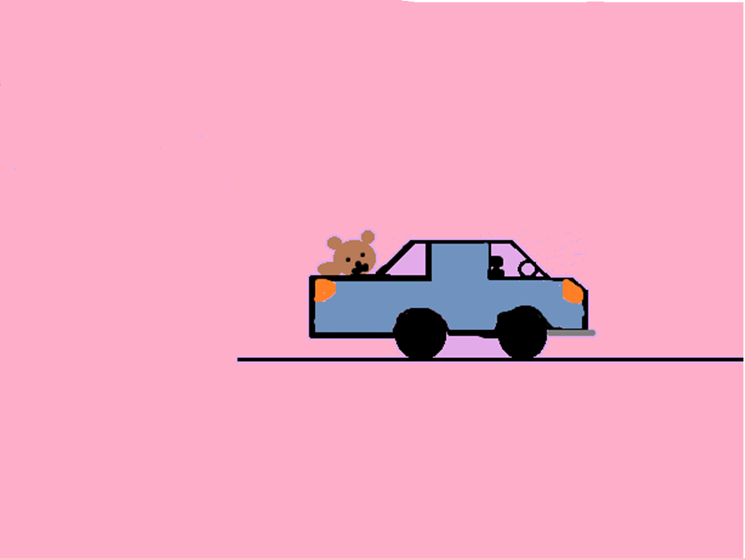
When they got there Melissa was so happy to see all of them and all of them said, “Let’s go home.” Brownie said, “Bye, I got to go back to the woods.” “No, you can come with us for a little while, please.” said all the girls. “Ok.” said Brownie

Slide 15
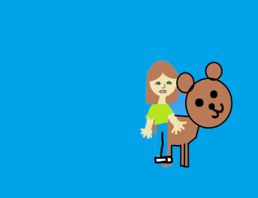
It was time for bed and in the morning they went to school. On her back. When they got to school Brownie and Tori saw hey girls and the 5 girls said, “We didn’t see you on the bus?” “We know, Brownie and I ran her.” “COOL!” everyone yelled, “Well, Brownie and I got to go to class, Bye.” “Ok, Bye.” and they all hugged. After class Brownie said, “Guys, I have to go back into the woods.

Slide 16
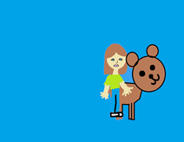
. I’m sorry I will miss all of you.” “BYE!” everyone cried and Brownie left for good

Slide 18
About the author
· Full name: Desirae Alexandra Nickerson Goodwin
· Date and place of birth: Bridgewater hospital 11/16/02
· Family information: a family of 1 brother
· What you like to do at home and school: doing art
· People and things that are important to you: parents, friends, best friends, and my pets.
· Accomplishments: finishing the book on time
· Major events of life: growing up
· What your ambitions are: artist

Slide 19
Comments
Jessica: An awesome book for kids.
Jasmine: AWESOME!
Madison: a good book.
Kennedie: Awesome!
Bella: Good!

