Slide 1
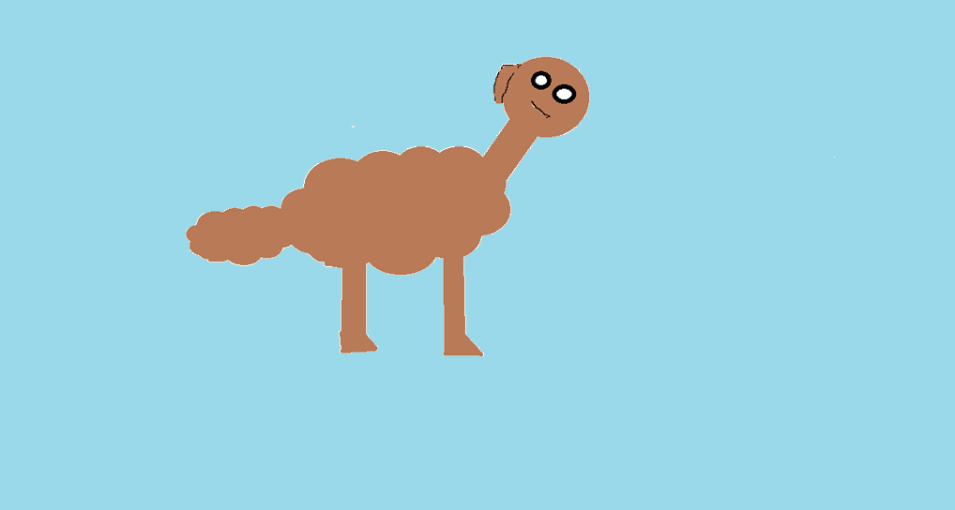
Peter and Cade’s New Dog
Written and Illustrated By Peter
By: Peter

Slide 2
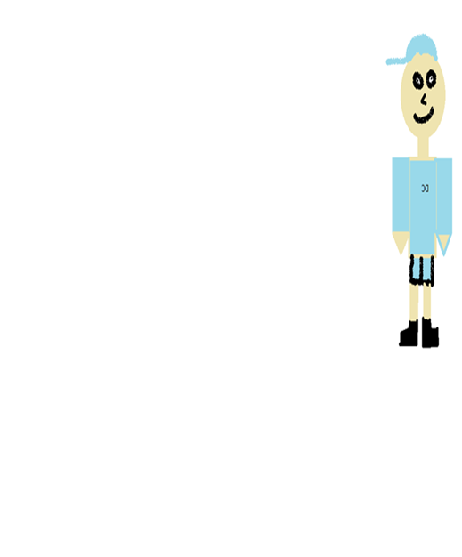
Dedication Page
This book goes out to my book buddy Cade. You have been a good book buddy.

Slide 3
Copyright Page
© 2015 Peter Baird
All Rights Reserved
This book or any portion may not be reproduced or used in any manner unless you ask Peter first.
Printed in Canada
PeterAndGabrielMakesAwesomeThings2015
15 Basin View Crt
King, Beast AP
PeterandGabriel.ca
Editor: Gabriel and Jesse
Published in 2015
To receive a colour copy, go to
http://tcdsbstaff.ednet.ns.ca/scroache/homework_for_mr.htm
ISBN Code 0-203-602-98671-9

Slide 4
Peter And Cade’s New Dog
Written and illustrated by Peter
Published by PeterAndGabrielMakesAwesomeThings2015

Slide 5
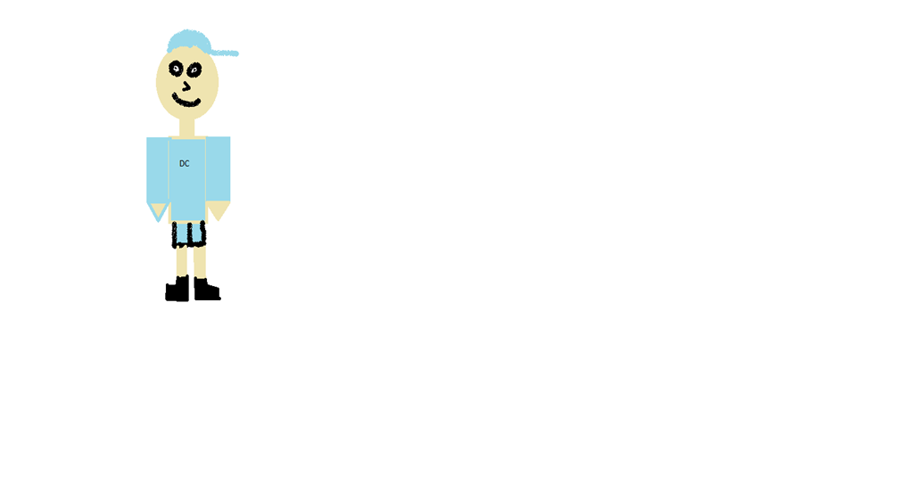
One day, there were two young brothers. Their names were Peter and Cade. Peter was on the left and Cade was on the right. They lived in Ottawa.

Slide 6
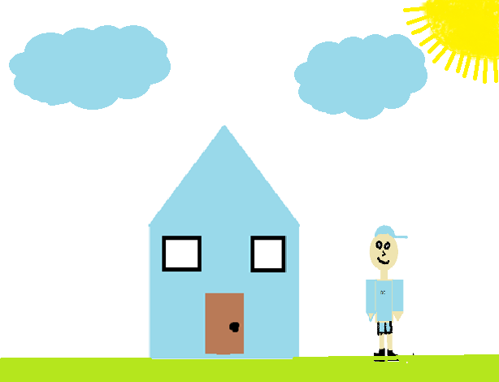
They had a mother named Stella and a father named Rowin. They lived in a blue house.

Slide 7
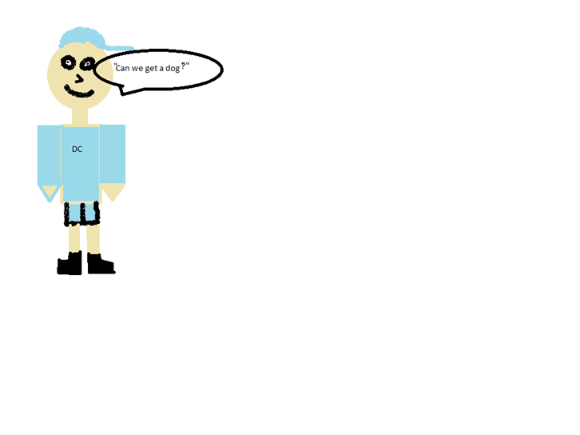
Peter and Cade wanted a dog. So Peter asked his parents, “Mom, can I have a dog?’’

Slide 8
They said yes. So Peter, Cade, and their parents went to the Pet Store. When they got there, they found a nice brown dog that they all liked.

Slide 9
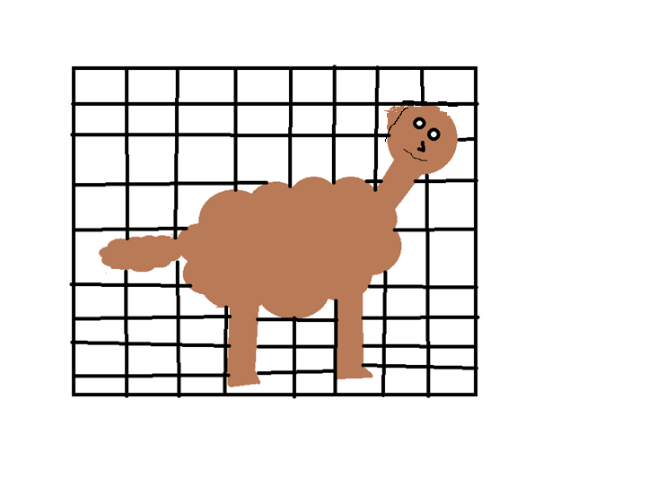
So they took the brown dog home and named him Stan.

Slide 10
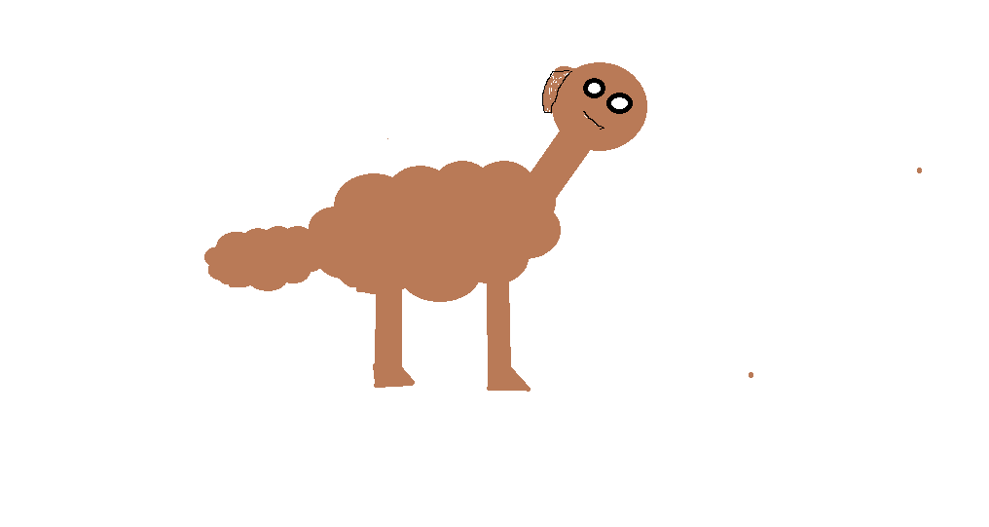
They went home and played with the dog. They played Frisbee until supper was ready.

Slide 11
They went in for supper. They had pizza that they got at Sobeys.

Slide 12
. At 8:30, Peter and Cade went to get ready for bed. They brushed their teeth.

Slide 13
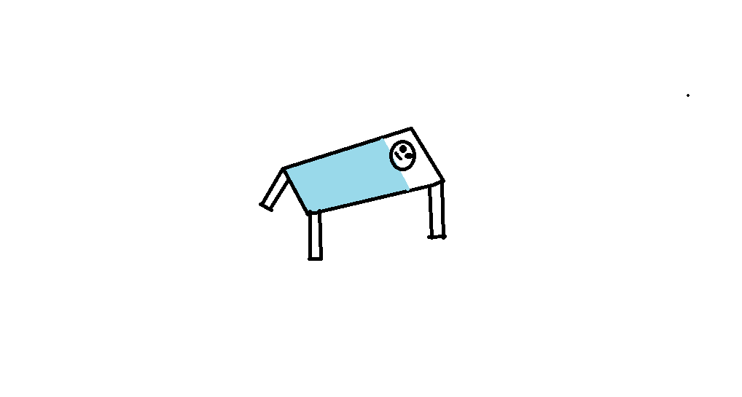
When they were ready for bed, they said good night to their parents and went to sleep.

Slide 14
Autobiography
Hi. I’m Peter. I’m 11 years old. I was born in Halifax at the IWK hospital on December, 22 2003. I lived in Truro until I was 7, then I moved to Shelburne. I have 1 brother. A couple things I like doing are playing soccer, basketball, Xbox and playing with my friend Gabriel. My major accomplishments are making it to high school next year.

Slide 15
Comments
Alicia – Good Book!
Jamie- Cool Book!!
Gabriel – Good Drawings!!!!!!!!!!!!!!!!!!
Sadie – Awesome Drawings!!!!
Jesse – Good Book!!!!!!!!!!!!!!!!!!!!!!

