Slide 1
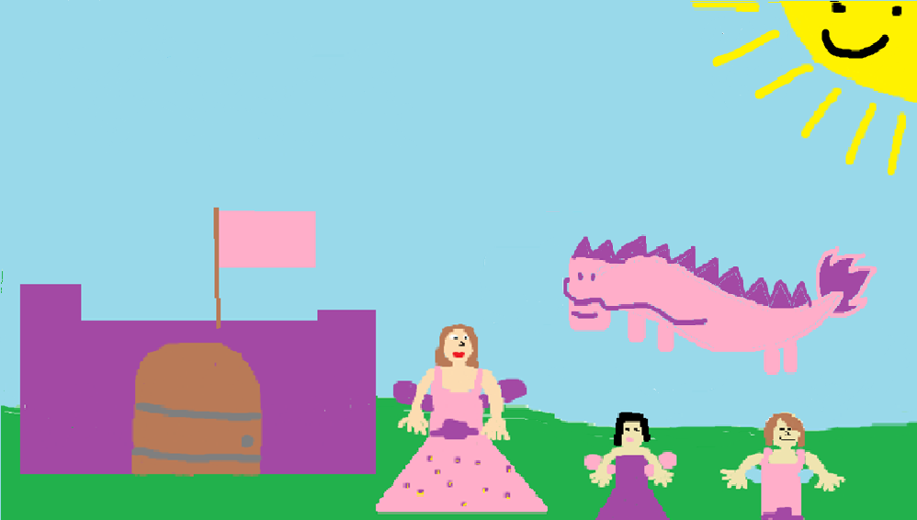
Rennay’s New Friend
By Emma and Yoyo Swansburg
Edited By Amiya Hartley

Slide 2
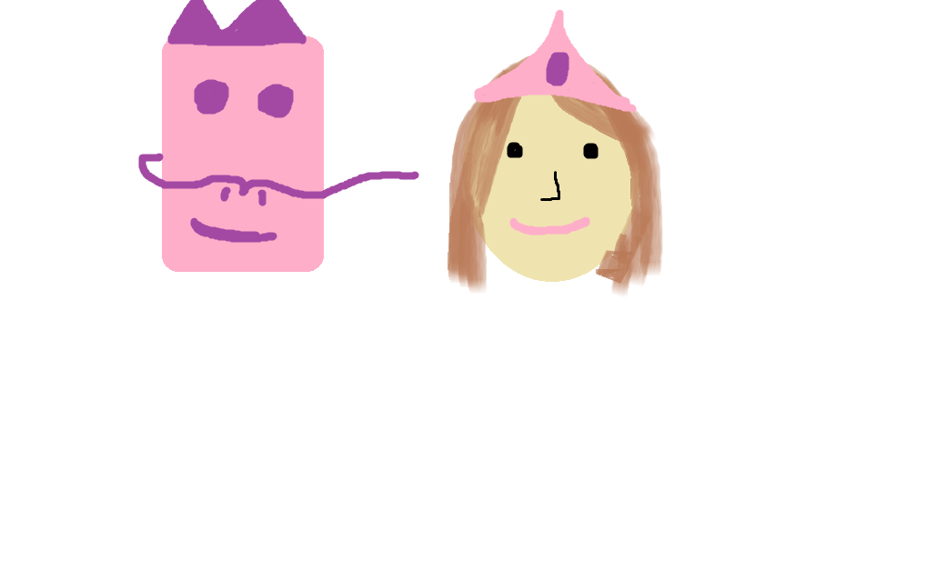
Rennay’s New Friend
Emma & Yoyo Swansburg
Illustrated by
Emma & Yoyo Swansburg
Rainbow Books Publishing

Slide 3
Copyright
Copyright © 2015 by Emma and Yoyo Swansburg
All rights reserved. This book or any portion of it may not be reproduced or used in any manner whatsoever without written permission of the publishers except for the use of brief quotations in a book review.
Color version available at http://tcdsbstaff.ednet.ns.ca/scroache/
Printed in Canada.
First printing,2015.
ISBN 0-203-622-41918-2
Rainbow Books publishing
457 Cookie Av
Beijing, China
www.RainbowBooks.com
28

Slide 4
This book is dedicated to Rennay,
the best book buddy ever!

Slide 5
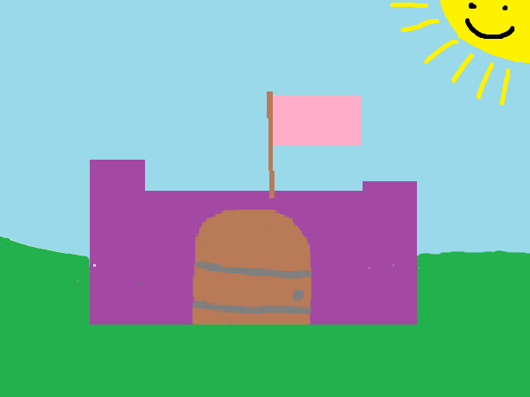
One day, there was a fairy ball. The ball was in a big castle!
Rennay, the fairy princess, went to the ball.

Slide 6
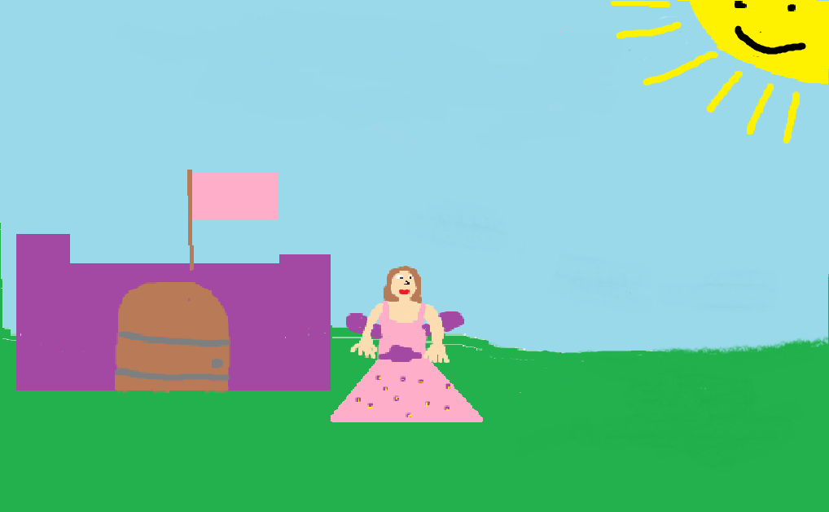
Rennay had her big pink dress on. It had flowers and a big bow on it too!

Slide 7
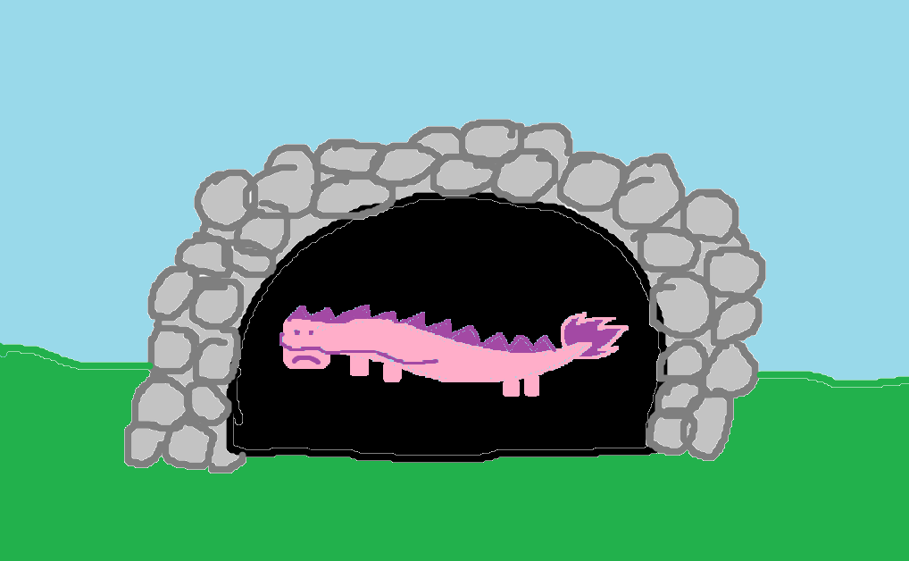
Yoyo the big, nice, dragon was in her big, dark cave. Yoyo was lonely.
Yoyo wanted to go to the ball too. She wanted to make friends.

Slide 8
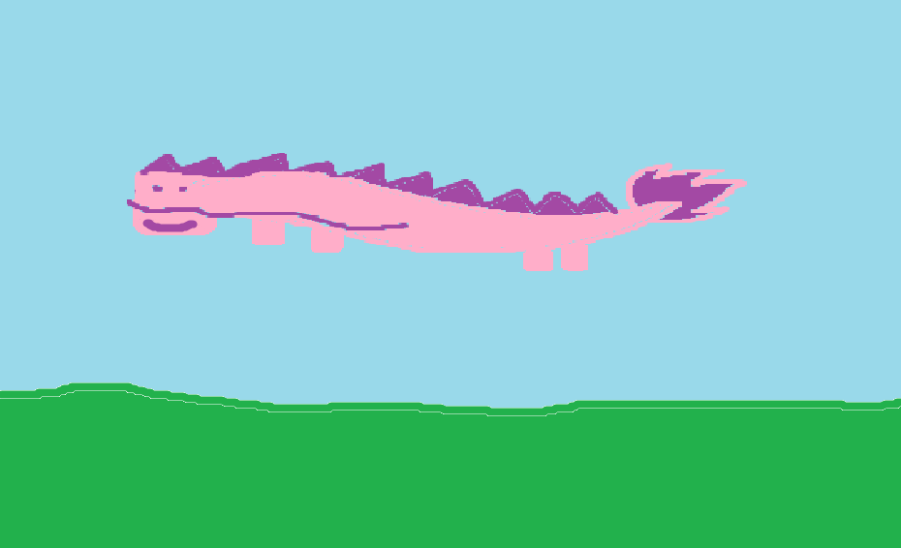
Yoyo went to the ball.

Slide 9
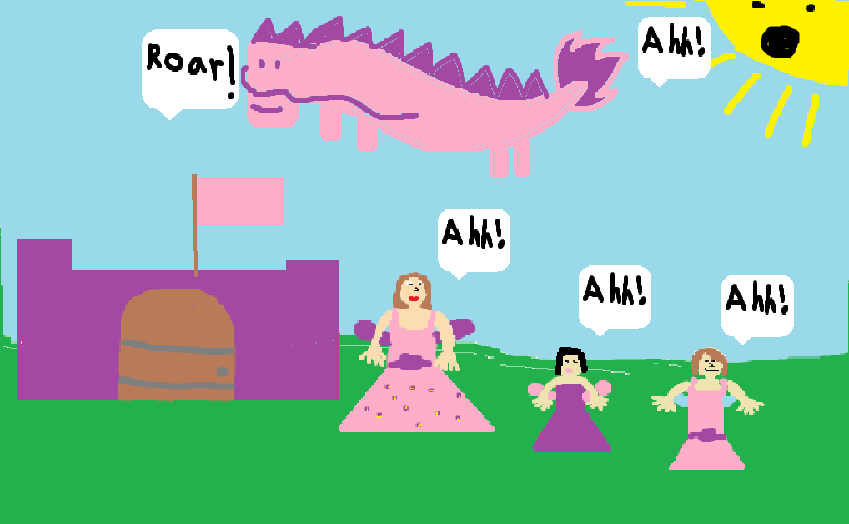
All of the fairies were scared of Yoyo, the big dragon.

Slide 10
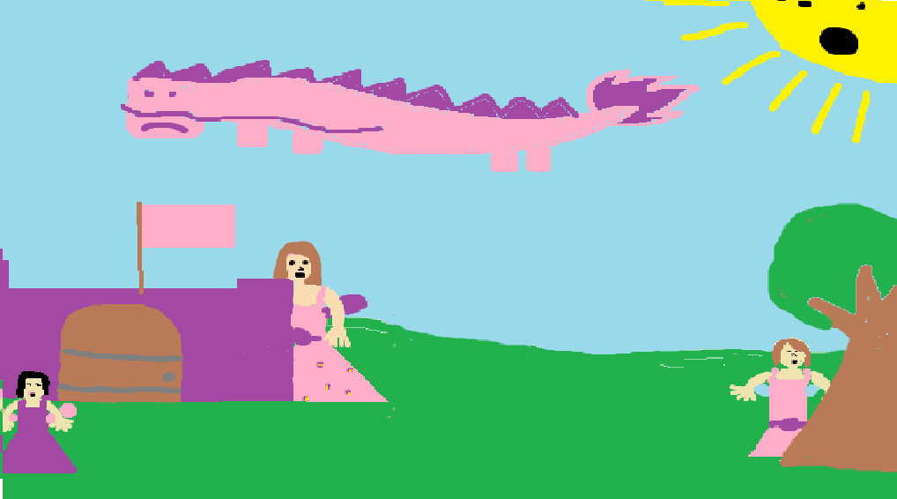
All of the fairies hid. Yoyo was sad.

Slide 11
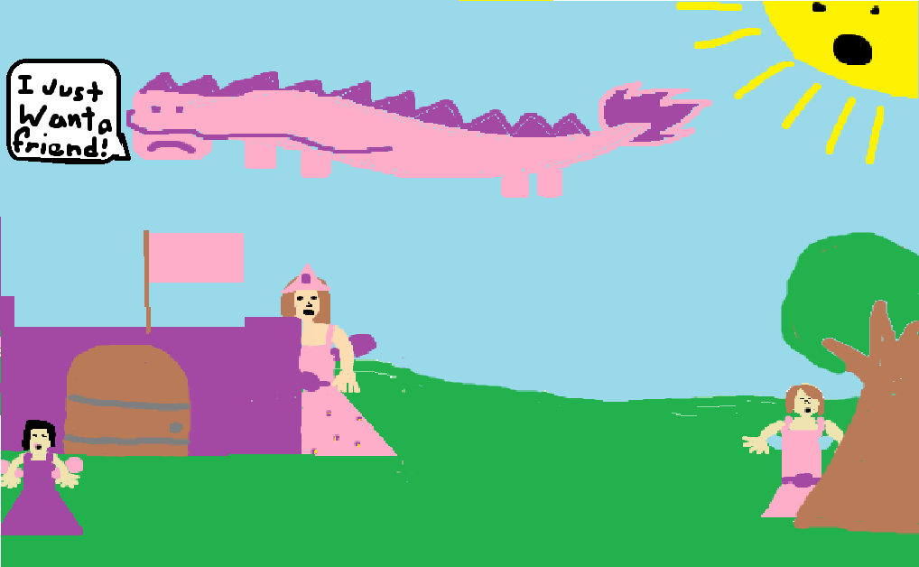
She just wanted a friend!

Slide 12
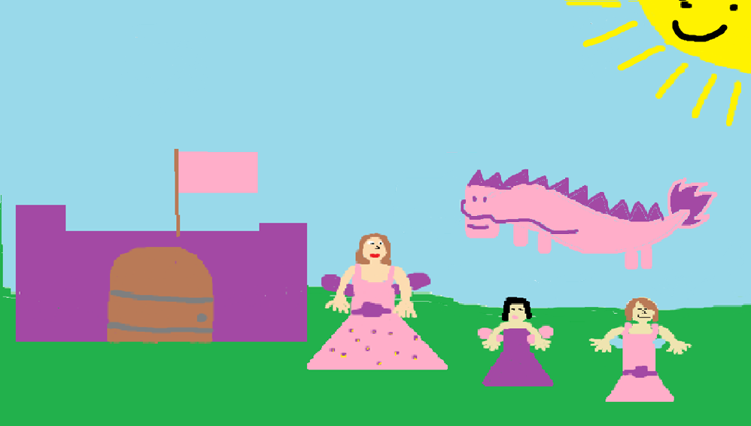
Rennay came out with the other fairies and said they could be Yoyo’s friends.

Slide 13
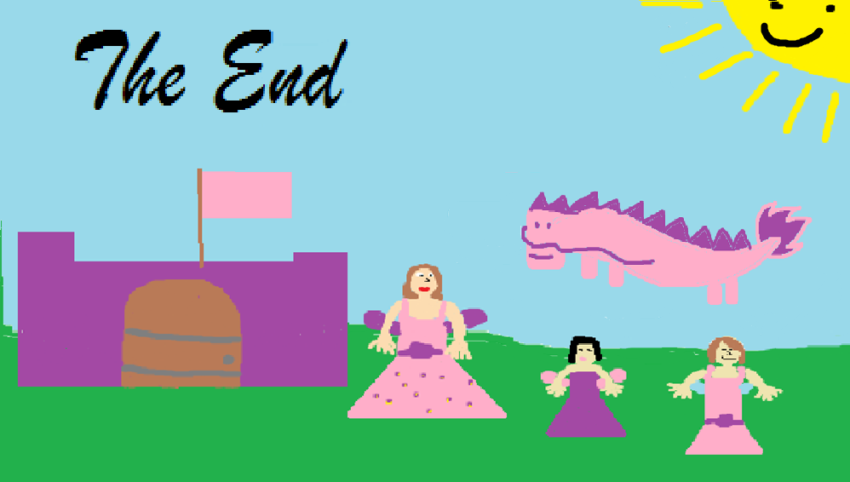
Rennay, Yoyo, and the other fairies are best friends now!

Slide 14
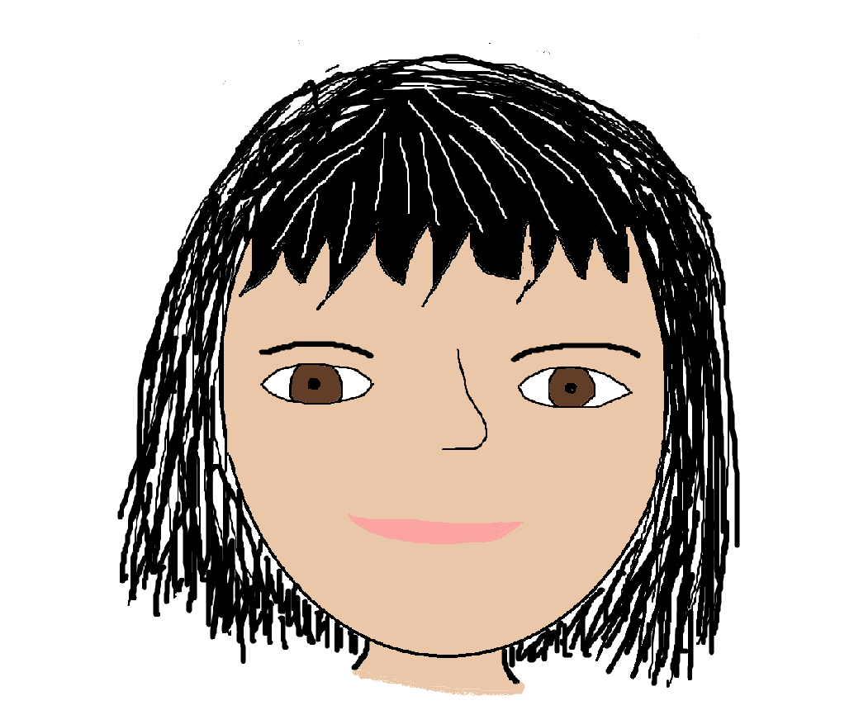
Author Autobiography
Name: Yoyo Swansburg/Tang Siqi
Born: December 21 ,2003 Taizhou, China
Family: I am an only child in my Chinese family, But I have 4 siblings in my Canadian family and one is from Brazil.
Things I like to do at home or at school: I like to play board games
Things that are important to me: My dogs from Canada and my dog from China, My Canadian family and My Chinese family, and my friends.
Accomplishments: I have some accomplishments but I don’t know how to say it in English.
Important events: My birthday, and the day I came to Canada.
Ambitions: I would like to go to high school in Canada.

Slide 15
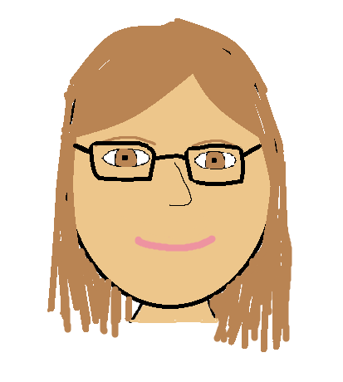
Author Autobiography
Name: Emma Claire Swansburg
Born: June 24, 2003 in Bridgewater, NS
Family: I have 4 siblings and one is from China and one is from Brazil.
Things I like to do at home or at school: I like to play card games at home.
Things that are important to me: All of my pets, my friends and family, and Rennay my book buddy.
Accomplishments: I have been to the Science Olympics and got silver twice in grade 6.
Important events: My birthday, my brother’s birthday, and my sister’s birthday
Ambitions: I would like to get a good job.

Slide 16
Comments
“It is a good book.”-Amiya
“It’s a very interesting and well designed book.”-Ms. Cindy
“ The book is very colourful and detailed.”-Caleb
“It is very interesting.”- Aidan
“It is an interesting book.”-Christina

