Slide 1
A Typical Day
Author: Mason S.
Illustrator: Mason S.

Slide 2
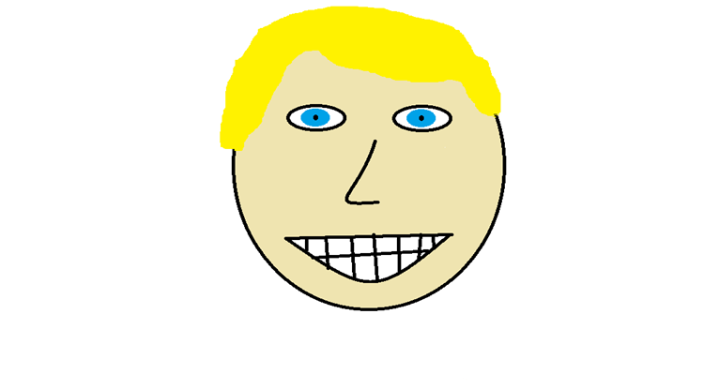
A Typical Day
Author: Mason S.
Illustrator: Mason S.
Publisher: Fus-Ru-Dah Publishing
Year of Publication: 2015

Slide 3
Copyright
Copyright ©2015 by Mason Sperry
All rights reserved. This book cannot be reproduced or edited in any way. You may only do so if you get a signed slip from Mason Sperry- himself.
Printed in Canada
Printed first in 2015
Fus-Ru-Dah Publishing
99 Long Street
Published by Mason S.
Solitude, Skyrim 15243
ISBN # 0-352-620-37828-4
Editor: Amiya Hartley
www.masonpublishing

Slide 4
This book is dedicated to Evan, the coolest book buddy ever.

Slide 5
One day, Evan was at school. The bell was just about to ring. He changed his shoes and waited to be dismissed.

Slide 6
His bus was called, as he arrived at his bus he slowly walked to his seat. When he arrived home he started to watch TV.

Slide 7
Evan asked his mom, “What are we having for dinner?” Evan’s mom said, “Chicken and potatoes.” Evan said, “Yay!”

Slide 8
After he finished eating his dinner he went right to bed. The next day Evan went back to school.

Slide 9
When he entered the school he saw Mason. Mason walked by he said, “Hi Evan!” Evan replied, “Hi.” He slowly waved to Mason.

Slide 10
When it was time for snack, Evan pulled out a big chocolate bar from his lunch kit. Evan ate his chocolate bar so fast he ate the wrapper.

Slide 11
As the bell for recess began to ring everybody ran outside as fast as they could to play. Evan was playing tag with his friends.

Slide 12
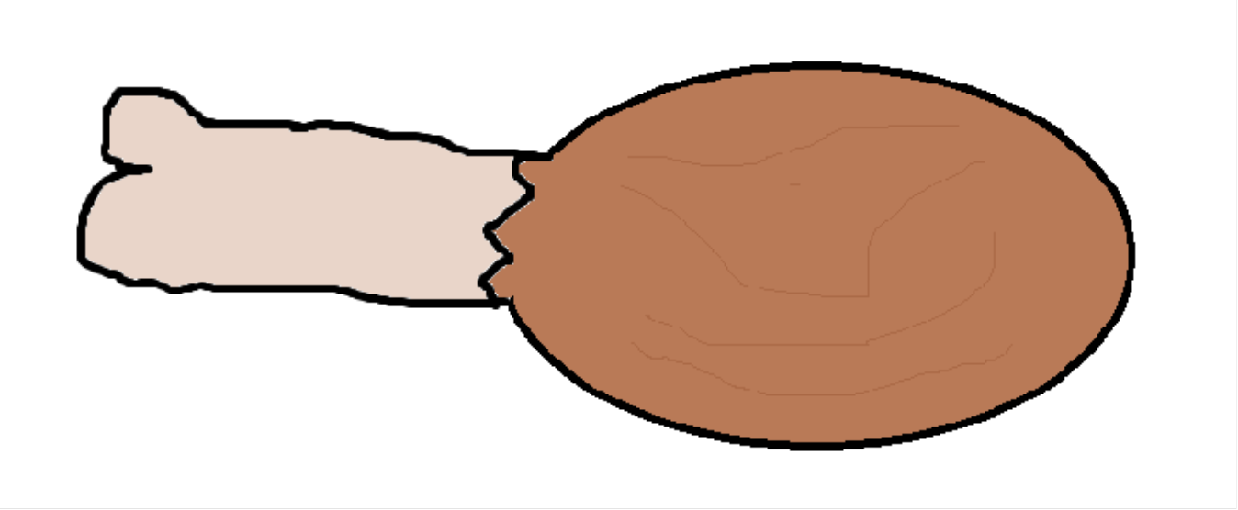
At lunch Evan had some leftover chicken, it was cold, but Evan liked cold chicken the best. Evan ate the chicken so fast he ate the bone.

Slide 13
After lunch, Evan ran right outside and played tag again.

Slide 14
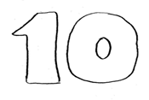
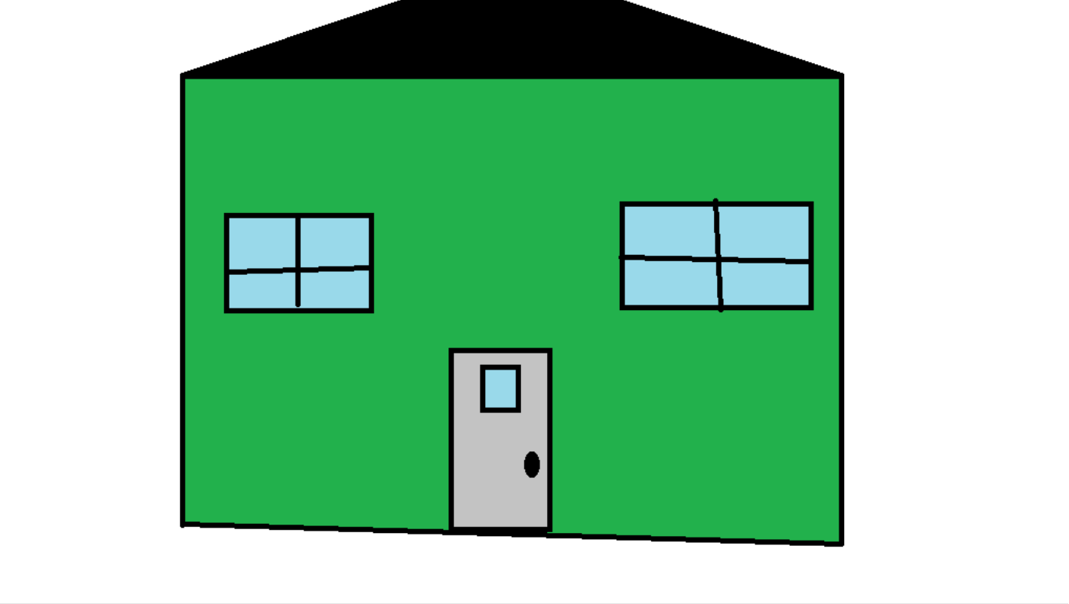
When the bell for home rang, Evan went back on the bus and went home.

Slide 15
About the Author
I was born in Yarmouth, N.S. on October 22nd 2002 . My Mom’s name is Lisa Acker and my Dad’s name is Christopher Sperry. My full name Mason Thomas Benjamin Sperry. I live with my mom but some times I will go to my dad’s. When I am home I like to play Xbox 360. When I am at school I like to play outside. My family are important to me , also my cat is. I want to be a police officer . My accomplishments are that I am going to grade 7.

Slide 16
Comments
1 Xiander: The book is funny and I think Evan will think it is funny too.☺
2 Jesse: I liked it.
3 Caleb: I think the book was funny and colourful.
4 Gabe: Awesome!
5 Peter: Awesome Book!!!

