Slide 1
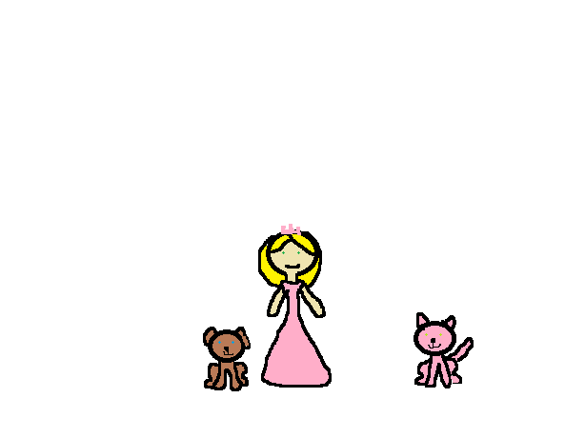
Allies Kitten
by: Sadie VanBuskirk

Slide 2
Copyright
Copyright © By Sadie VanBuskirk
All rights reserved Do anything you want with this book
Printed in nova scotia Canada
First printing 2015
Rainbow unicorn 123 Maze St
Rainbowunicorn.com
Editor-Jessica Hemeon

Slide 3
Dear Allie you are the best book buddy in this world.

Slide 4
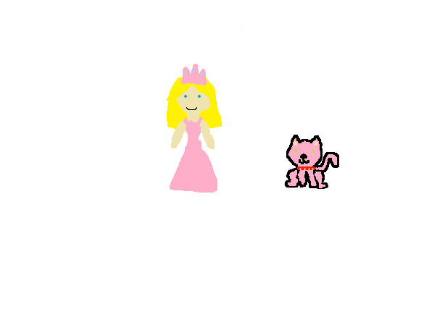
One sunny day a princess named Allie wanted a new pet. So princess Allie went to the pet shop and seen a pink fluffy kitten. “I want that pink fluffy kitten” said princess Allie. So Allie bought the pink fluffy kitten and named it fluffy.

Slide 5
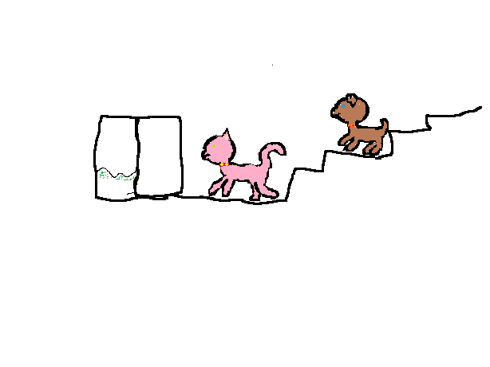
When Allie the princess came home and remembers about her dog Aurora. Allie ran upstairs but Allie forgot to close the door. The kitten ran down the stairs wolf said Aurora the dog “meow live me alone.”

Slide 6
The cat and dog ran outside.”Where did they go? I know they went into the woods I will go call Jessica the unicorn”. Allie the princess ran over to Jessica the unicorn.” My pet dog and cat ran into the woods can you help me?”. “Sure” said Jessica.

Slide 7
Princess Allie and unicorn Jessica flew around the wood to find fluffy and Aurora. “I see a house can we go and see it”. “Sure” said Jessica they flew dawn to see how was in the house. Princess Allie knocked on the door. A girl came out of the house “hello my name is Sadie and you are?”. “I’m princess Allie and have you seen a kitten and a dog ran by here?”. “Yes they went that way” she said pointing to the right.

Slide 8
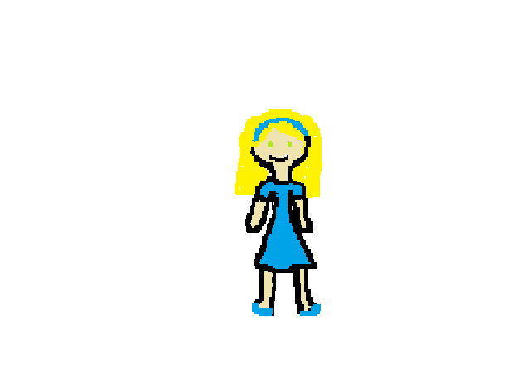
Princess Allie and unicorn Jessica flew of again they went to the ice cream shop. princess Allie knocked on the door and Sadie came to the door . “Sadie you work here? "said Allie the princess yes I seen a dog run back to the castle said Sadie.

Slide 9
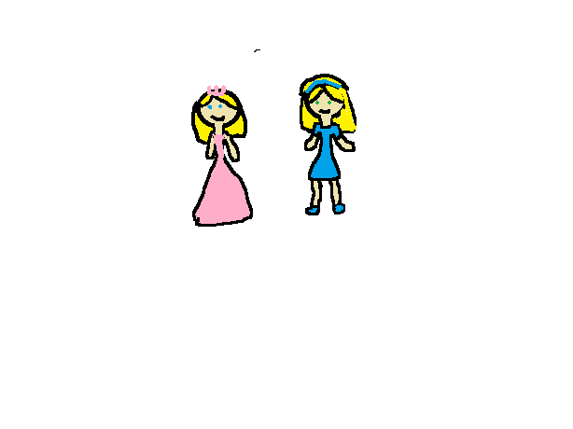
“Wait said Sadie. If your looking for your kitten come with me”. “Ok I will go get Jessica”. “Can’t we walk?” said Sadie. “Why?”. “Because Jessica can only have one person on her back” said Allie . “You are right ok we can walk” said Sadie.

Slide 10
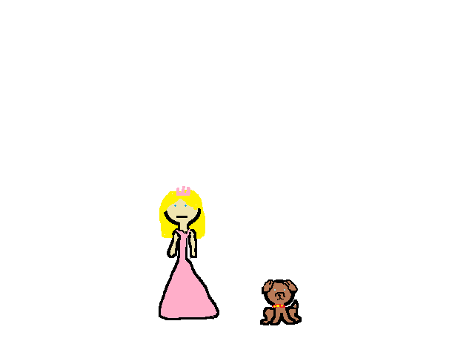
When princess Allie got back to the castle she open her door and seen Aurora the dog setting by the door. “Aurora where is fluffy?”. “I do not know”.

Slide 11
Than there was a knock on the door it was Sadie. “Allie did you find your dog?” .” yes I did but I can’t find my kitten fluffy”.” I know I will go get Jessica again and we will go and look for my kitten again!”.
Notes:
AZS

Slide 12
Princess Allie and Sadie went into the woods and walked on the path. When they got to Sadie’s house Allie went inside and sat on the couch. and Sadie went into her room and got a box with something in it. Princess Allie open the box and seen something pink she looked at it and seen her pink fluffy kitten Fluffy. “Thank you Sadie!”. “Your welcome”. Princess Allie bought the kitten home.

Slide 13
When princess Allie got home she put the kitten on the floor. Fluffy and Aurora made friends and Allie and Sadie made friends to.

Slide 14
Comments
Jessica-Awesome story!
Jesse good book !!!!!!!!!!!!!!!!!!!!!!!!!!!!!!!!!!!!!
J.T-AWESOME book!
Dylan: it was awesome
Aurora-yolo epic book!!!!!!!!!!!!!!!!!!!!!!☺

