Slide 1
Bob and Emily
Written and Illustrated by Madison Goulden
Published by Goulden Papers

Slide 2
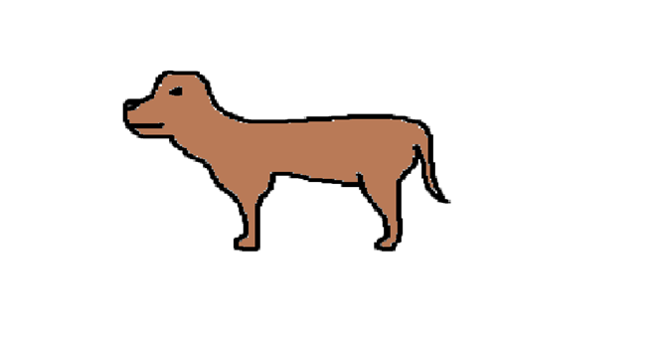
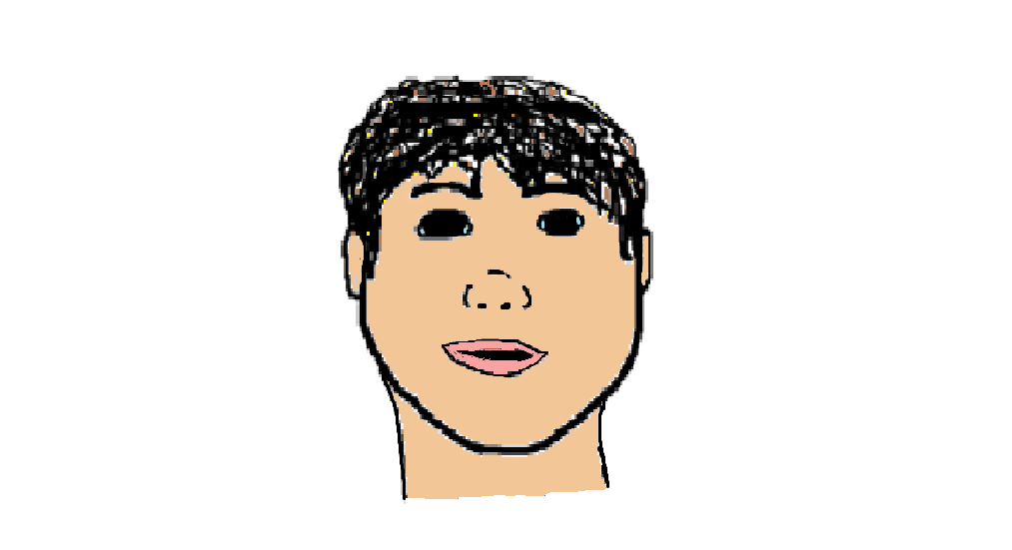
Bob and Emily
By Madison

Slide 3
☺
To Emily.
You are the best book buddy ever!
You have nice eyes.☺
From Madison

Slide 4
Copyright ©
Copyright © 2015 by Madison Goulden
All rights reserved. No part of this publication may be reproduced, distributed, or transmitted in any form or by any means, including photocopying, recording, or other electronic or mechanical methods, without
the prior written permission of the publisher, except in the case of brief quotations embodied in critical
reviews and certain other non-commercial uses permitted by copyright law. For permission requests, write
to the publisher, addressed “Attention: Permissions Coordinator,” at the address below.
RAINBOW LOBTER
1911 Cuba Avenue
First printing in 2015
www.madisongoulden.ca
Shelburne Nova Scotia 256752
ISBN- 0-203-608-12233-0
Edited by Bella Hagel and Makaila Chapman
colour copy can be found at -
http://tcdsbstaff.ednet.ns.ca/scroache/

Slide 5
“ Hi, my name is Bob!
I can’t find my dog Emily.
Can you help me find her?”
1

Slide 6
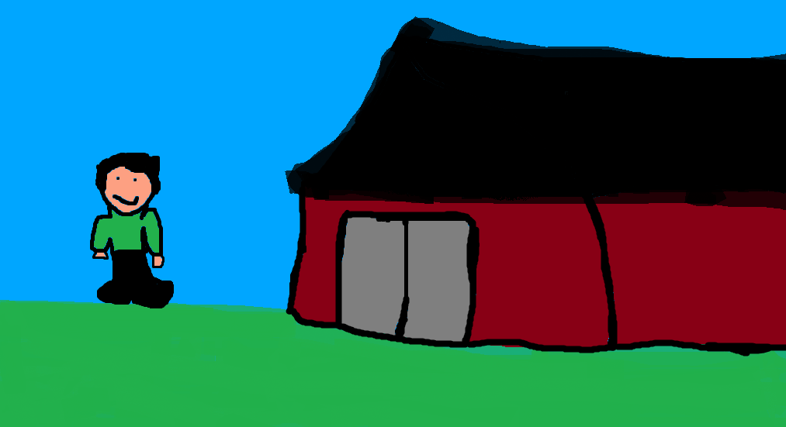
Bob checks the barn
“Do you see Emily?”
2

Slide 7
Bob checks the backyard.
“Do you see Emily?”
3

Slide 8
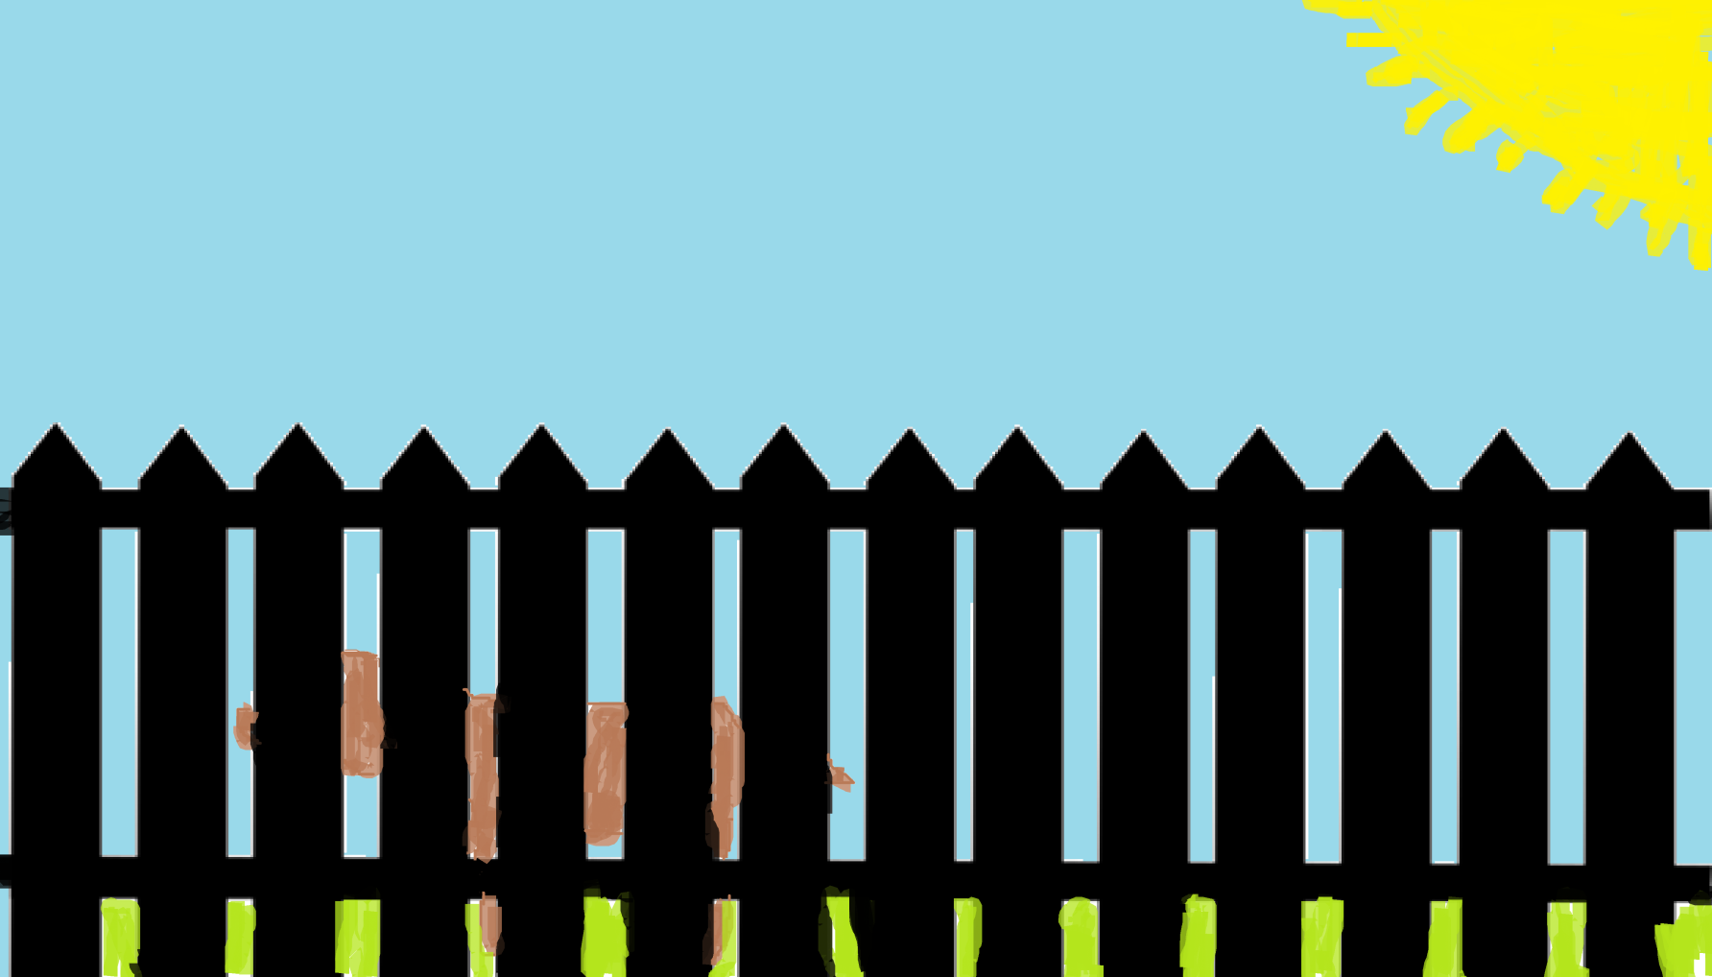
Bob looks in the dog pen.
“Do you see Emily?”
4

Slide 9
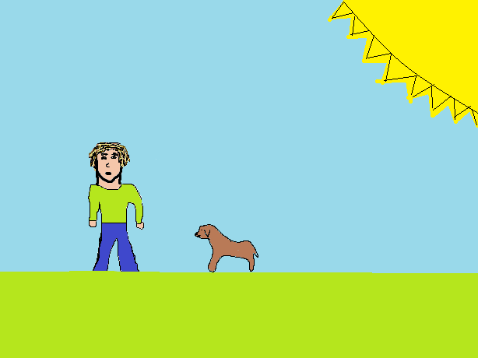
Bob walks over and says to Emily.
“I forgot I left you in your dog pen, hahaha”
Then bob unlocks the pen and lets Emily out. ☺
5

Slide 10
Reviews
Bella- Good book!
Jasmine- Nice book. I think she will like it.
Desirae-Awesome!☺
Kennedie- Kind of scary.
Christina- It’s good.

Slide 11
Autobiography
Hi, my name is Madison Goulden. I am 12 years old, my birthday is January 10th 2003. I was born in Bridgewater hospital. I have one brother, his name is Calen, he is 15. I have a dog named Piper, she is a pure bread chocolate lab. At home I like to drive my dirt bike and play with my dog. At school my favourite subjects are art and gym.

