Slide 1
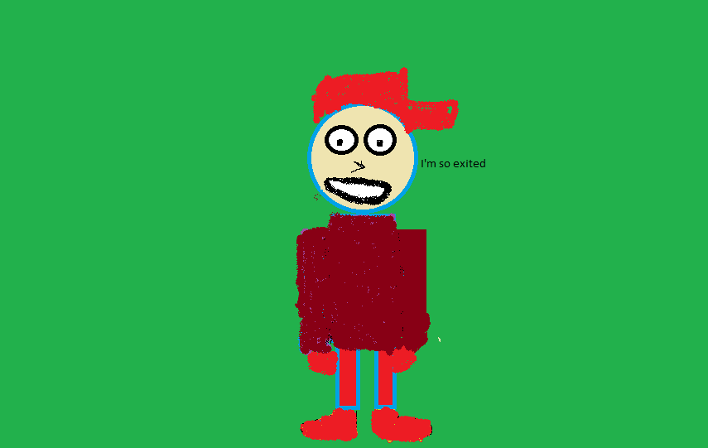
Ethan Gets a Pet
By Gabriel

Slide 2
Ethan Gets a Pet
Illustrated and written by Gabriel.
Published by Gabe Makes Awesome things.

Slide 3
Copyright page
©2015 Gabriel Bower
ISBN code 0-203-603-12345-7
This book can be printed but it can’t have any damage on it or be sold.
Printed in Canada
Gabe Makes Awesome Things
5678 Beast Road, Roseway Russia
Editor Peter
www.ILikepizza.ca
You can find a colour copy at the Hillcrest Academy website. http://tcdsbstaff.ednet.ns.ca/scroache/homework_for_mr.htm

Slide 4
Dedication
This goes to the best book buddy in the world, Ethan.

Slide 5
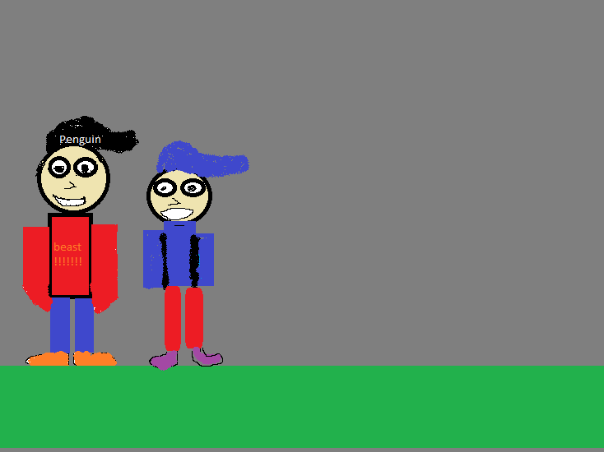
One day there was a little boy named Ethan. His big brother Gabriel was bringing him to the shelter.

Slide 6
He was very excited because he was getting a pet hamster . He never had a hamster before.

Slide 7
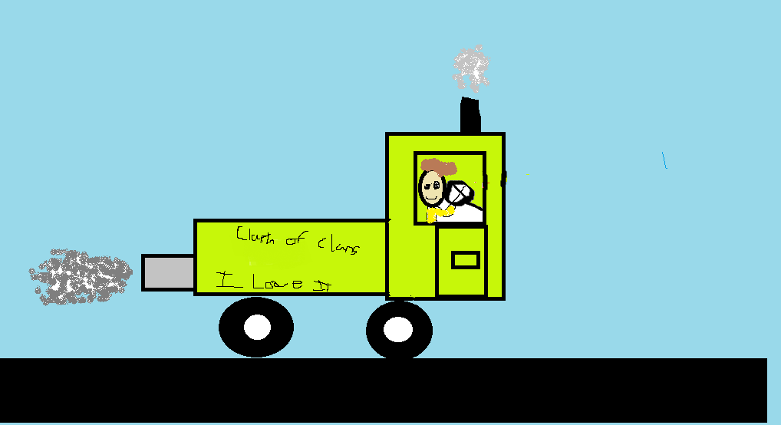
“How much longer?” said Ethan.
“5 more minutes,” said Gabriel.
They got there. Gabriel said. “Be good, ok, Ethan” said Gabriel.
So Gabriel had to sign in. So they looked around.

Slide 8
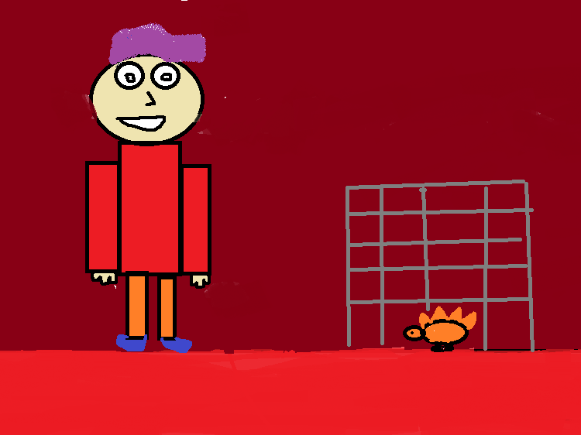
“They are so cute,” said Ethan.
“What one do you want?” said Gabriel he pointed to a little orange hamster.
“Can we get him?” said Ethan.
“Yes,” said Gabriel. Ethan jumped for joy.

Slide 9
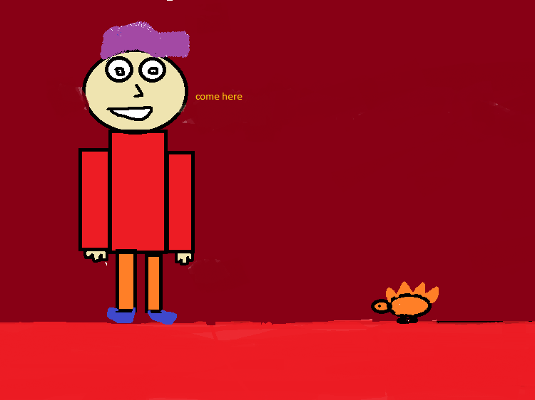
“I love it,” said Gabriel.
Ethan played with him for hours. Gabriel loved seeing Ethan so happy.

Slide 10
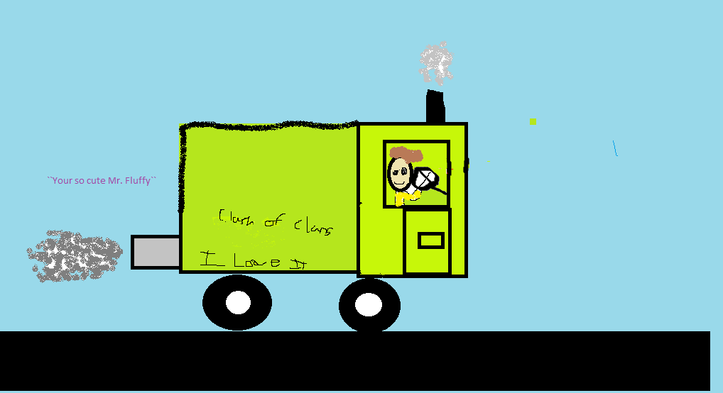
On the way home Ethan played with the hamster. He was very happy.
Than Gabriel said, “Ethan we need to give it a name.”
“How about Mr. Flurry?” said Ethan.

Slide 11
He would play with him before school and after school.

Slide 12
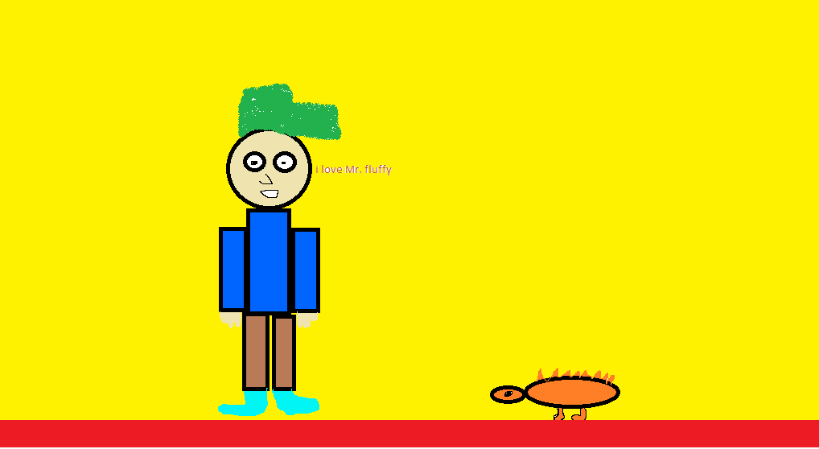
Ethan loved Mr. Fluffy.

Slide 13
They lived happily ever after.

Slide 14
Autobiography
My name is Gabriel. I was born in Bridgewater, N.S. I’m 12 years old, and I was born on March 17, 2003. I like to play soccer, basketball, hockey and playing Clash of Clans with my friends like Peter and Aurora.

Slide 15
Comments
Makaila= I thought the book was cool there where lots of cool pictures!
Alicia= Cool book! You’re book buddy will love it!
Peter- My Friend’s book is the best book ever!!!!!!!!!!!!!!!!!!!!!!!!!!!!!!
Aurora=Very cool. I liked the photos and the name of the hamster.
Caleb- The book was very colourful and I liked the hamster’s name. “Very good.”

