Slide 1
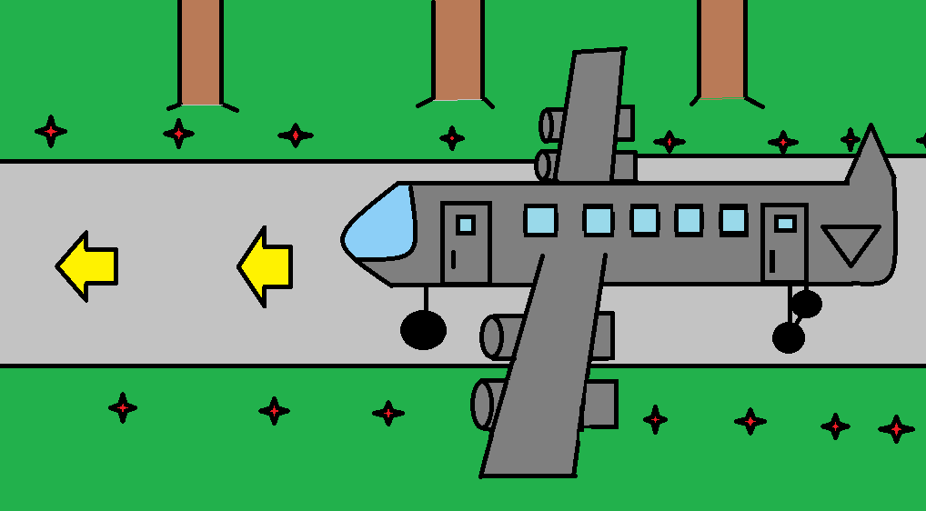
Going to Toronto
Written and illustrated by: Jamie Fehr

Slide 2
GOING TO TORONTO
Writing and illustrated by: Jamie Fehr
Publisher
131OhioPublishing
1

Slide 3
Copy right
Copyright © 2015 by Jamie Fehr
All rights reserved. No part of this publication may be reproduced, distributed, or transmitted in any form or by any means, including photocopying, recording, or other electronic or mechanical methods, with out the prior written permission of the publisher, except in the case of brief quotations embodied in critical reviews and certain other noncommercial uses permitted by copyright law. For permission
requests, write to the publisher,
131OhioPublishing 1371 Maine street New York www.Rstudios.com
ISBN code 0-203-607-13441-7
1 Editor: Gabriel Bower
2 Editor: Christina Harris
2

Slide 4
Dedication
I dedicate this book to the best book buddy ever, Blake
3

Slide 5
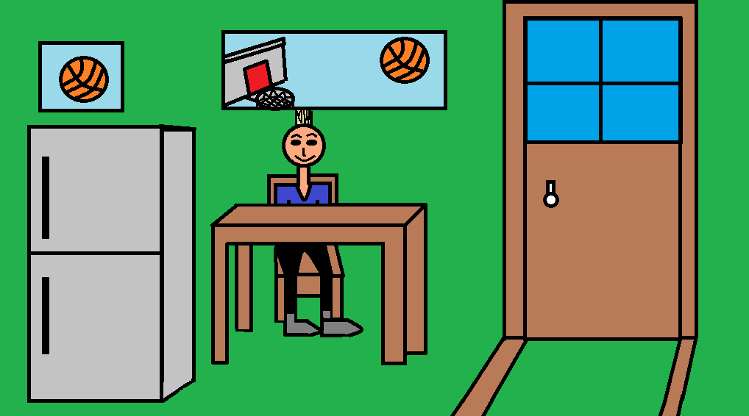
This morning, Johnny was very scared about going on an airplane to Toronto. He didn't even eat his breakfast. Johnny said to his mom. “Will the airplane crash?” “No” said his mom. “Airplanes are actually really fun! “Why?” asked Johnny.
4

Slide 6
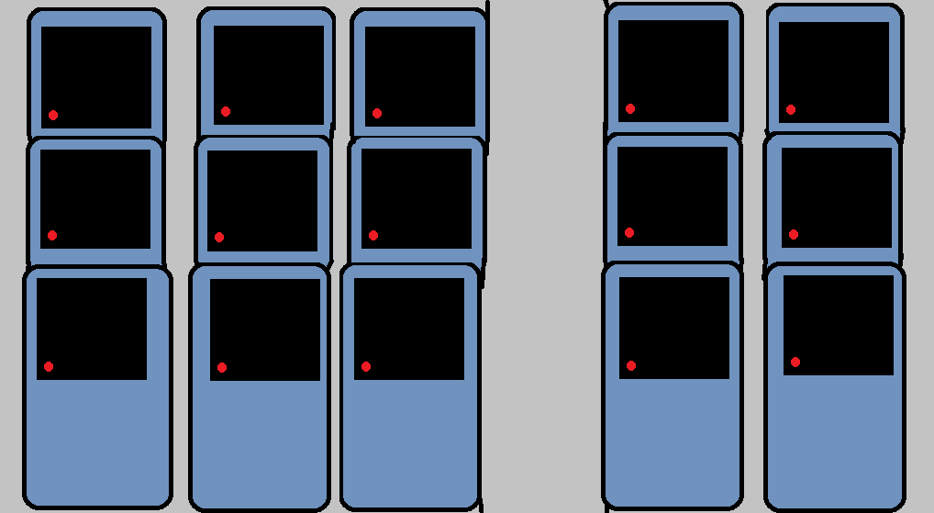
“Well,” said his mom, “there is a TV in the back of each seat so you would get to watch the one in front of you.”
“Really?” asked Johnny.
5

Slide 7
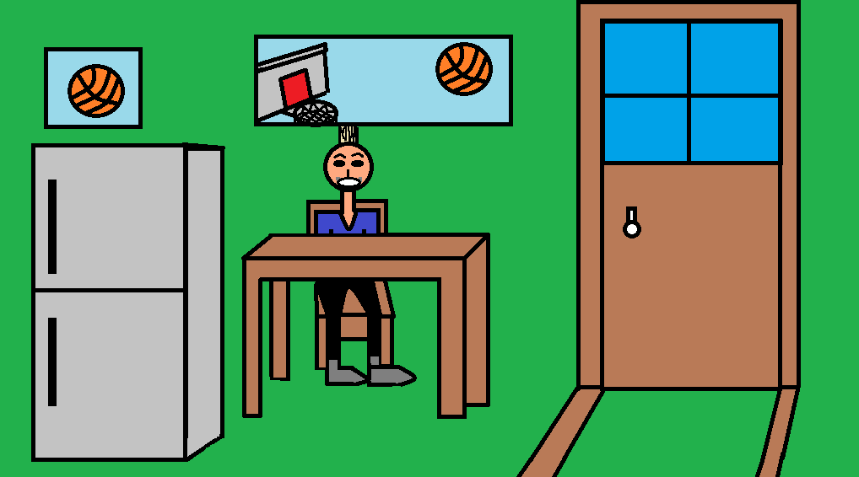
“Yes” said his mom. “They even bring you snacks.” “That’s awesome, but I am still a little scared.”
“That’s ok” said his mom, “I think you will like it.”
6

Slide 8
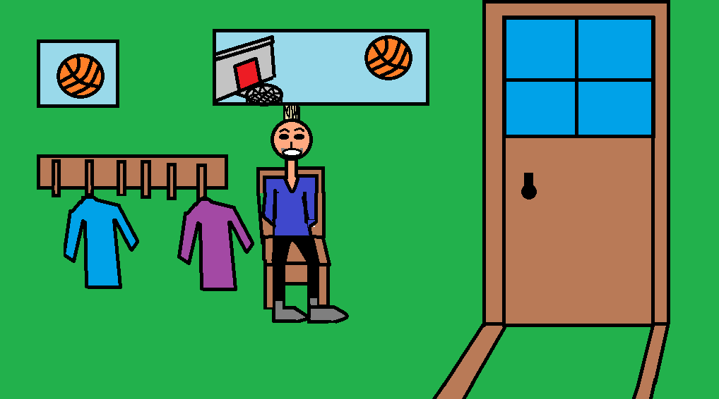
Johnny was still unsure about flying, but soon enough mom said it was time to go.
7

Slide 9
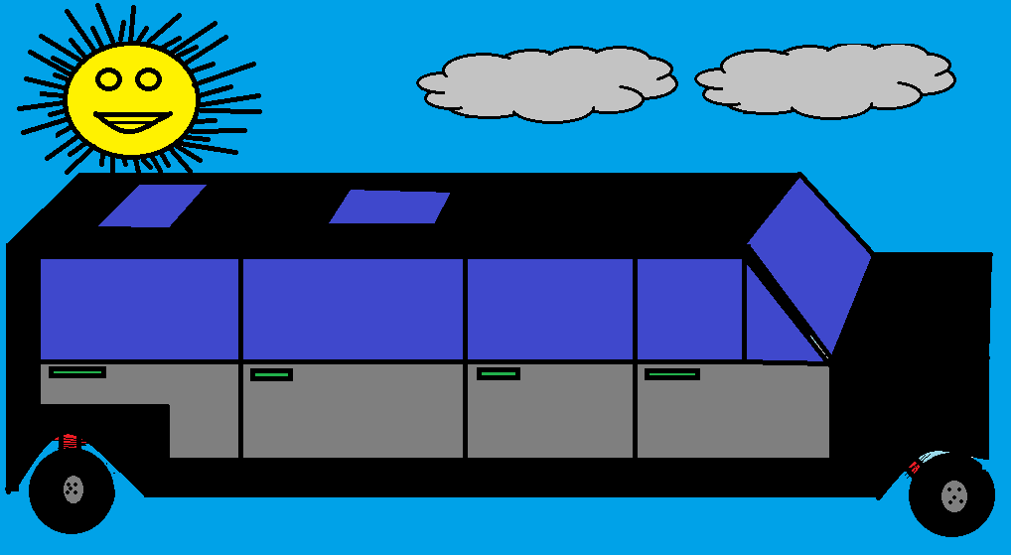
Before they got into the car Johnny said “I am still scared’
6

Slide 10
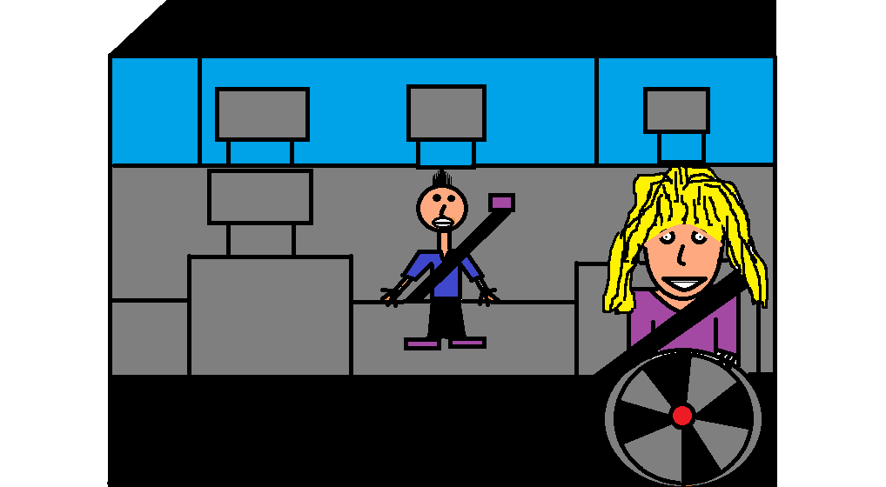
Mom said, “There is nothing to be scared of”.
“I know” said Johnny. “But I am just am”. “Try not to be”
9

Slide 11
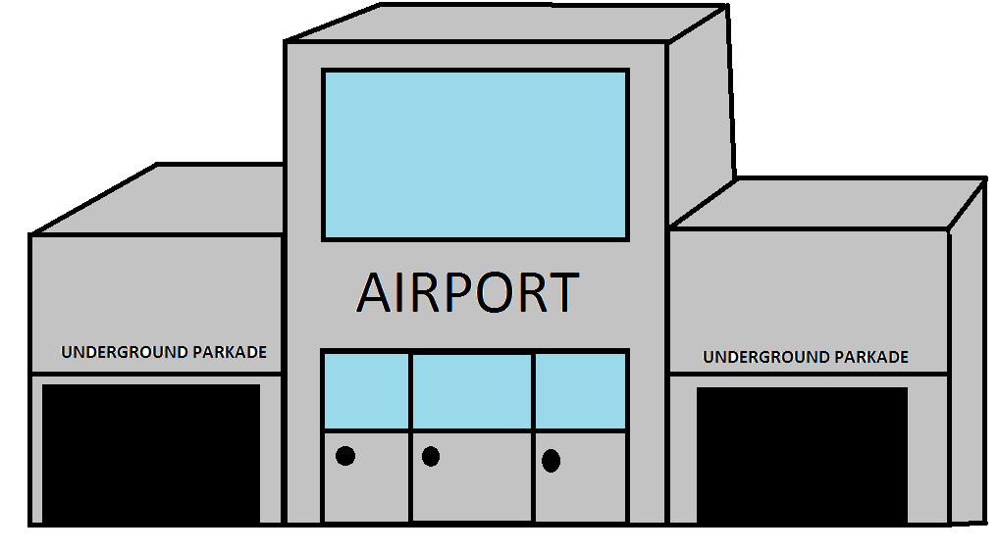
“Try not to be” she said. He just nodded. When the got to the airport he was not (as) scared anymore.
10

Slide 12
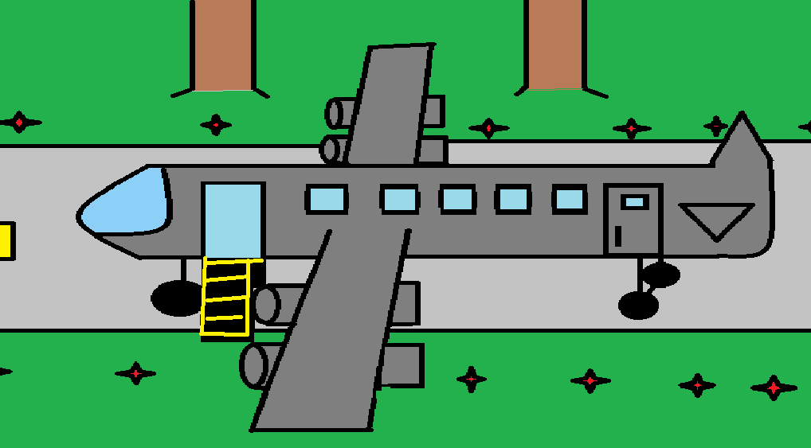
When they got on the airplane there was a big comfortable seat and after they got in the air they brought him snacks just like his mom said.
11

Slide 13
After they got their snacks. He turned on the TV and watched iron man the whole way there. It was awesome!
12

Slide 14
Biography
This is Jamie Fehr. I am 12 years of age. I live in Ohio, NS with my brother, mom, and dad. You would find me usually driving my ATV, dancing at the YMCA in Yarmouth, or Fishing at my gramps or Treefalls. I go to Hillcrest Academy in Shelburne, NS.

Slide 15
Reviews
Ryan-It was good.
Gabe-Nice pictures.
Dylan-It’s a great book.
Caleb-I like the book.
Peter-Awesome Car.

