Slide 1
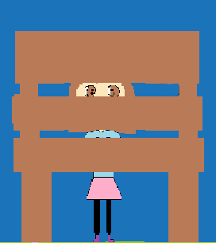
Written by Bella Hagel Illustrated by Bella Published by: Pandas Smell Like Lemons

Slide 2
By: Bella Hagel For Emily
HIDE N SEEK

Slide 3
Copyright ©
Copyright © 2015 by Bella Hagel
All rights reserved. No part of this publication may be reproduced, distributed, or transmitted in any form or by any means, including photocopying, recording, or other electronic or mechanical methods, without the prior written permission of the publisher, except in the case of brief quotations embodied in critical reviews and certain other non-commercial uses permitted by copyright law. For permission requests, write to the publisher, addressed “Attention: Permissions Coordinator,” at the address below.
Panda Smell Like Lemons
47 king St.
First printing in 2015 NS
Shelburne N.S CA 256778
www.bellakiki2003@hotmail.com
ISBN 0-203-609-22220-2
Editor: Madison Goulden, Makaila Chapman
You can find the colour copy at http://tcdsbstaff.ednet.ns.ca/scroache/

Slide 4
Dedicated to
Emily. I really liked being your book buddy.
I hope you have a good time at hillcrest.

Slide 5
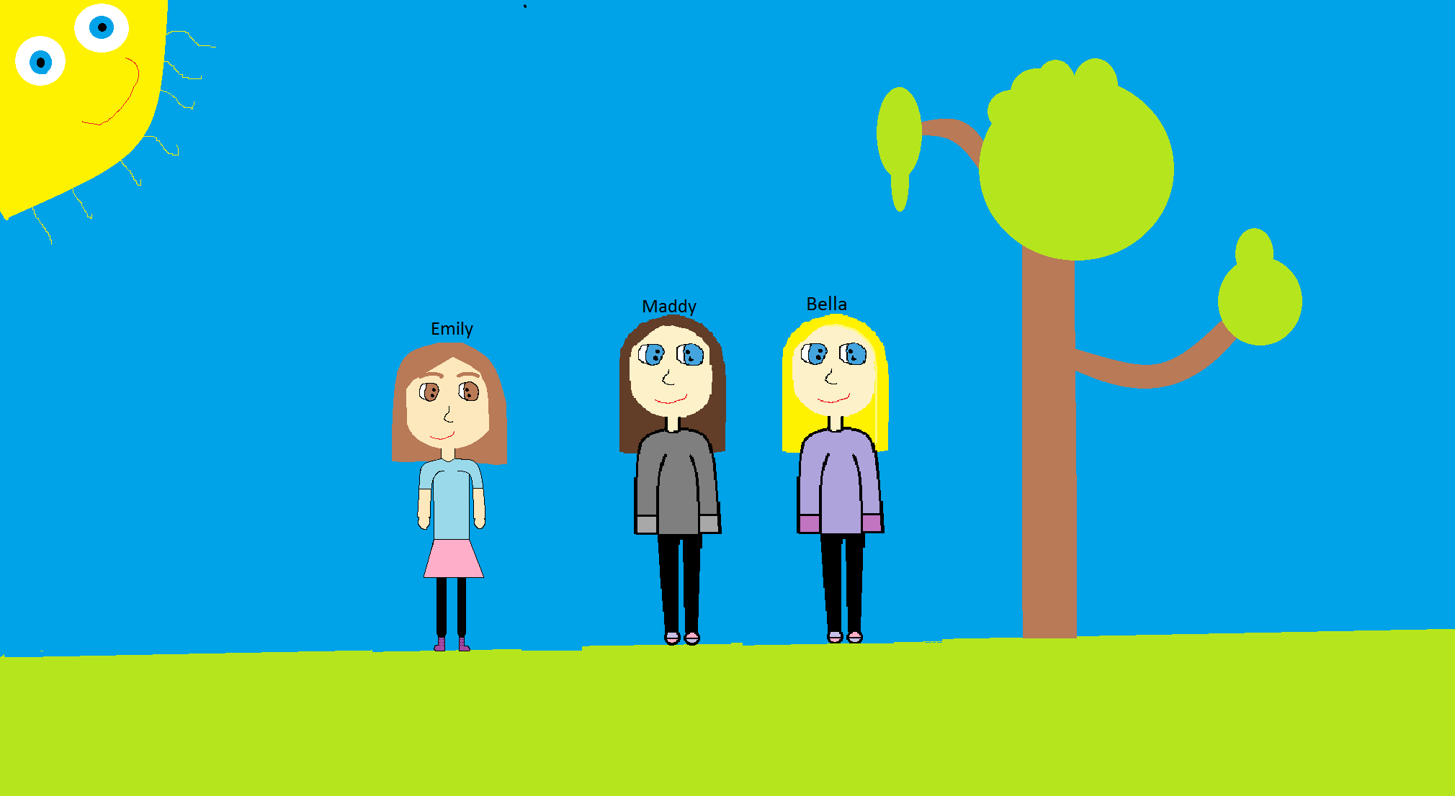
Emily is playing with her friends, Bella and Maddy.

Slide 6
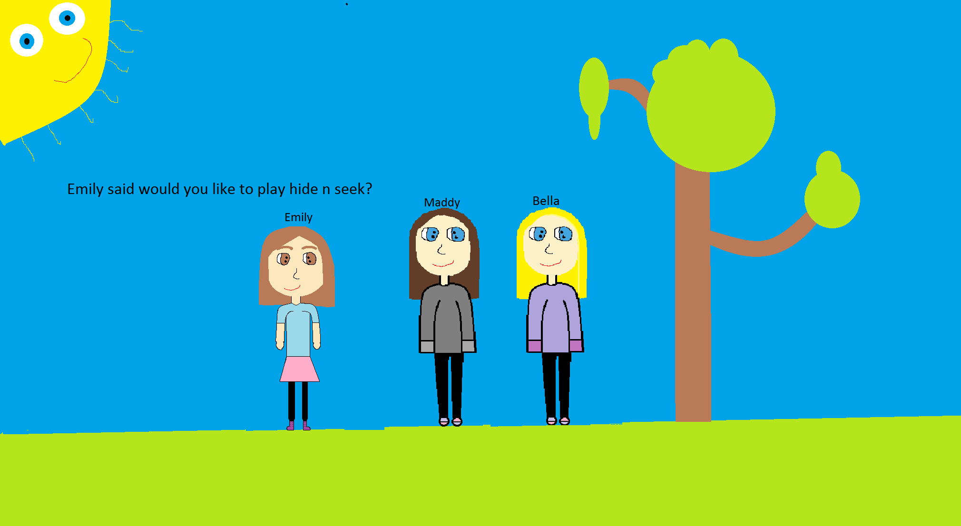
Emily said, ‘‘Would you like to play hide n seek?’’ ‘‘OK,’’ they said.

Slide 7
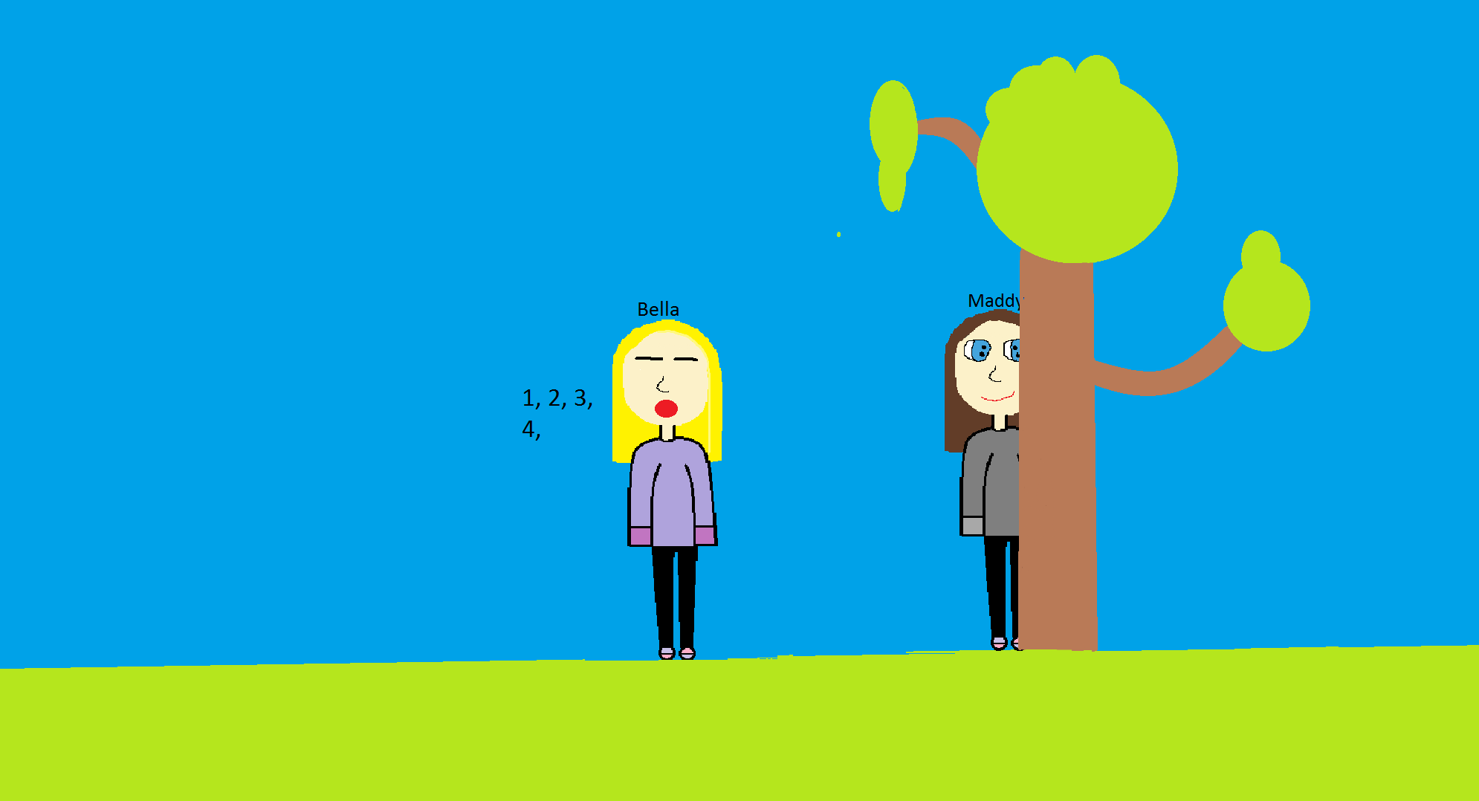
Bella said, ‘‘I will be it, go hide 1, 2, 3, 4,’’

Slide 8
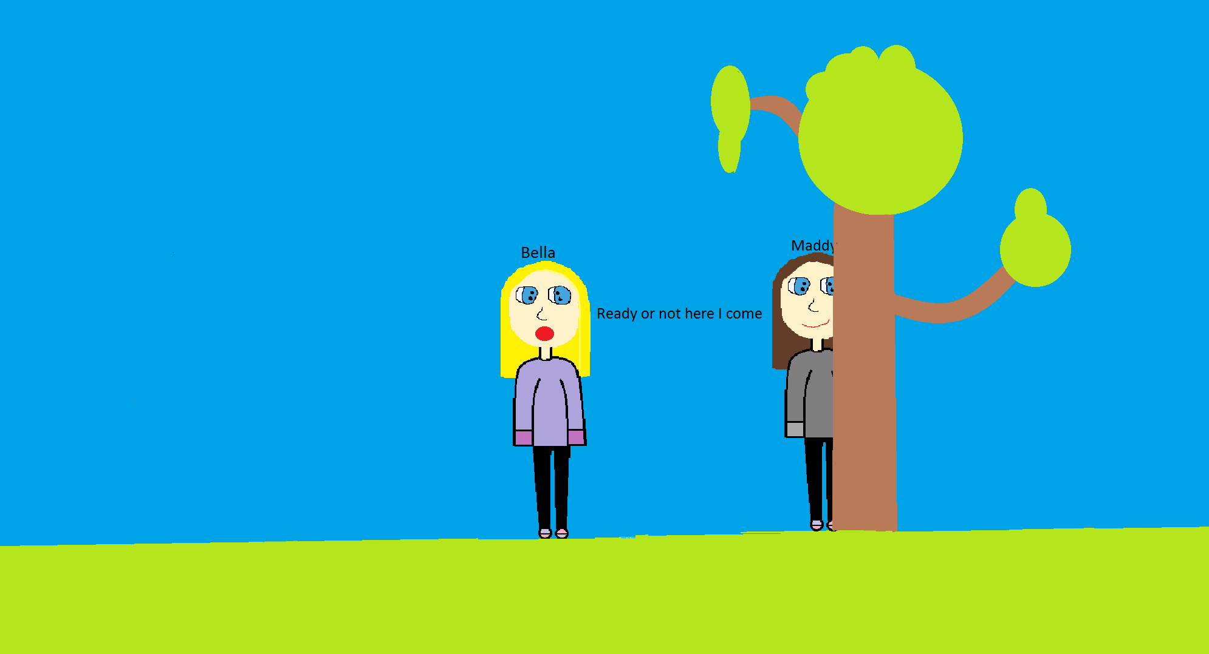
‘‘19, 20. Ready or not here I come!’’ Bella ran off to find them. Where could they be thought Bella.

Slide 9
Maybe behind the tree. ‘‘Found you Maddy!’’

Slide 10
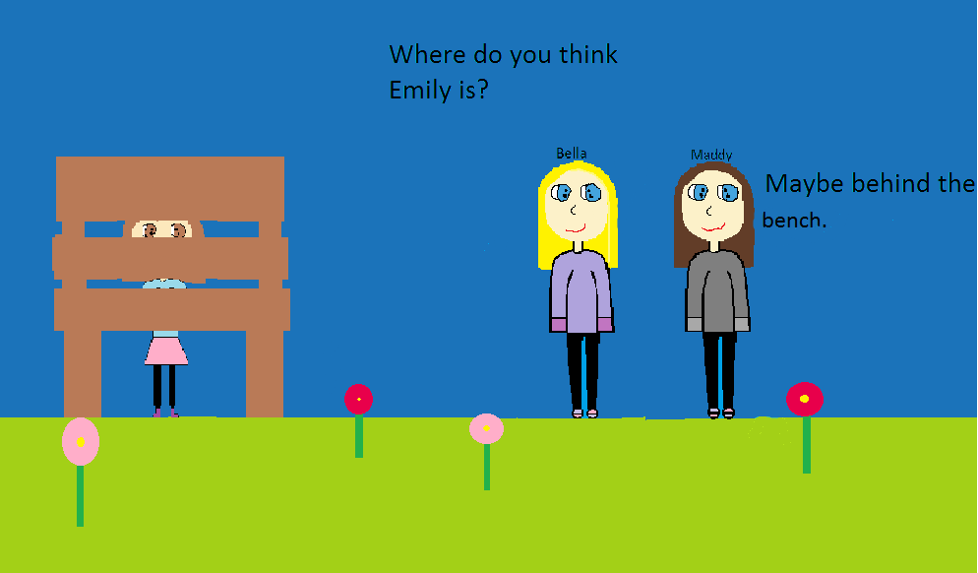
‘‘Where do you think Emily is? ‘‘Maddy asked Bella. ‘‘Maybe behind the bench,’’ said Maddy.

Slide 11
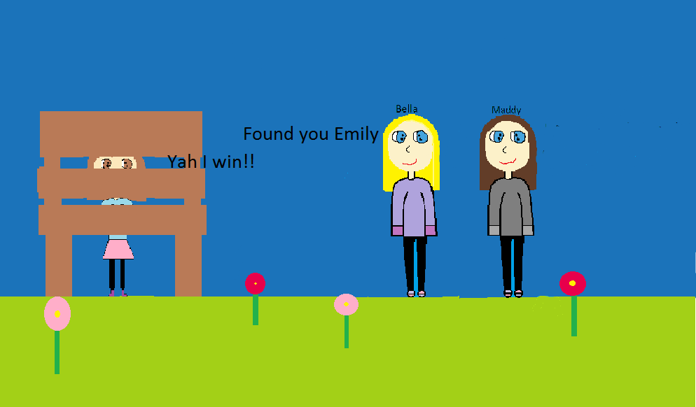
Bella and Maddy have found Emily. Emily is very happy because she has won the game of hide n seek.

Slide 12
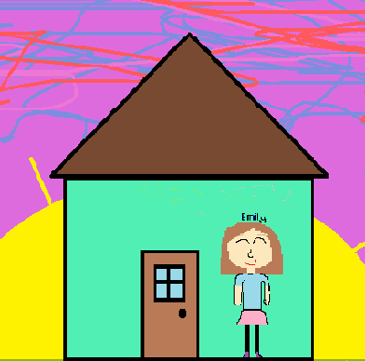
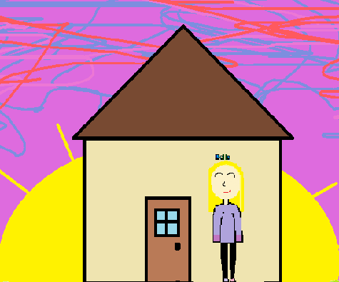
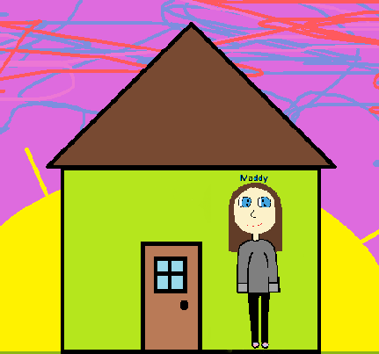
It was getting late so Emily, Maddy and Bella went home. They all had a very fun time play hide n seek with each other.

Slide 13
Autobiography
My name is Bella Hagel, I’m 12 years old. My birthday is May 21st 2003. I was born in Halifax, N.S. I have 5 sisters and 1 step-brother. I have one older sister and my brother is older than me too. I live with my mom, dad, 5 sisters, 1 cat and 1 dog. I like art, math and my iPod.

Slide 14
Comments
Jessica- It’s awesome I think Emily will like it.
Maddy- It’s nice, I think Emily will like it.
Christina- Good book for Emily.
Jasmine- Amazing book.
Kennedie- Love it!

