Slide 1
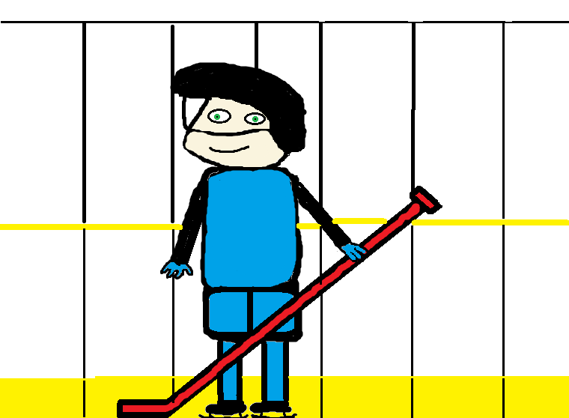
Ketch Likes Hockey
By, Xiander and Brad

Slide 2
Ketch Likes Hockey
Authors: Xiander and Brad
Illustrators :Xiander and Brad
Publishers: Xainder and Brad
Year of Publication: 2015

Slide 3
© 2015 By Xiander and Brad
This book may not be copied or duplicated in any way. This book cant be given away or damaged in any way. You cant copy any of these pictures. Although you may do any of these things if you have permission from the author or publisher.
If you would like permission you can send a letter to this email:
xianderbrad@eastlink.ca
You can find a colour copy at http://tcdsbstaff.ednet.ns.ca/scroache/homework_for_mr.htm
Made at Hillcrest Academy
First Printed: 2015
Published by: Brad and Xiander
Hillcrest St., Shelburne
Alberta, BOW4S6
ISBN: 0-203-619-01946-8
www.ketchsbook.com
First Edition
Editor: Mason

Slide 4
This book is dedicated to Ketch for being the best book buddy ever!

Slide 5
Ketch likes hockey. Ketch is super good at hockey!

Slide 6
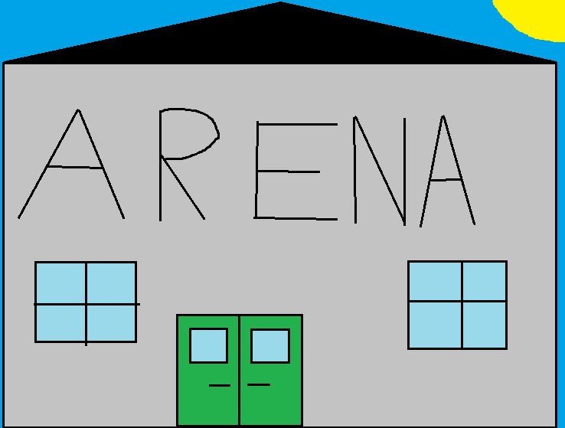
Ketch plays hockey in a super big arena.

Slide 7
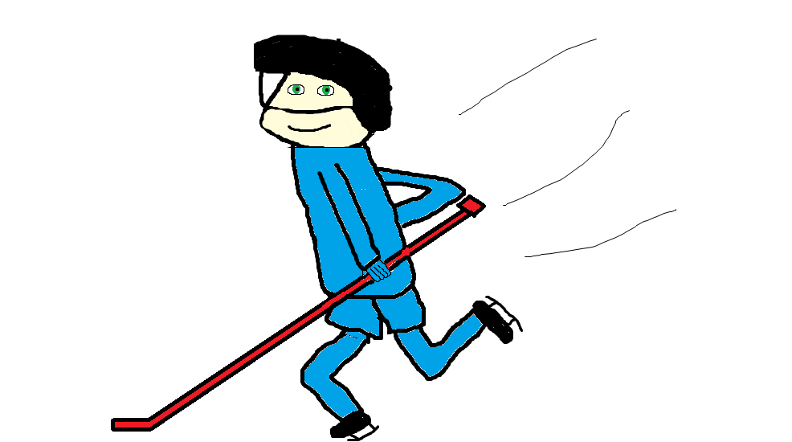
Ketch likes to skate super fast!

Slide 8
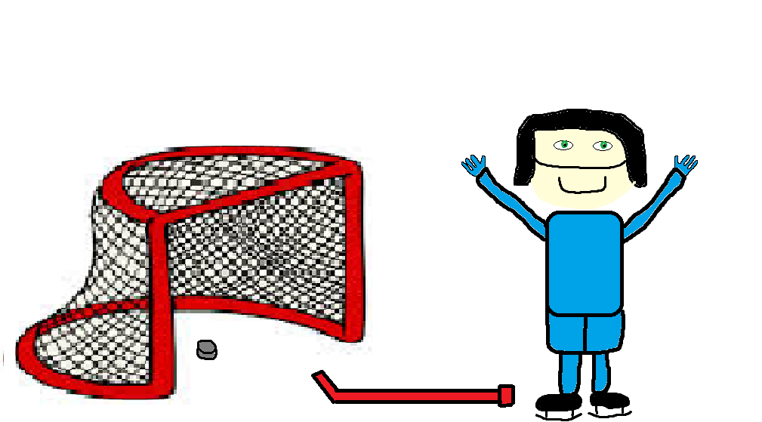
Ketch likes to get lots of goals!

Slide 9
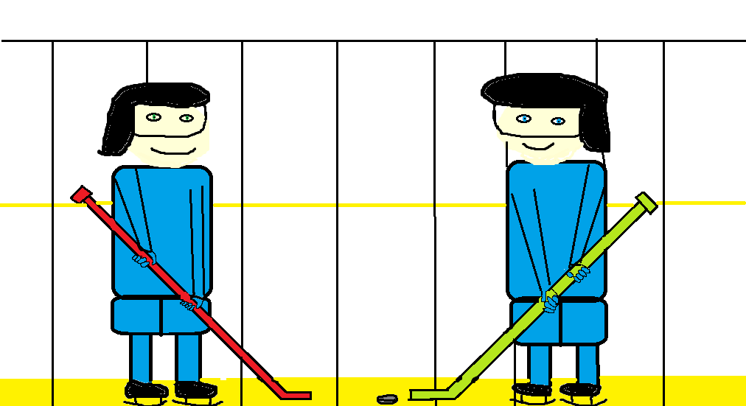
Ketch likes to make good passes.

Slide 10
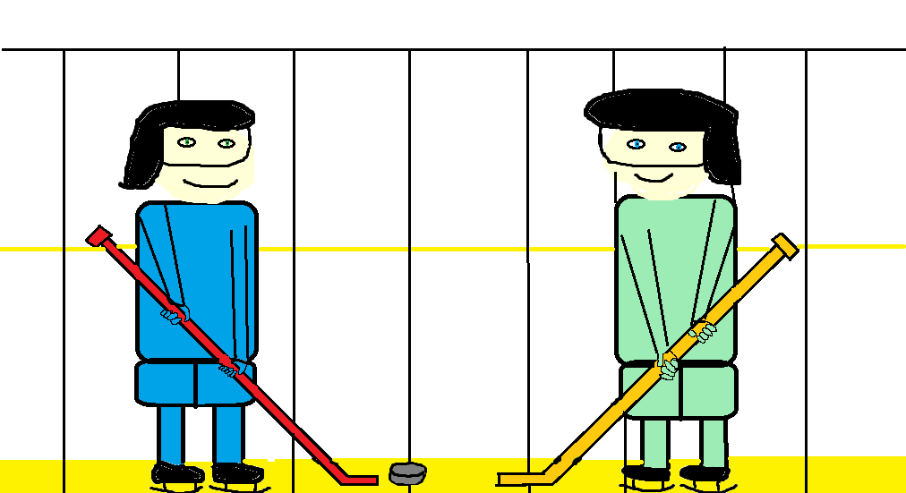
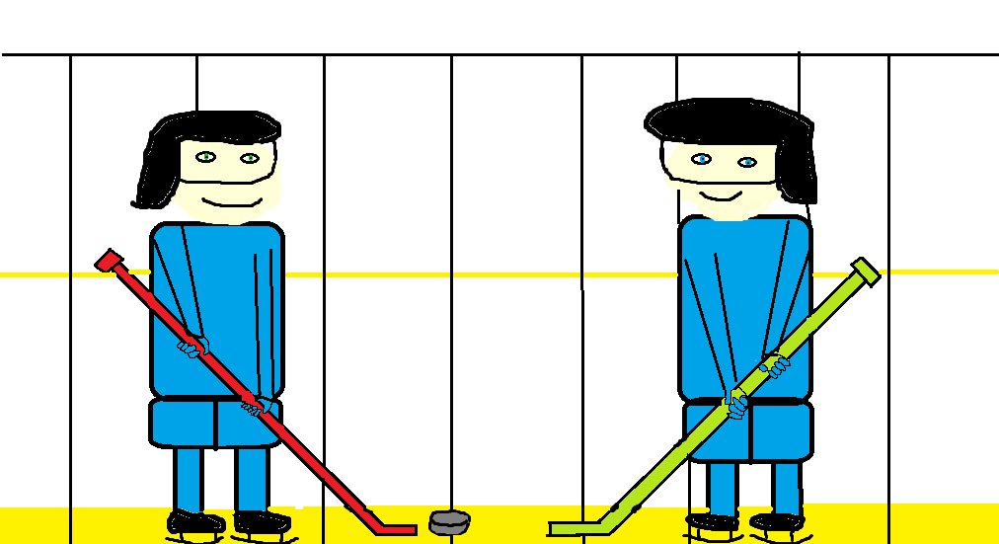
Ketch likes to play hockey with his friends. Ketch likes to play hockey against his friends.

Slide 11
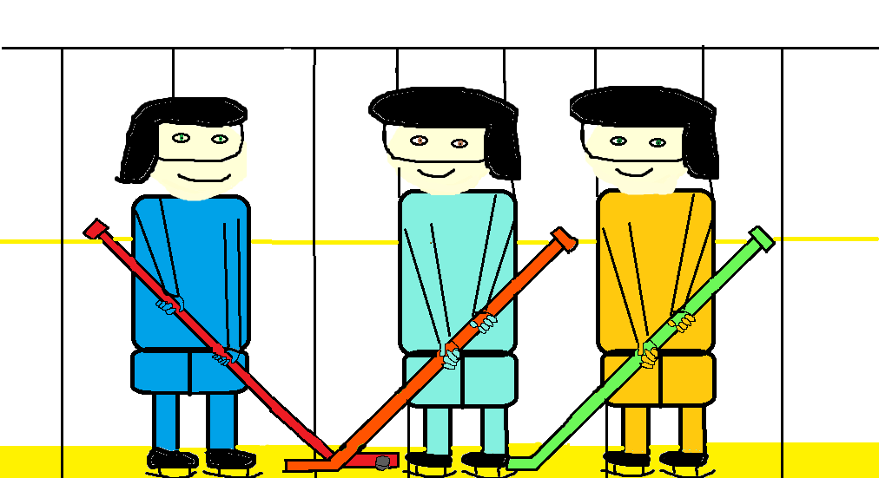
Ketch likes to play hockey with Xiander and Brad.

Slide 12
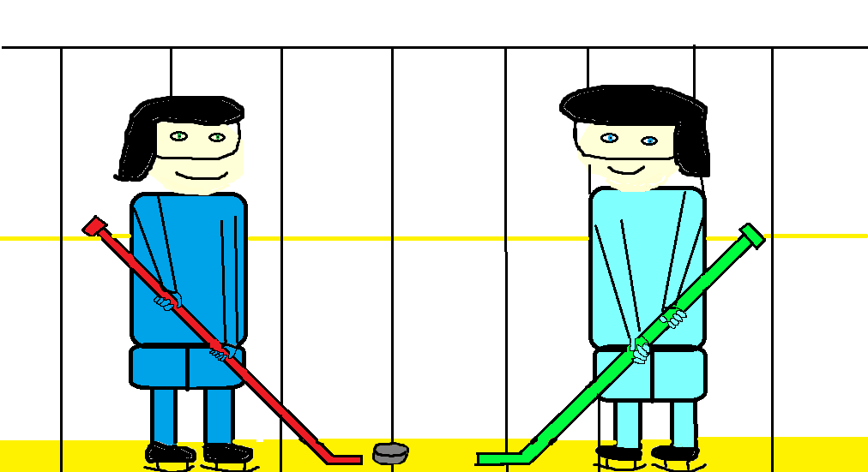
Ketch likes to play hockey with his family and everybody else.

Slide 13
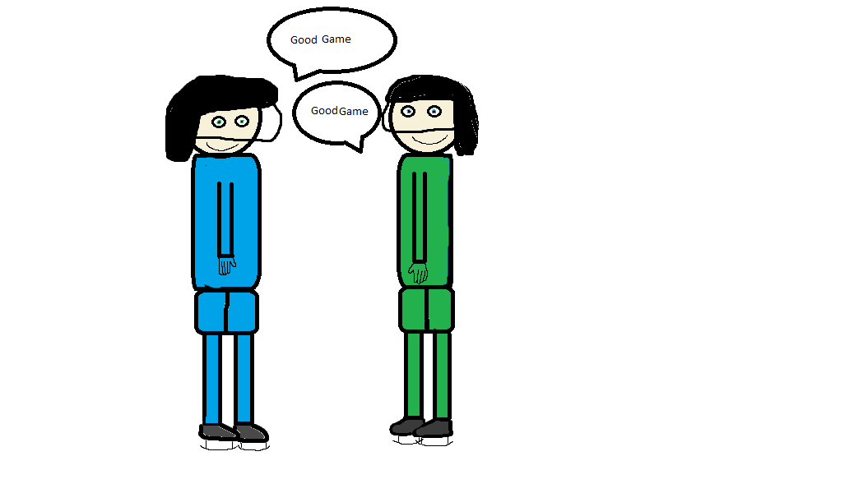
Ketch likes to play fair.

Slide 14
Ketch Loves Hockey!

Slide 15
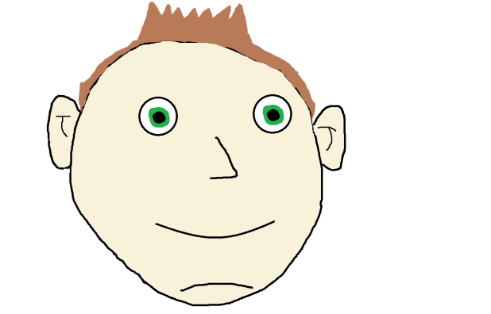
About the authors
My name is Xiander Michal Shand. I was born in Bridgewater and lived in Liverpool for a year then I moved to Shelburne. I have a mom named Angie, a dad named Mike, a little brother named Maddox and two dogs one is named Coco and the other is named Kane. I like to play soccer, hockey, baseball, but I like basketball the most. My mom, dad and brother are the most important people to me. My favourite acaccomplishment is wining basketball provincials. My major event in life was when my awesome little brother was born. When I grow up I want to be in the NBA, but I know that will never happen so I would like to be a fitness trainer.

Slide 16
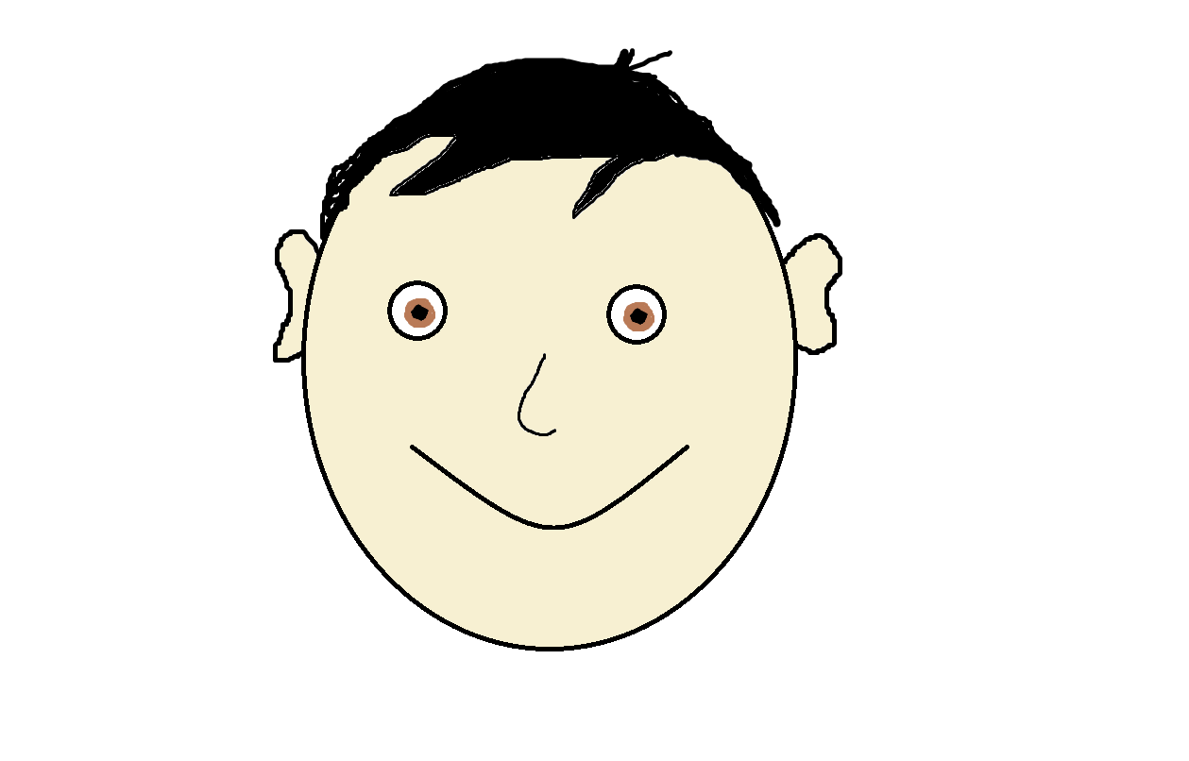
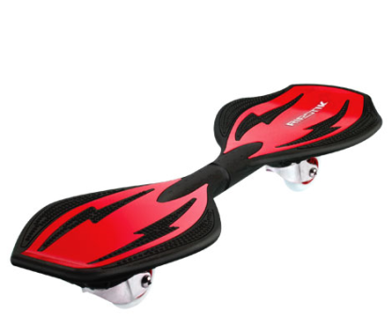
About the authors
My name is Brad ( Li Xinyue) I was born in Guangzhou, China. I am an only child my mom’s name is 孙波 (Sun Bo) and my dad’s name is 李伟(Li Wei).I like to play soccer, basketball , Table Tennis and use a ribstik(it is like a skate board) etc. The people who are important to me are my Mom and Dad and my four best friends; Huang Xuhang, Zhang Yiyang, Xu Zehao, and Shen Zichao . My accomplishment are being a good host, a very good story teller in Chinese etc. I have gotten toffies, meddles and plaques for doing good in these. When I grow up I want to be a scientist.
This is a ribstik

Slide 17
Comments
Mason- The book has very colourful pictures and I think Ketch will like the book.
Caleb- I like this book and I think Ketch will like it too.
Ryan- It is good because it encourages kids to play sports.
Jamie- This book is awesome because it is very colourful and the drawings are cool!
Peter- Awesome Pictures and a good book.
Lucas- It is good

