Slide 1
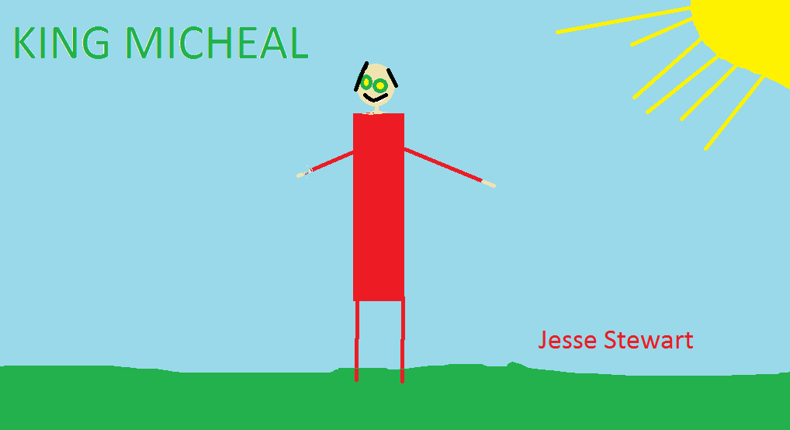
King Michael

Slide 2
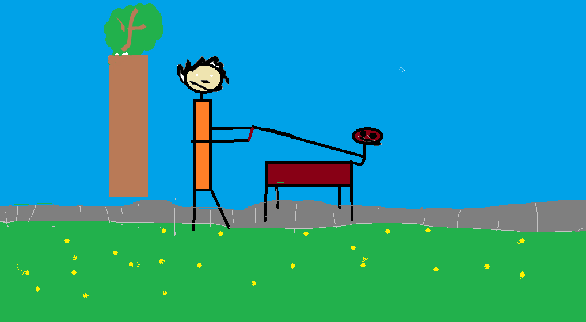
DEDICATON PAGE
THIS BOOK IS DEDICATED TO MICHEAL.
Michael LOVES DOGS.

Slide 3
KING MICHEAL
BY JESSE
PUBLISHED BY JESSE

Slide 4
Copyright
MY NAME IS Jesse Stewart. JUN 9 2015 This book or any portion there of may not be reproduced or used in any manner whatsoever without the express written permission of the publisher except for the use of brief quotations in a book review.
Printed in Canada
First printing 2015
ISBN 0-432-621-8543-2
Jacks Rule publishing
Shelburne, N.S B0T
www.jacksRuleBooks.com
Edited by: Aidan Treloar and Ryan

Slide 5
One day king Michael went for a walk with his dog Pickle. One day Pickle tripped and hurt his paw.

Slide 6
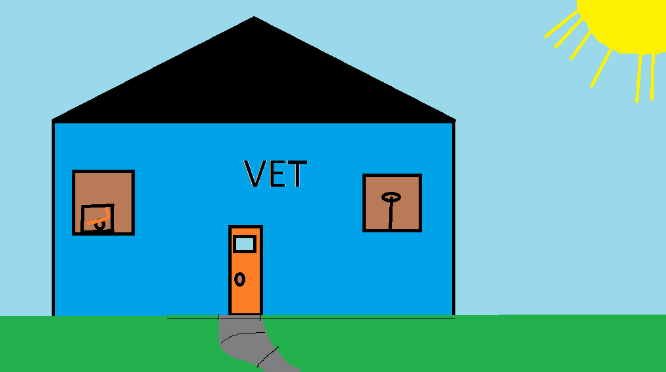
They had to go to see Jesse, the vet.

Slide 7
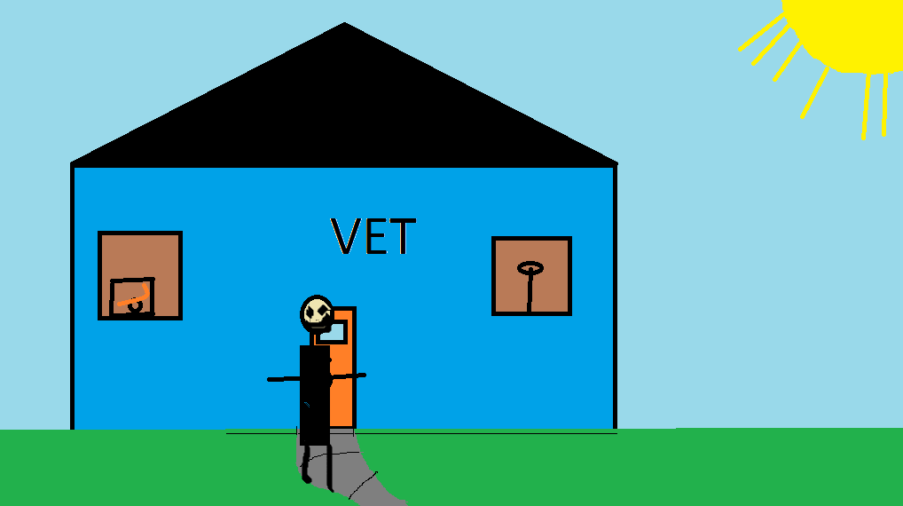
The next day he sent one of his best solider ‘Pickle 2.0 to pick up his dog Pickle.

Slide 8
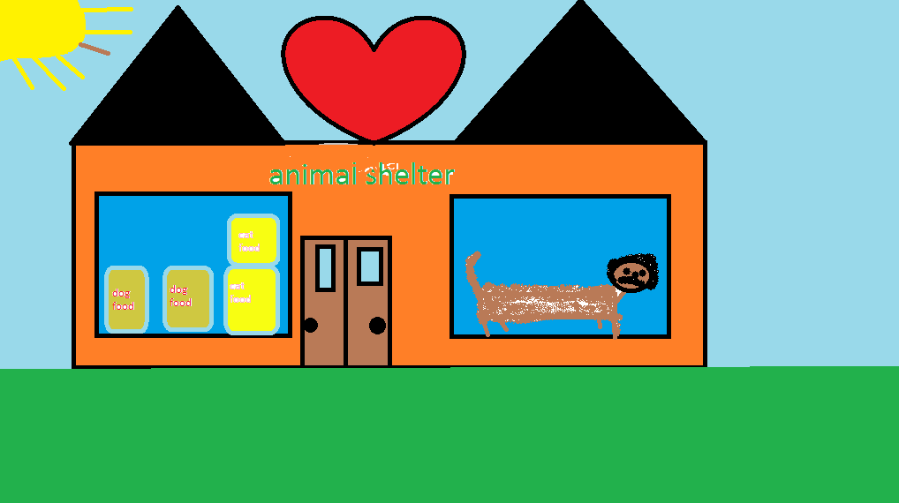
The next day King Michael went to the animal shelter to pick up some dog food.

Slide 9
What he didn't know was that there was a cat loose in the store.

Slide 10
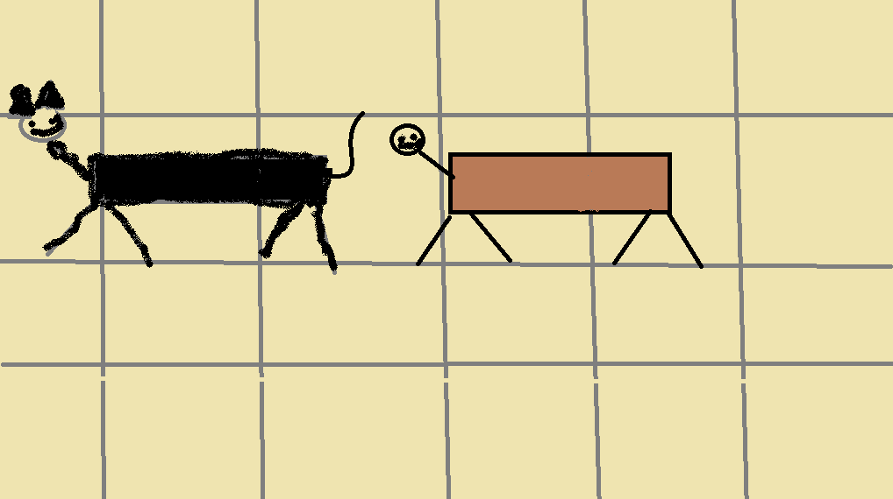
Pickle started to chase the cat.

Slide 11
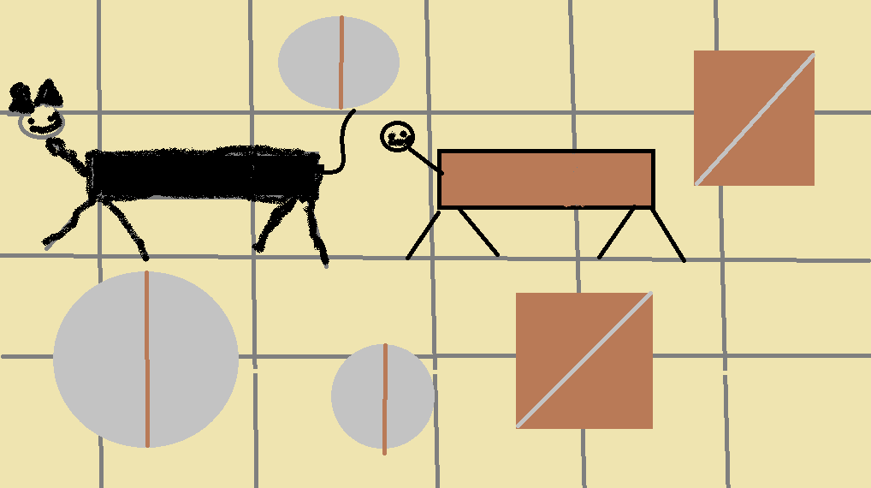
He knocked everything over in the pet shop.

Slide 12
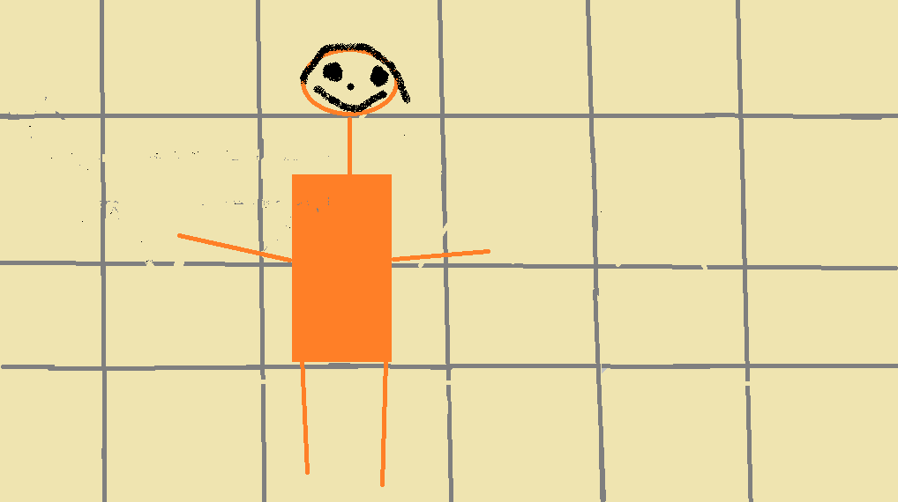
King Michael had to clean up Pickle’s mess.

Slide 13
Even cages.

Slide 14
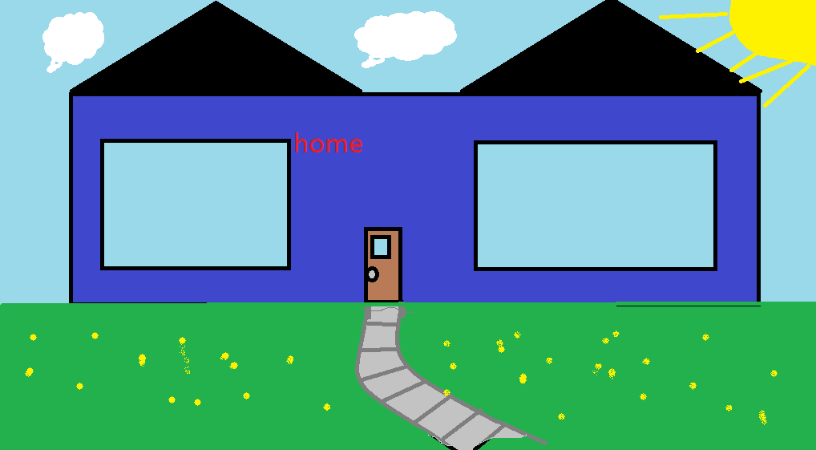
They went home.

Slide 15
Biography
My name is Jesse Stewart I'm 12 years old.
I like fixing motors. I was born in Halifax in the IWK hospital in 2003 April 20th . I wrote this book in 2015, May 27th.

Slide 16
Reviews
Isaac :I liked it.
Dylan :I liked the pictures and it’s colourful.
Caleb : I liked the book and the pictures.
Ryan : It was good.
Peter: Ok. There are some mistakes.

