Slide 1
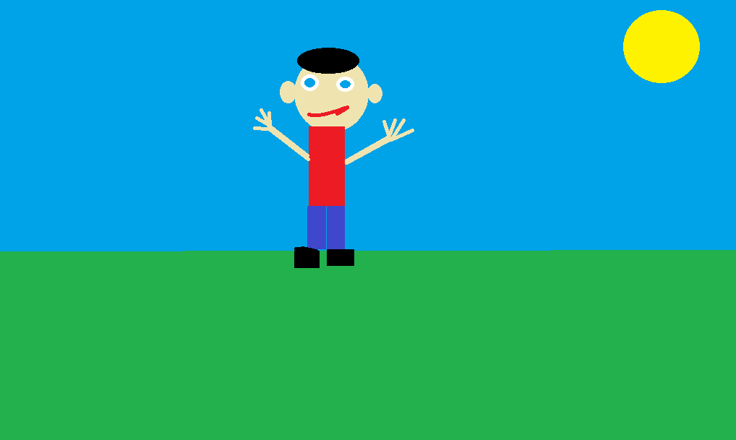
Mario Rowin
By Caleb Demings

Slide 2
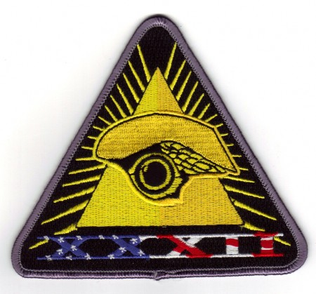
Title Page
Written by Caleb Demings
Illustrated by Caleb Demings
Yolo Writing

Slide 3
Copyright page
© 2015 Caleb Demings
ISBN Code 0-203-606-98765-X
This book can be printed but there cannot be damaged or sold
Printed in Canada
Yolo Writing
6969 Yolo lane, Jamaica
www.YoloWriting.com
Phone 696-9696
Fax 212-1212
Editor Ryan O’Callaghan

Slide 4
This book goes to the best book buddy in the world, Rowin.

Slide 5
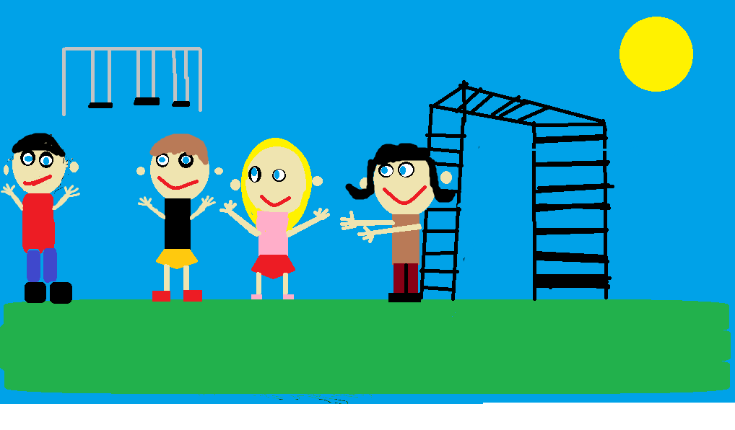
Once upon a time there was a boy named Rowin. He liked to play with his friends Ethan, Rennay, and Amaya.

Slide 6
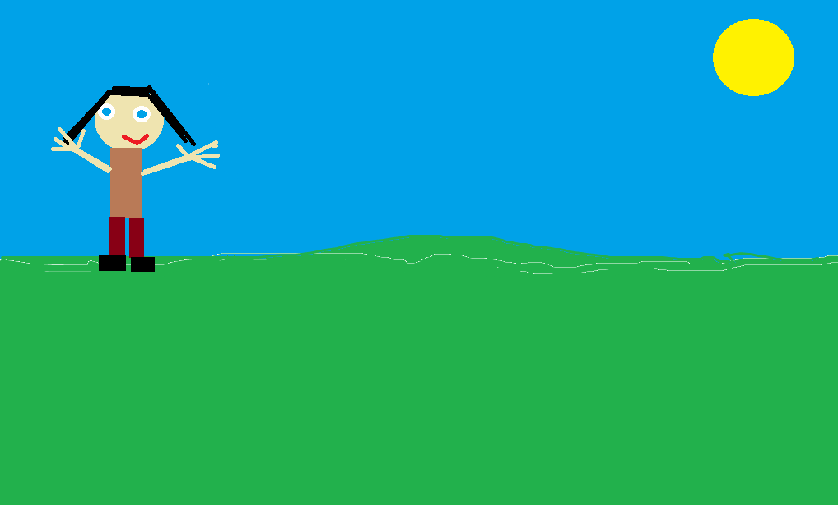
One day Amaya wanted to play tag. Rowin wanted to, Ethan didn’t want to and Rennay didn’t want to either.

Slide 7
They decided to play a best two out of three series of rock, paper, scissors to decide if they were going to play tag or not.

Slide 8
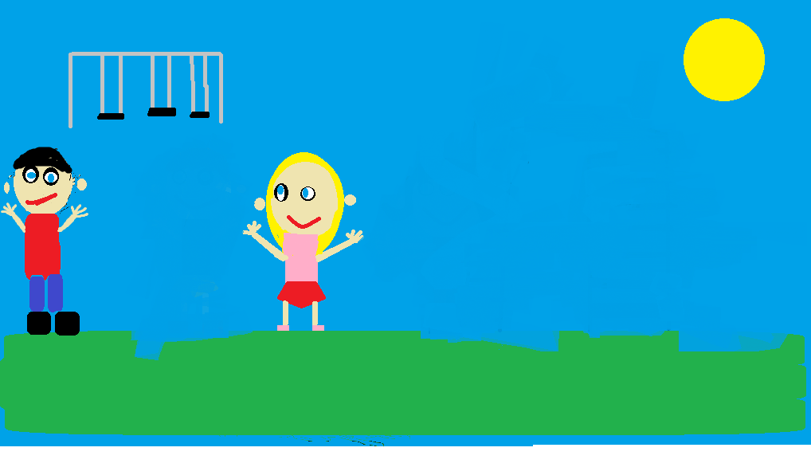
Rowin and Amaya won the best two out of three series of rock, paper, scissors.

Slide 9
When they won they were happy of course but they decided they liked to play rock, paper, scissors so they played it for the rest of lunch hour

Slide 10
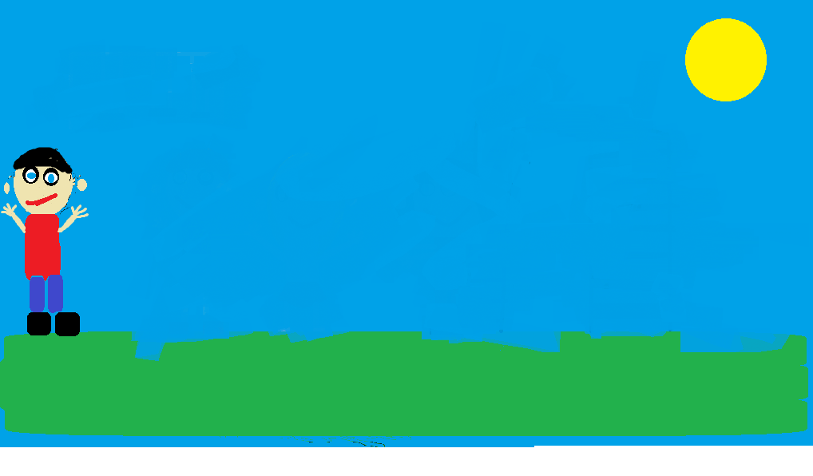
It was almost time to go home and Rowin new exactly what he was going to do when he got home.

Slide 11
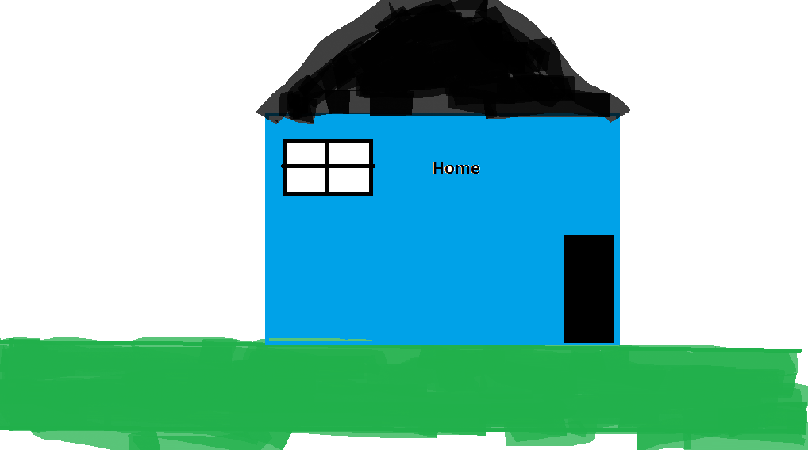
When Rowin got home he threw his book bag and went right into his living room.

Slide 12
He turned on his Wii U and started to play Mario Bros

Slide 13
He was up all afternoon trying to beat and get from the first world to the second world.

Slide 14
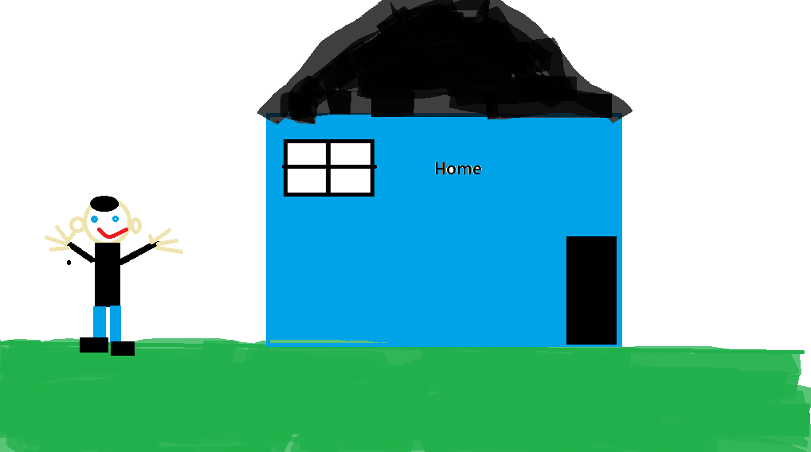
He finally beat the first world and got to the second world he was very proud and happy.

Slide 15
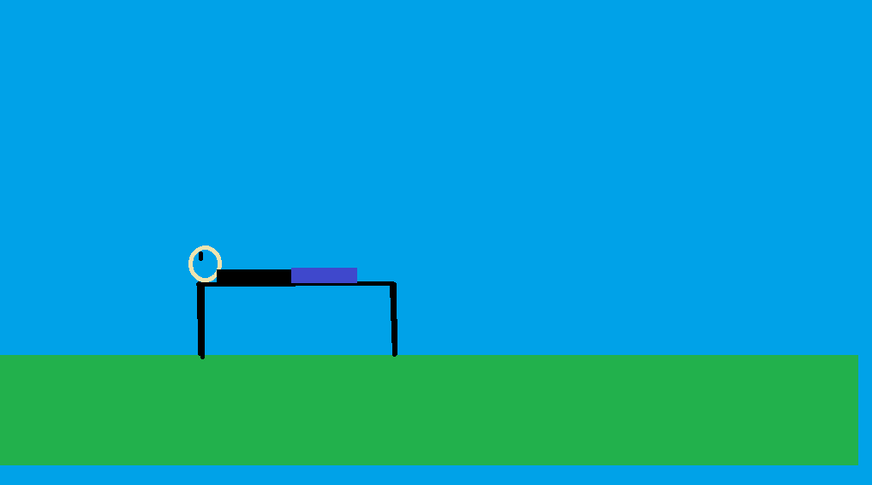
As you can tell Rowin had a wonderful day and now its time to go to sleep ZZZZZZZZZZ.

Slide 16
Bibliography
Hello my name is Caleb Demings and I’m 11 years old. I like the sports hockey, soccer, and basketball. I’ve moved once in my life. I have a little sister named Madyson, she is 8 years old. My friends are Ryan, Xiander, Lucas, Jamie, and Isaac.

Slide 17
Comments of my book
Ryan- I liked the book
Lucas- I liked the book is was colourful
Xiander- I liked the book
Isaac- I liked the book it was cool
Jamie- It was a good book

