Slide 1
Princess Rennay’s 14th Birthday Author and Illustrator: Christina Harris

Slide 2
Dedication I dedicate this book to Rennay an awesome book buddy! Hope you have a fun time at Hillcrest!

Slide 3
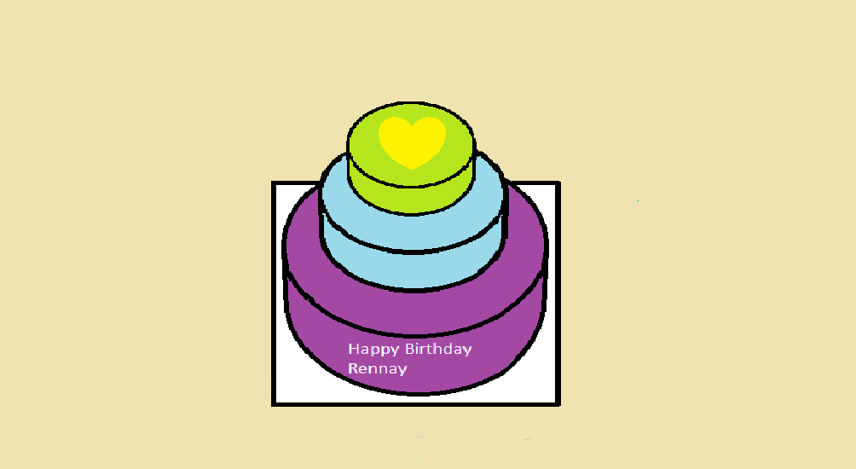
Princess Rennay’s 14th birthday

Slide 4
Copyright © 2015 by Christina Harris
All rights reserved. No one can change or reproduce this book without the permission of Christina Harris.
Publisher: cheezeprinting
Phone: 555-1055
Fax: 555-3563
Address-Shelburne N.S.
www.cheezeprinting .com
Printed in Nova Scotia, Canada
First Printing 2015
ISBN 0-203-610-51367-8
Editor: Kennedie Clarice Rennehan
You can find a color copy at: http://tcdsbstaff.ednet.ns.ca/scroache/

Slide 5
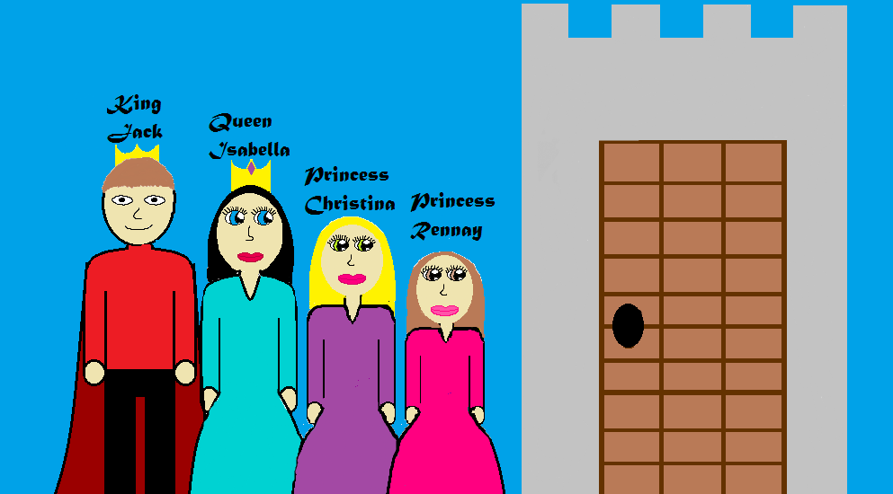
Once upon a time there was a royal family; there was King Jack, Queen Isabella, Princess Christina and Princess Rennay. They had a lovely life in their beautiful castle in England.

Slide 6
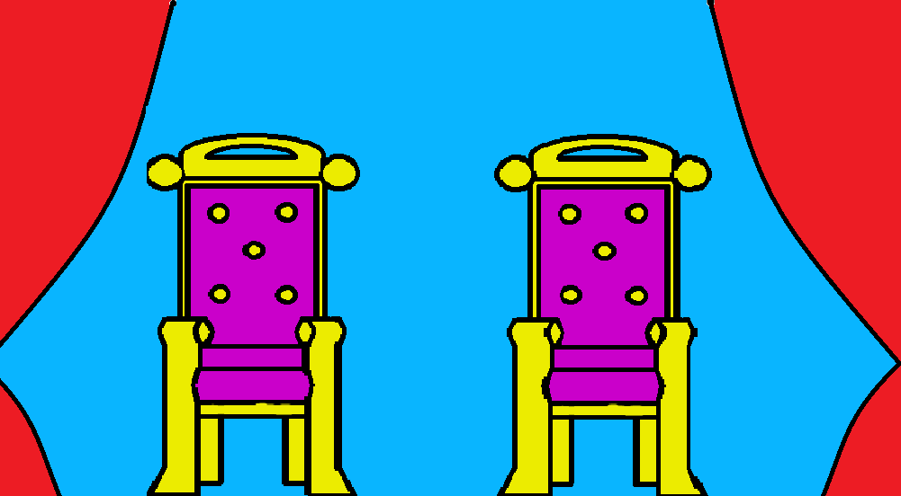
It was almost Rennay’s 14th birthday so her parents King Jack and Queen Isabella were throwing a royal ball just for her birthday.

Slide 7
There was going to be flowers and anything a Princess would want for her birthday. Plus, they were making very pretty invitations; they invited the entire kingdom, even the poor people.

Slide 8
The day before the ball everyone was taking dance lessons and getting their dresses and suits picked out for the big ball. Everyone was good at dancing, but they still took dance lessons just so their dancing would be perfect.

Slide 9
It was the day of the ball and everyone was getting their hair done up all nice and pretty, then got their dresses and suits on and left to go to the ball. When everyone got to the ball they were amazed at how nice it was there, there was a really big cake and so many decorations. It was beautiful!

Slide 10
Everyone was having a great time, but right before they cut the cake a dragon flew right in the castle doors and picked up Princess Rennay and took her to the dragon’s cave! Then the dragon flew away and left the princess all alone.

Slide 11
. Then Princess Rennay yelled as loud as she could, “Help! Help! I have been taken by a dragon! Someone please Help!” Just then the dragon came back with a ball and passed it to the princess. Then the princess realized that the dragon was all alone and just wanted to play.

Slide 12
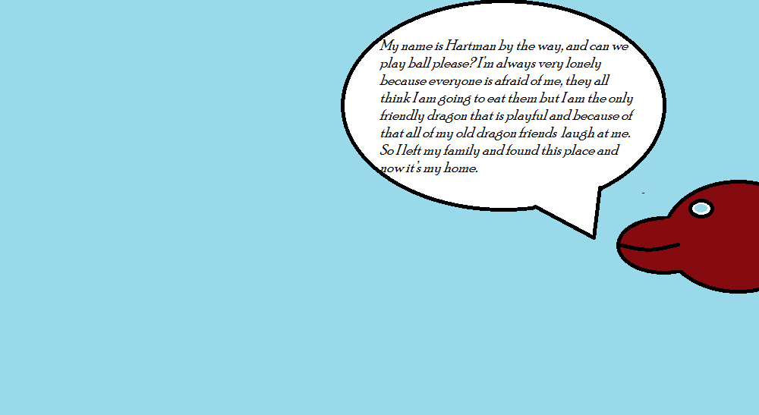
When Princess Rennay was picking up the ball the dragon said, “My name is Hartman, by the way, and can we play ball please? I’m always very lonely because everyone is afraid of me, they all think I am going to eat them, but I am the only friendly dragon that is playful and because of that all of my old dragon friends laugh at me. So I left my family and found this place and now it’s my home.”

Slide 13
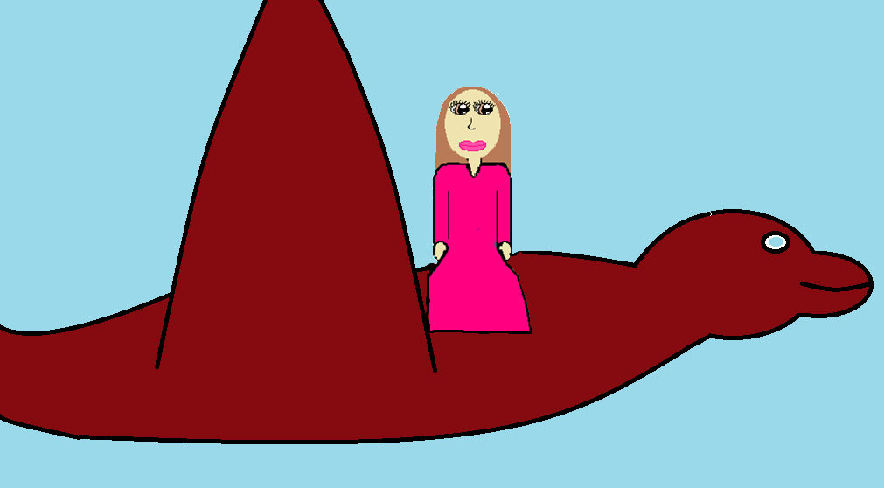
So Princess Rennay said yes to the dragon and they played ball for hours. Then Princess Rennay asked Hartman to bring her home. Hartman said yes but when he was flying her home Rennay said, “I will ask if you can live at the castle with me.” Then Hartman said right away with joy, “Yes please.”

Slide 14
So when they were at the castle Princess Rennay asked and her parents and they said, “Yes, he can stay as long as he is nice.” Then they all lived happily ever after.

Slide 15
comments
Jessica: It’s awesome Rennay will like it.
Bella: I think it is a really good book and I think Rennay will like it.
Amiya: Its a good kids book.
Maddy: It’s cool.
Desirae: It was awesome!

Slide 16
About the author
Hello, my name is Christina, I am 11 years old and I have 1 sister named Anna, and I have 1 cat at the moment.

