Slide 1
Authors name Isaac

Slide 2
DEDICATION
This book goes out to Blake the best book buddy there is.

Slide 3
The lonely boy
Authors name Isaac

Slide 4
Copyright
© 2015 Isaac Cossaboom
All rights reserved do not. Damage unless Isaac gives permission.
www.fight.com
Printed in Canada Nova Scotia
First printing 03/06/15
Editor- Kennedie Rennehan
Fax-567-9807
Phone-453-7768
Address-1586 sesame st. Shelburne Nova Scotia Canada
Fight LTD
Publisher Isaac Cossaboom
Isbn- 0-203-605-12345-3
To find a colour copy at http://tcdsbstaff.ednet.ns.ca/scroache/

Slide 5
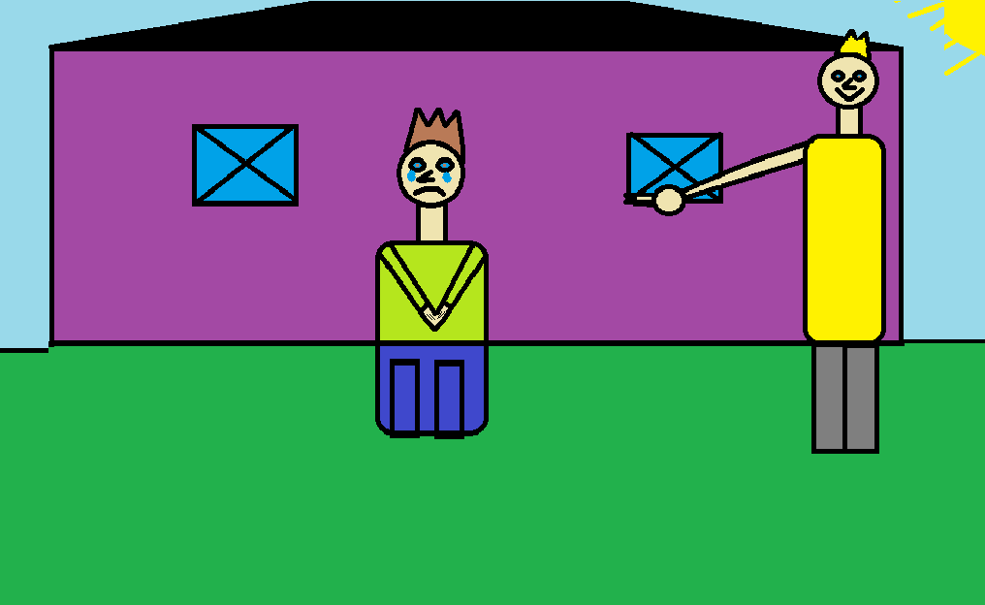
1.Once upon a time there was a boy named Blake. Blake was lonely so his dad Jamie said, “Let’s go to the pet store. On a nice day like this, you should not be lonely.”

Slide 6
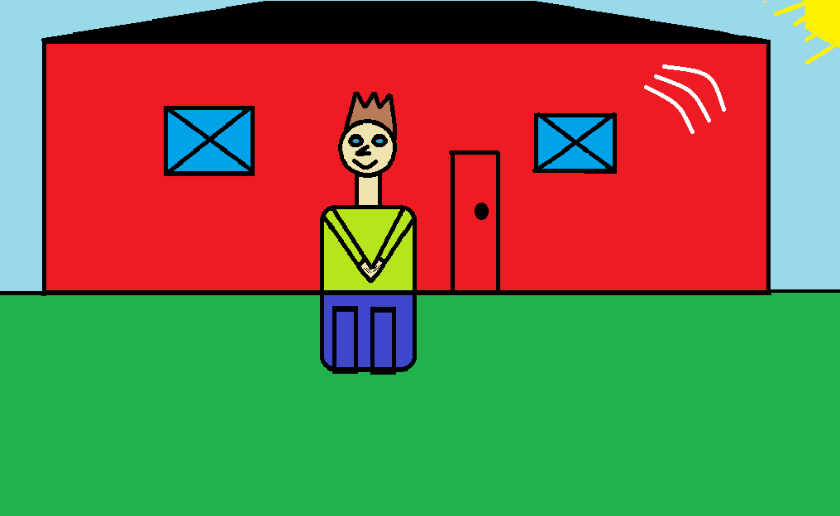
2. The pet store was bright red on the outside and yellow on the inside. There was a lot of noise inside the pet store like bears, parrots, cats, dogs, elephants, and splashes from a shark.

Slide 7
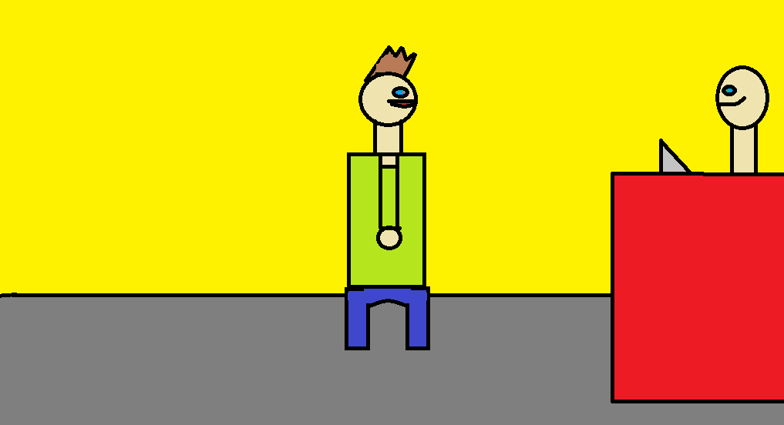
3. So Blake went up to Jake, the pet store owner, and said “I want a baby bear for a pet.” So Jake said, “It’s your lucky day. they are free.”

Slide 8
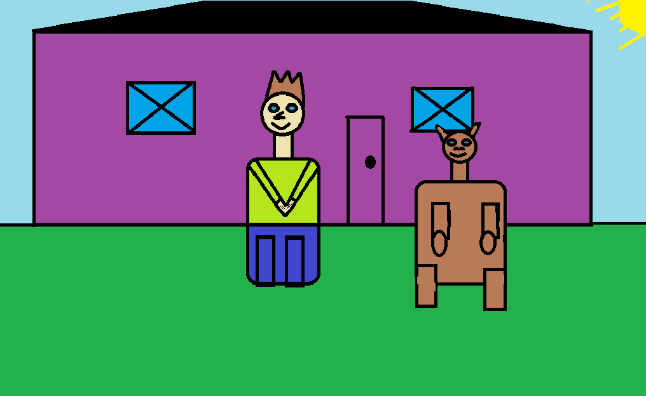
4. So Blake got one named Isaac. Blake was a happy boy. Isaac and Blake lived happy ever after.

Slide 9
comments
Jessica: Awesome!
Jamie: Funny!
Xiander: Good book, very funny!
Emma: “It is a good book.”
Christina: A good, funny book for Blake!

Slide 10
About the Author
My name is Isaac Cossaboom. I like to play basketball and soccer. like pizza. I like to ride my four wheeler. I have 1 brother. I'm 12 years old.

