Slide 2
The Pet Store
Author- Kennedie Rennehan
Illustrator- kennedie rennehan

Slide 3
Dedication
This book goes out to Stella the best book buddy there is.

Slide 4
copyright
©2015 Kennedie Rennehan
All rights reserved. Do not damage unless Kennedie gives permission.
www.greenhouse.com
TheGreenHouse LTD
Printed in Nova Scotia Canada
First printing 26/05/2015
Fax- 765-9970
Phone-554-6523
Address Shelburne Nova Scotia
Editor- Christina Leanne Harris
ISBN-0-203-618-12435-3

Slide 5
THE PET STORE

Slide 6
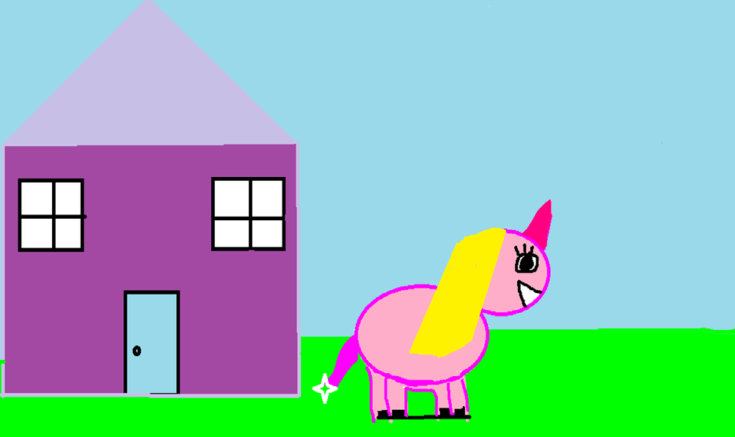
Stella had to go to the pet store for Mistey . Stella said, “I’m going now”. I need money, Rhonda “OK”. Off went Stella to the pet store.

Slide 7
When Stella got to the pet store Stella saw more than a the pet food. She saw llama corn!

Slide 8
This is Taylor’s house.

Slide 9
When Stella got to Taylor’s house they Painted beautiful paintings. Stella’s was colourful and bright. Heres what it looked like.

Slide 10
This is Rhonda. She is Stella’s mom. Rhonda called Taylor’s house to see if Stella could come home for supper

Slide 13
PICTURE OF ME

Slide 14
Autobiography
Hi, I'm Kennedie. I’m 11 years old. I was born in Bridgewater, N.S. on September 13th 2003. I have a big brother, his name is Cohan. I have a big sister, her name is Kaileen. My favourite food is chicken-wraps.

Slide 15
comments
Desirae-AWESOME.
Christina- Good book for Stella.
Madison-Pictures are colourful and Stella would love it.
Jasmine- Good book.
Makaila- It was a funny book.

