Slide 1
A Wolf Adventure
Written and illustrated by:
Makaila Chapman

Slide 2
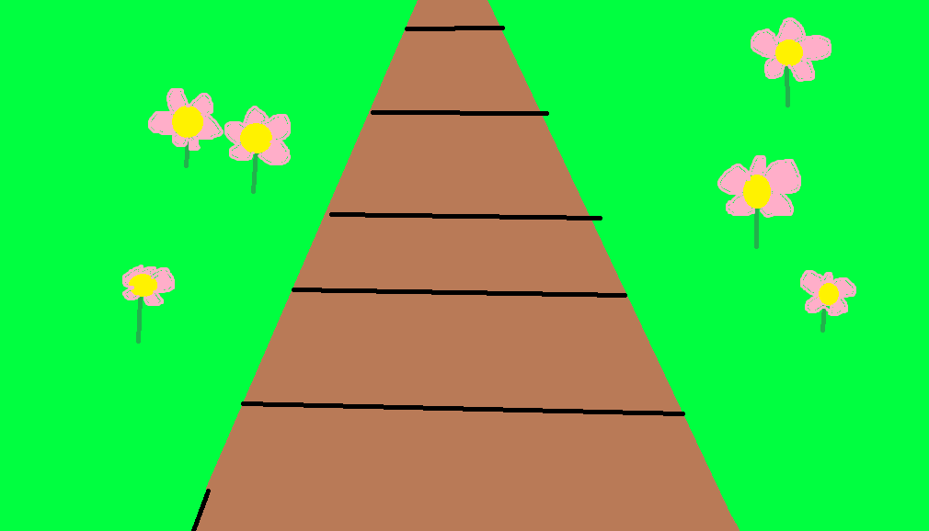
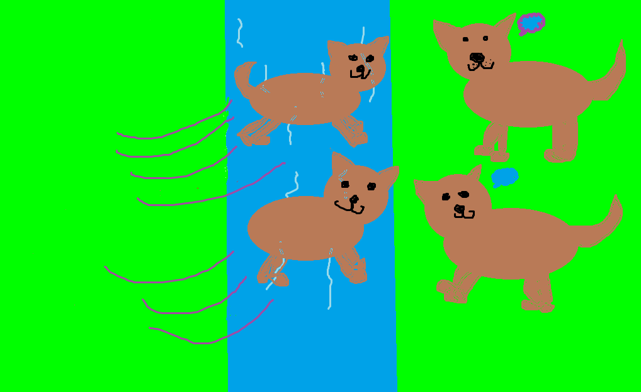
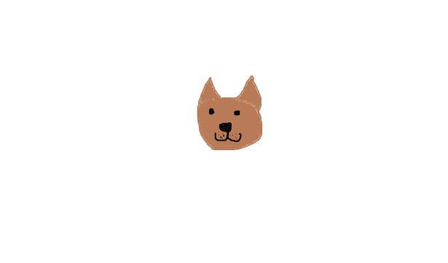
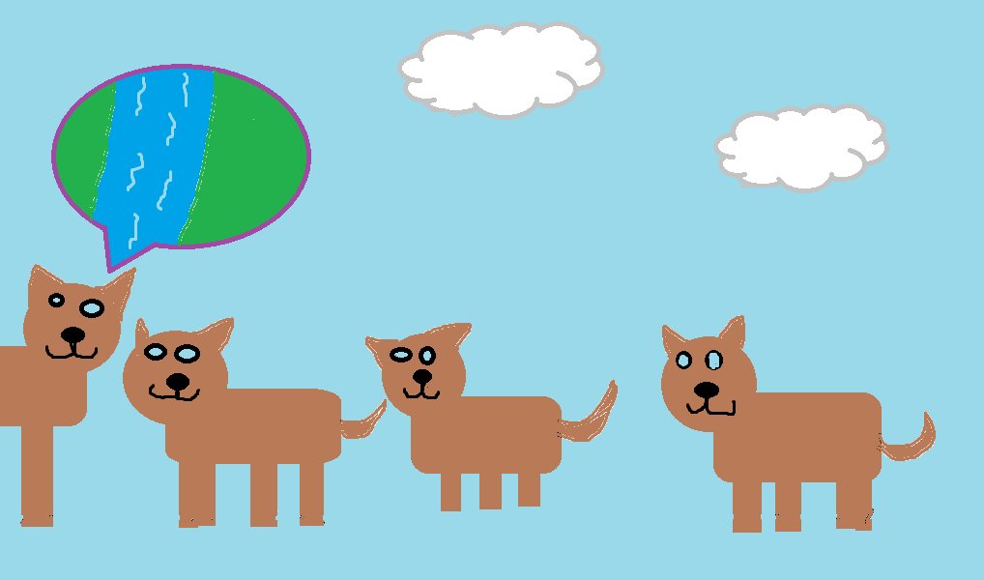
A Wolf Adventure
Author: Makaila
Published by:MAY_KAY_Time Publishing

Slide 3
Copy Right
©2015Makaila Chapman.
ISBN code 0-203-604-54321-4
This book can be used as examples, but cannot be printed or sold without Makaila’s permission.
Printed in Canada.
www.Gotothisawsomesite.com
Editor- Jamie Fehr.
42 Water Slide road.
Publisher: MAY_KAY_ Time Publishing.
Find a colour copy at www.gotothisawsomesite.com

Slide 4
Dedicated to Amaya the BEST book buddy ever!!!

Slide 5
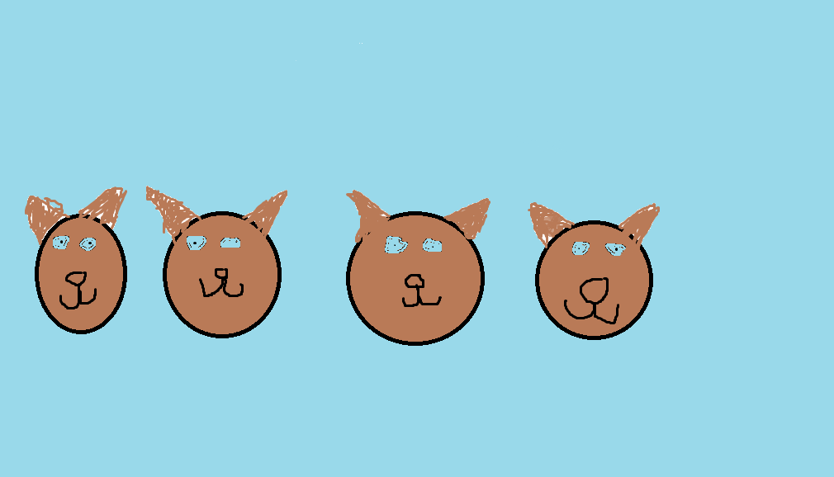
1
Once there were four baby wolves named Emma, Flash, Hunter, and Amaya.

Slide 6
2
One day they asked their mama, “Can we go on an adventure?’’

Slide 7
3
“ If you don’t go past the river,” said their mama. “ I don't want you to get hurt".

Slide 8
4
So the babies started their adventure.

Slide 9
5
They walked a little ways through the woods and came to the river.

Slide 10
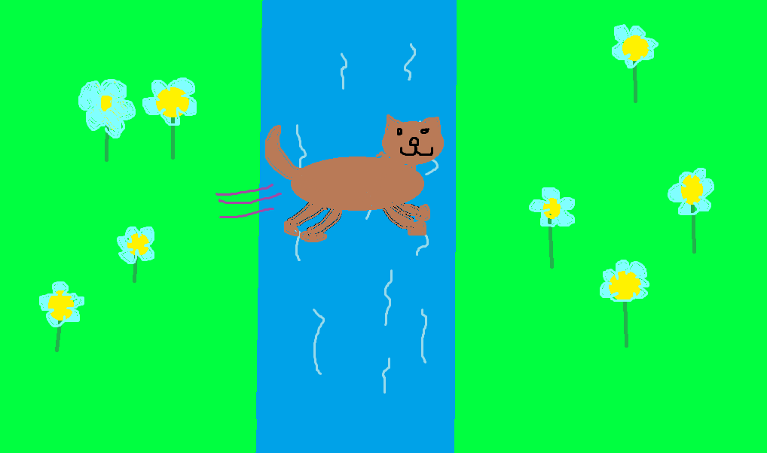
6
Then flash jumped over the river to the other side.

Slide 11
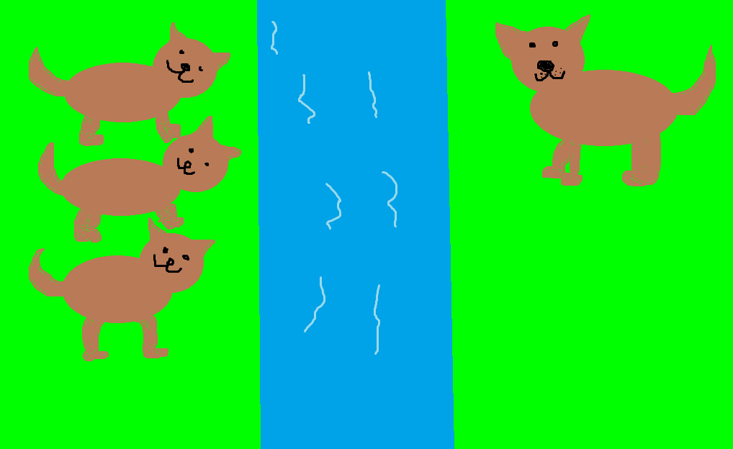
7
“ Come on you guys it’s cool on this side of the river,” said flash.

Slide 12
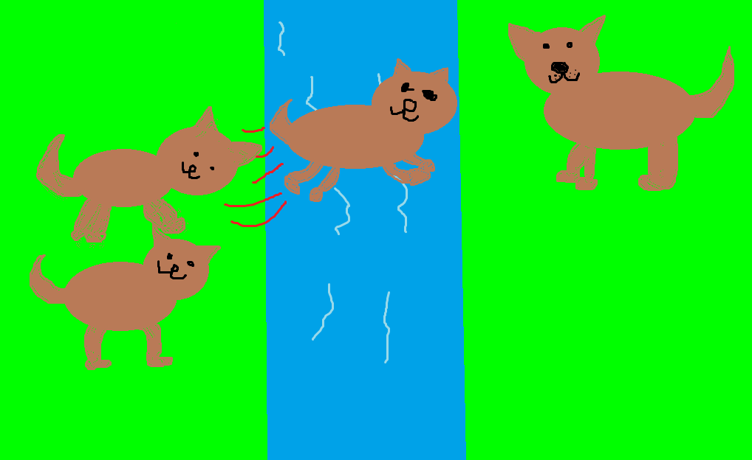
8
Then hunter jumped over the river too!!

Slide 13
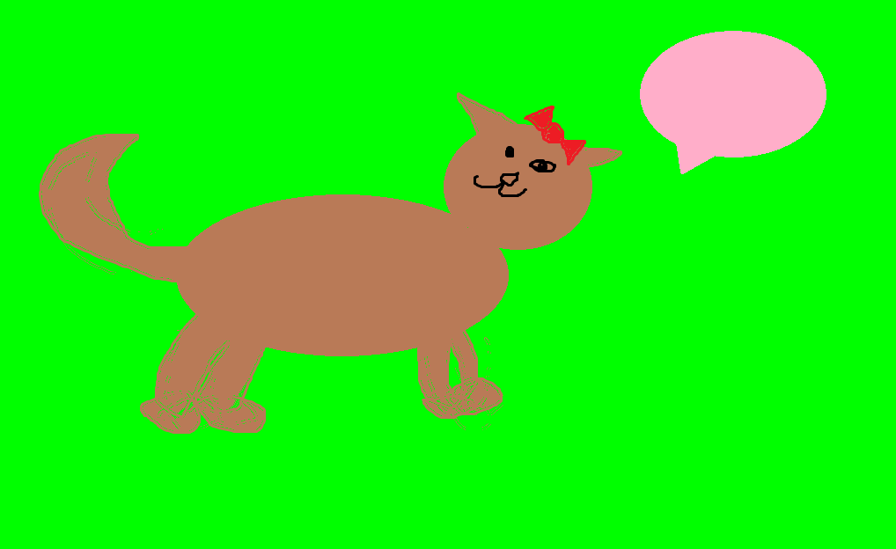
9
“Come back,” shouted Emma!
“Mama said not to past the river,” said Amaya.

Slide 14
10
“We won’t go very far, we’ll be fine,” said flash.
“Ok, but not too far,’’ said Emma.

Slide 15
11
So Emma and Amaya jumped over the river too!!

Slide 16
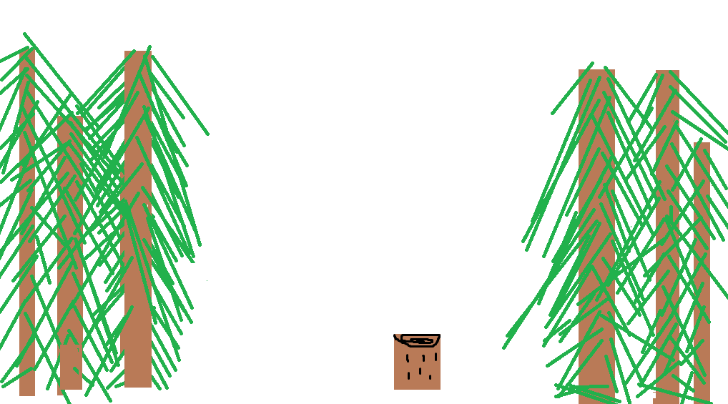
12
They walked for a few minutes and found a clearing in the woods.

Slide 17
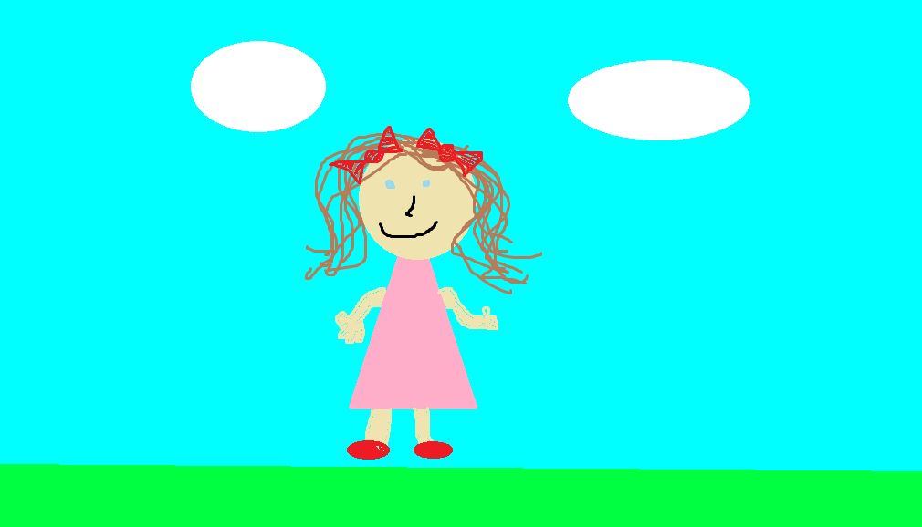
13
“Shhh, be quiet, there might be a HUMAN!’’ said Amaya.

Slide 18
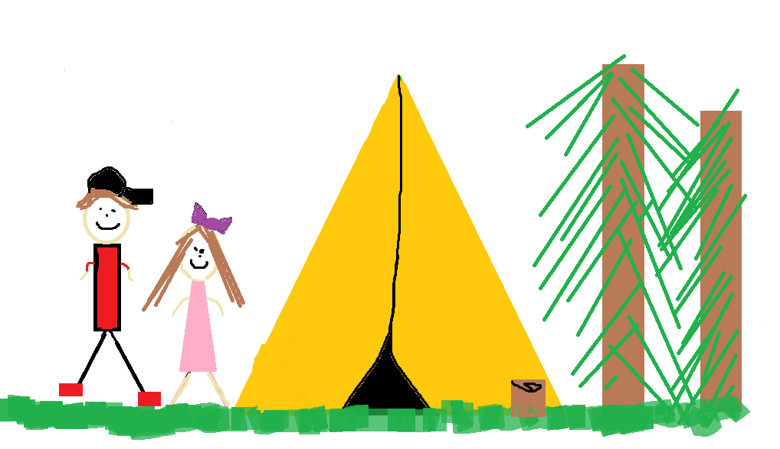
14
Then a little girl, a little boy, a mother, and a father came out of a tent.
The dad saw them and said, “Come here I won’t hurt you.’’

Slide 19
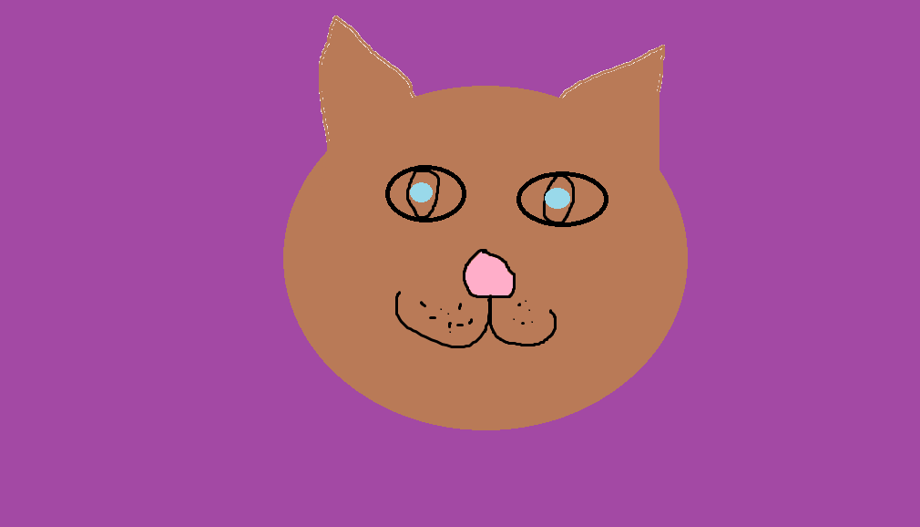
15
“Let’s go back to mama,” said Hunter.
The babies ran home to their mama.

Slide 20
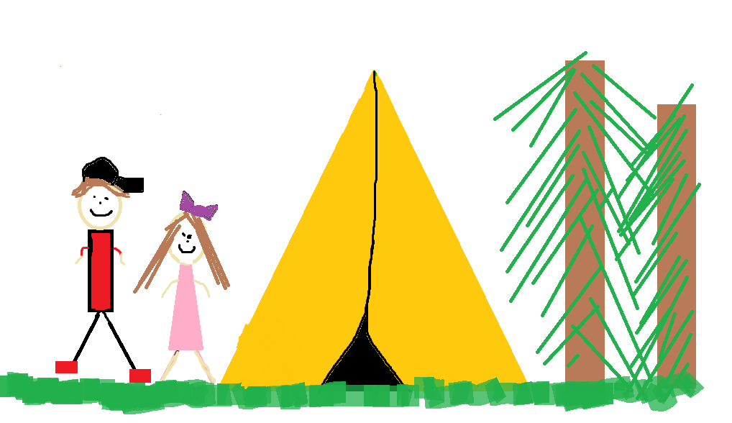
16
Then they took her to where they saw the humans.

Slide 21
Biography
Hi, my name is Makaila. I am 11 almost twelve. I live in Shelburne, Nova Scotia. I have one dog and two cats. I like to hang out with friends and[more]. I have grown up in Shelburne for most of my life. I have moved 8 times in my life. I have lived in Shelburne, Barrington, and Jordan Branch.

Slide 22
17
The dad called them all over to him.
The babies and their mama walked over to the dad and the dad gave them all a dog bone. They where all very happy and no longer afraid of humans.
The End

Slide 23
Reviews
Christina- It is a good book.
Brad- Good story and pictures.
Gabriel- Nice pictures.
Amiya- Nice book and pictures.
Caleb- Good book.

