Slide 1

The book about princesses

Slide 2

This book is dedicated to Katelyn for being the best book buddy ever!

Slide 3
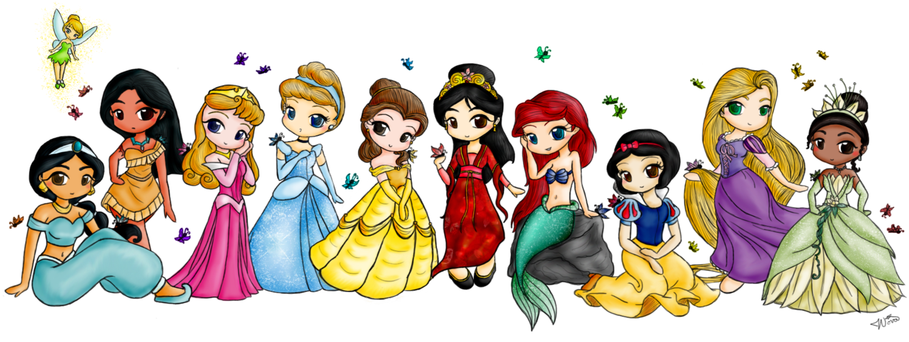
The Book About Princesses
Author-jasmine Nickerson
Publisher-desirae Nickerson

Slide 4
COPYRIGHT©
copyright©2015 by Jasmine Nickerson
All rights reserved. No part of this publication may be reproduced, distributed, or transmitted in any form or by any means, including photocopying, recording, or other electronic or mechanical methods, without the prior written permission of the publisher, except in the case of brief quotations embodied in critical reviews and certain other non-commercial uses permitted by copyright law. For permission requests write to the publisher, addressed “Attention: Permissions Coordinator,” at the address below.
The book about princesses
27 Winslow's Rd.
Ns,canada
www.princess books.com
ISBN 0-203-6-15-12345-3
Editor:Desirae Nickerson find your colour copy at the homework page ☺

Slide 6


Slide 7
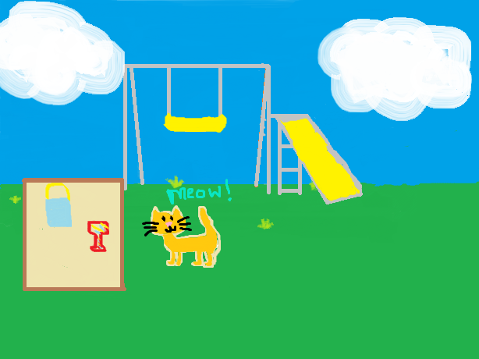

Slide 8
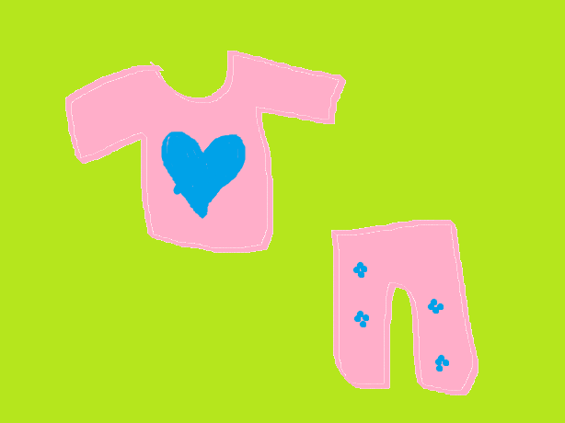

Slide 9


Slide 10
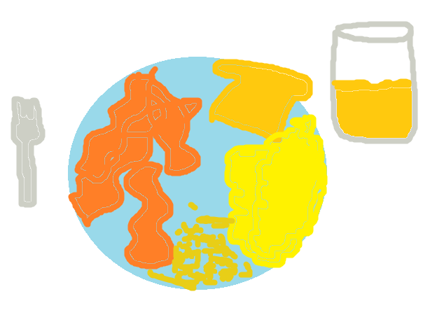

Slide 12


Slide 15


Slide 16
About the author
Full name: Jasmine Suzanna Mae Nickerson
· Date and place of birth:Yarmouth Regional Hospital, 6/25/03
Family information: family of 3 brothers and 1 sister
What you like to do at home and school: draw pictures
People and things that are important to you: my best friends, family, and pets
Acaccomplishments: finishing this book in time
Major events of life: growing up
What your ambitions are: to become an artist

Slide 17
Review page
Desirae: AWESOME!
Jessica: a really good book
Bella: a good book
Maddy: a good book
Kennedie: awesome!

