Slide 1
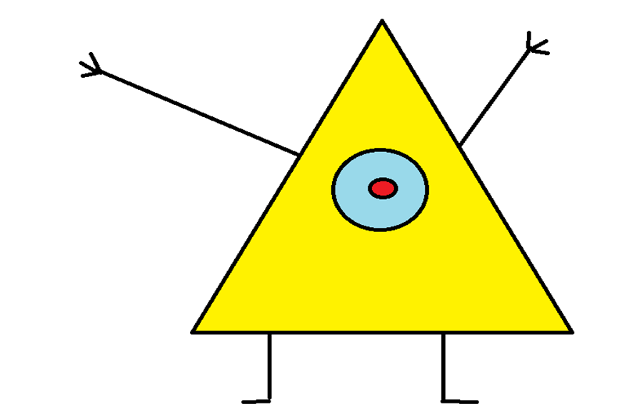
ILLUMINATI’S FIRST TRIP TO THE LIZARD BASE
By Aidan
Trelor
Published by Lonely Badger Press

Slide 2
ILLUMINATI’S FIRST TRIP TO THE LIZARD BASE
By Aidan Treloar
Published by Lonely Badger Press

Slide 3
Copyright
© 2015 Aidan Treloar
Disclaimer I do not own the rights to “Mountain Dew” or “Doritos“ they all belong to Pepsi.
© all rights reserved. This book shall not be copied or distributed without the express written consent of AidanR.T.Holmes.
The Lonely Badger Press
360 Hollow Street, PO box 12342 Sydney Australia
www.Aidanisnumber1.com (ISBN 0-203-623-111-118)
EDITOR :MASON SPERRY

Slide 4
This book is dedicated to Jaden,
the best book buddy ever

Slide 5
Once upon a time there was a Dorito shaped boy named Illuminati.

Slide 6
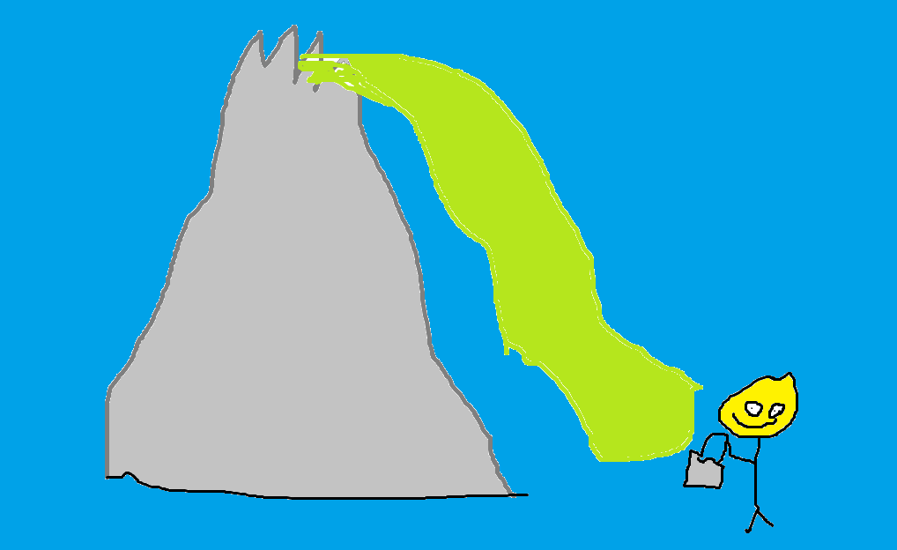
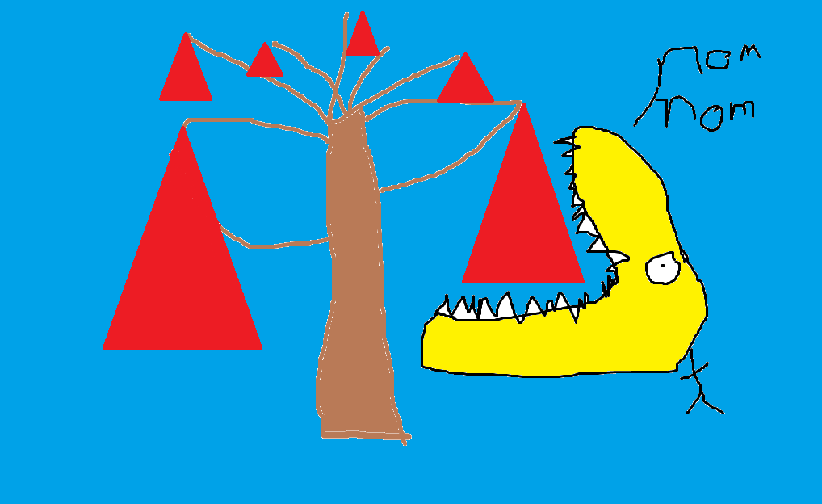
His mom told him about the lizard base. He really wanted to go, ever since he heard about the Mountain Dew waterfall and the Dorito trees.

Slide 7
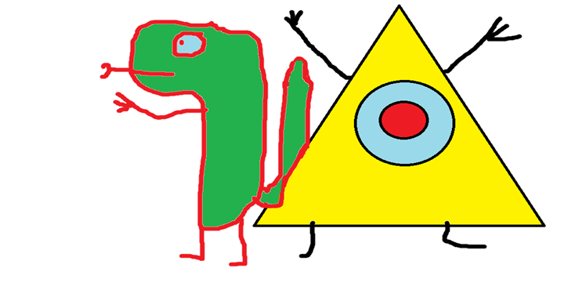
Illuminati and his lizard best friend wanted to go to this mystical land.

Slide 8
His best friend was a lizard named Tomato. He asked Illuminati if he wanted to go to the lizard base.
Illuminati said, "YES!!!!!!!!!”
He asked his mom if he could go to the lizard base.
his mom said, “Yes but be careful”.
“ AWESOME!!!!!”Said Illuminati.

Slide 9
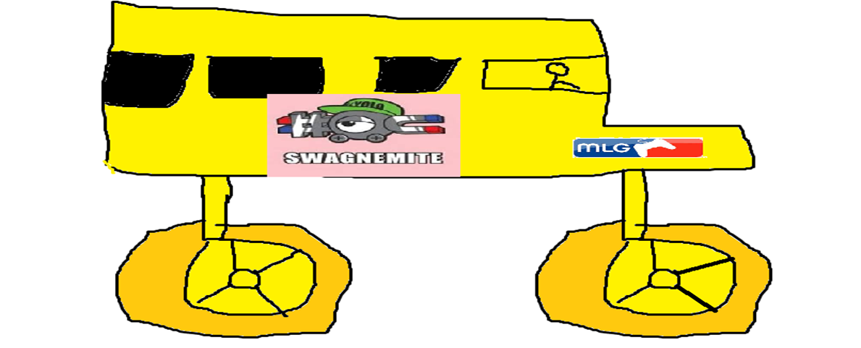
Then he got on the lizard bus with Tomato and they got to the lizard base.

Slide 10
When they got off the bus they both said “ WOW!” At the same time.

Slide 11
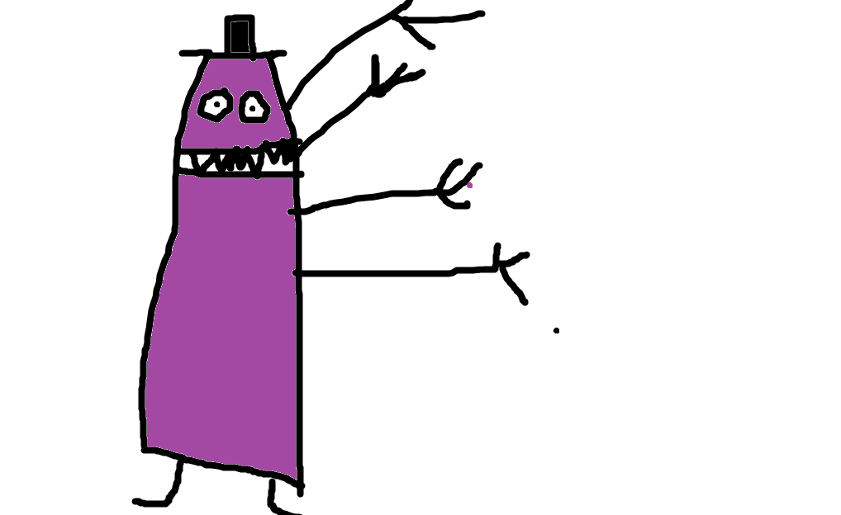
Every thing was fine while they were eating Doritos and drinking Mountain Dew then a scary monster jumped at them and chased them.

Slide 12
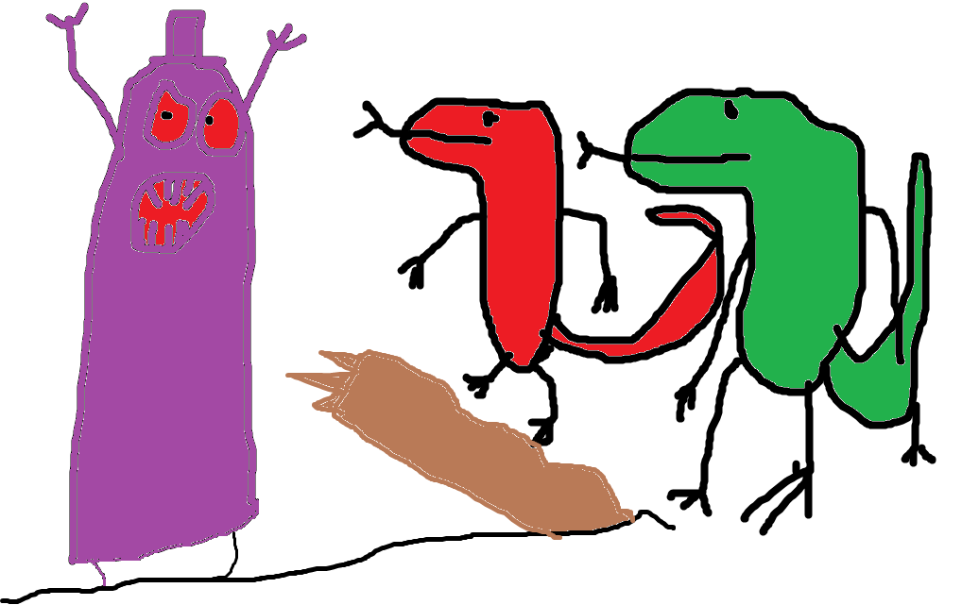
Then the lizard squad came and rescued them. They said thanks for rescuing them.

Slide 13
Then on the bus ride back they talked about how much fun the trip was. Illuminati said good bye to Tomato when he went home.

Slide 14
His mom asked, “How did the trip go?”.
“AWESOME!!!!!!” said Illuminati.

Slide 15
The end

Slide 16
Color copy
http://tcdsbstaff.ednet.ns.ca/scroache/

Slide 17
Author biography
Aidan Treloar
Born February 1st 2003 in Bridgewater N.S.
I enjoy video games and science.
One of my major accomplishments was making it to the 2013 Science Olympics.
One day I hope I'll be a video game developer.

Slide 18
Comments
“It was good, I liked the monster.” – Mason
“It was great.”-Isaac
“It was good!!!” - Jesse
“It was colourful, I liked it.”- Caleb
“It was a good book for Jaden.”- Christina

