Slide 1
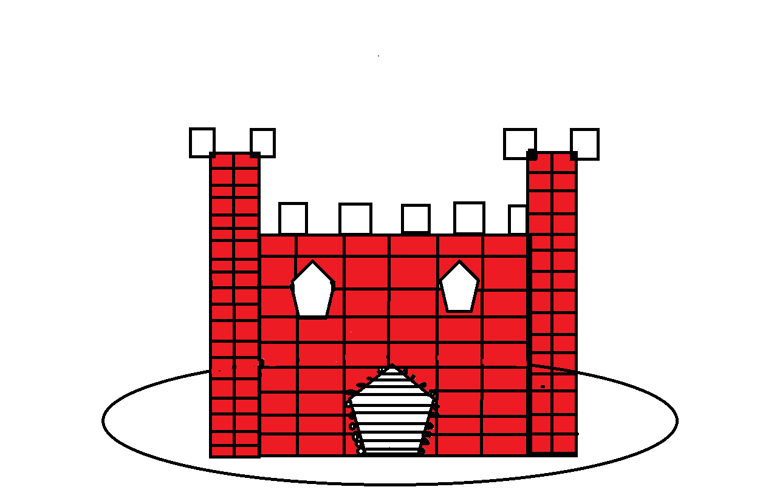
St. Clair, The King
By J.T Urquhart

Slide 2
Copyright
Copyright © 2015 By: J.T Urquhart
Do not wreak this book
Printed in Nova Scotia Canada
First Printing 2015
JT’s Awesome publishing 456 pug st
JT`sAwesomePublishing.com
Editor-

Slide 3
Once upon a time there was a king named St. Clair. Their servants names were JT and Lucas. They lived in a big stone castle. There is a moat around the castle. So the EVIL knights don’t get in the castle.

Slide 4
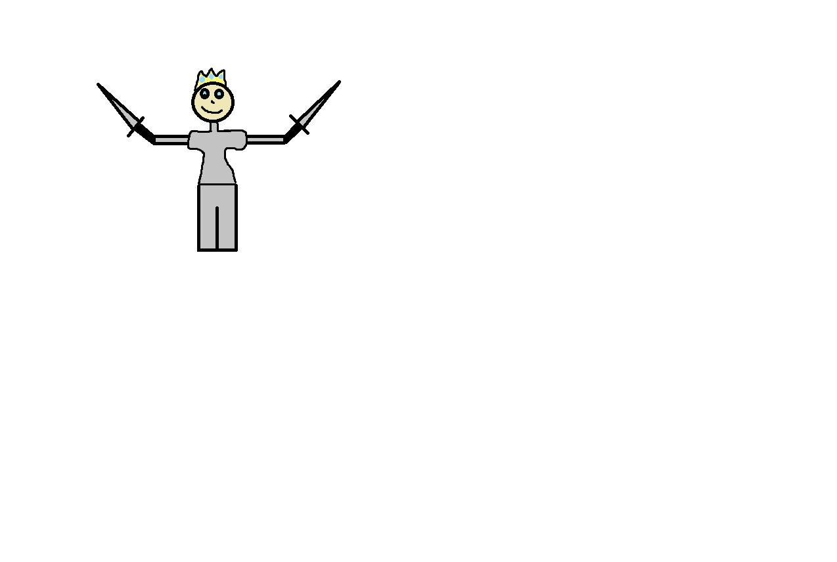
The Kings knights were not with them. So the King had to protect the Queen. JT and Lucas were way behind them.

Slide 5
And they heard the EVIL knights. So they ran to the castle. So they could get a army for battle.

Slide 6
So they got a army ready for battle. They ran and ran in till they got to the King and Queen. They had to save the King and Queen.

Slide 7
And they did save the King and Queen. But one of the EVIL knights. Was still alive and he came running at the King but one of the Kings knights saw and jumped in front of the King and saved him.

Slide 8
And then JT and Lucas ran up and captured the EVIL knight in the heart. So they went to the castle and prayed. For one of his best knights who sacrificed his life for the King. So the King and Queen ended up having two Babies. One boy and one girl. So the King and Queen and the good knights had a party for the great knight.

Slide 9
As the years go by the prince and princess grew up in the beautiful grounds surrounding the castle.

Slide 10
The King and Queen and Prince and Princess rode off in to the sunset But trust me the WAR is far from OVER.

