Slide 1
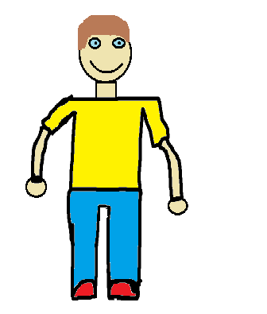
St. Clair’s
Big
Surprise
By: Lucas Williams

Slide 2
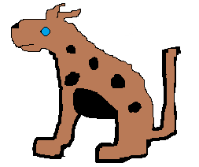
ST. CLAIR’S
BIG
SUPRISE
Lucas publishing company
By: Lucas Williams

Slide 3
© 2015 Lucas Williams
All Rights Reserved
21 Yolo writing
Printed in Canada
2169 Yolo St. Jamaica
www.Yolobro.com
Phone 692-1911
Fax 213-223
1121 Williams St.
ISBN 0-203-626-11235-9
Year published 2015
Editor Aiden
second Editor Caleb
You can fiend a collared copy at http://www.hillcrest.ednet.ns.ca/main.php

Slide 4
DEDICATION
I dedicate this book to the coolest book buddy ever St. Clair. He is the best at reading in grade
primary I have ever seen.
☺

Slide 5
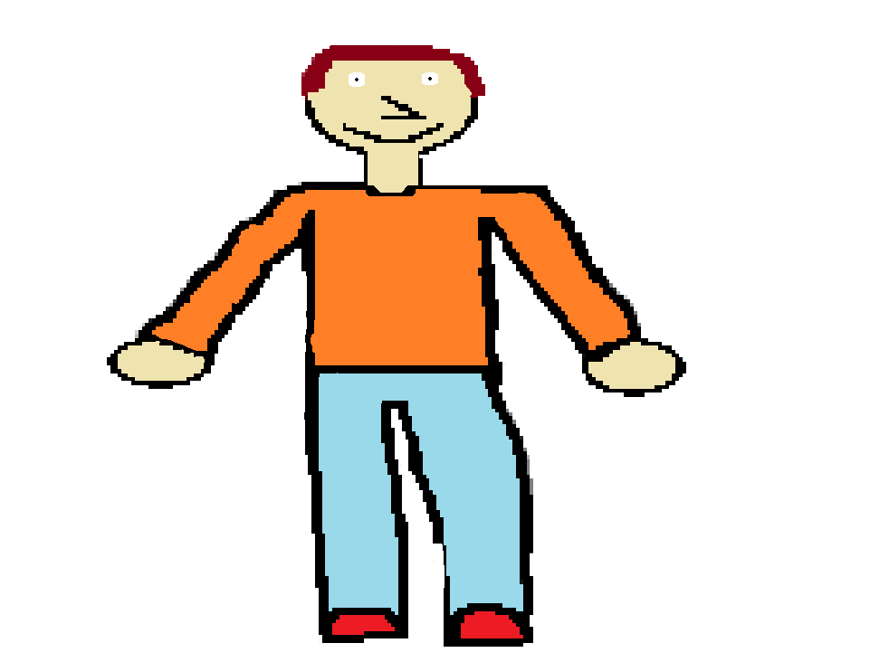
St. Clair had always wanted a dog. He decided he would ask his parents for a dog one last time.
1

Slide 6
His parents told him if he had a dog he would be responsible to feed him and take him for walks every day. St. Clair “promised” to do all of these things.
2

Slide 7
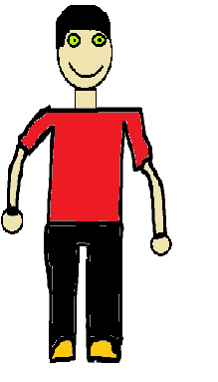
The next day St. Clair went to school and told his friend Lucas that he may be getting a dog. Lucas was very happy for him.
3

Slide 8
After school St. Clair went home. When he walked in his house his parents told him there was something in the garage they wanted to show him.
4

Slide 9
When he opened the garage door he saw a small black and brown puppy. He was very surprised! He didn’t think it would happen so soon.
5

Slide 10
The puppy started running at St. Clair , then tripped and landed right on him. His parents told him to name it. So St. Clair said, “Bob”.
6

Slide 11
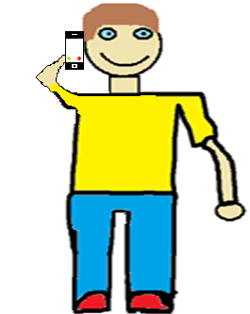
St. Clair called Lucas right away to tell him that he had a new puppy and to invite him over after school the next day to meet him.
7

Slide 12
The next day Lucas went over to St. Clair’s house to meet Bob. Bob was sitting by the door waiting to go for a walk.
8

Slide 13
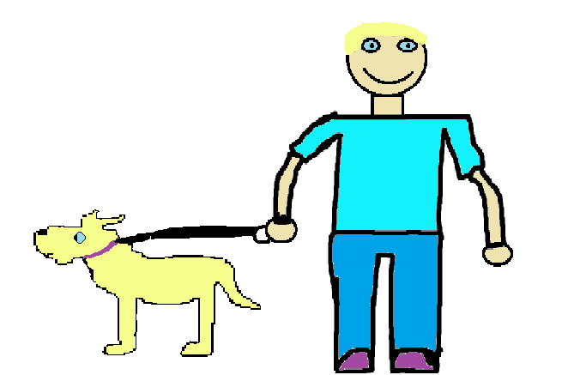
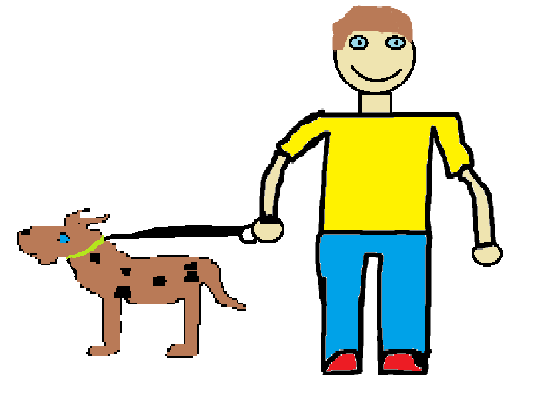
When they took Bob for a walk they met another dog named Joe and a boy named Fred and they played for a long time.
9

Slide 14
So Luke and St. Clair walked Bob every day from then on.
10

Slide 15
autobiography
My name is Lucas Michael Williams. I was born in April 23, 2003. I lives in Shelburne, Nova Scotia. I have two sisters, Halle and Mackenzie. I love to play basketball. My favorite food is pizza. My closest friends are Xiander Shand, Ryan O’Callaghan and Caleb Demings.

Slide 16
Comments
Ryan: It was a good book.
Dylan: It was a very good book.
Isaac: An awesome story.
Xiander: The story was funny and the pictures were good.☺
Gabriel: You did a Good job.

