Slide 1
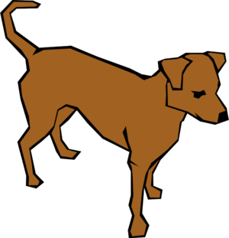
Where’s Charbel?
By Ryan O’Callaghan

Slide 2
Dedication
This book is dedicated to Charbel Chidiac the best book buddy ever.

Slide 3
Where’s Charbel?
Author: Ryan O’Callaghan
Illustrator: Ryan O’Callaghan
Publisher: Ryan O’Callaghan

Slide 4
Copyright
© 2015 Ryan O’Callaghan
All Rights Reserved Do Not Damage Unless Ryan Gives Permission. This Book May Be Reproduced By Charbel.
TheGreenWallLTD
Address: Shelburne, Nova Scotia
Phone: 999-9876
Fax: 888-8765
www.thegreenwall.com
ISBN 0-203-617-12345-3
First Editor: Xiander Shand
Second Editor: Caleb Demings

Slide 5
Once there were three animals named Charbel the Dog, Jacob the Sheep and Fred the Chicken. The three animals went outside to play hide and seek, but they couldn’t find Charbel.

Slide 6
Jacob and Fred started to look for Charbel in the woods until they heard a noise. “Is that Charbel?” “No, that’s just Marvin the Crow.”

Slide 7
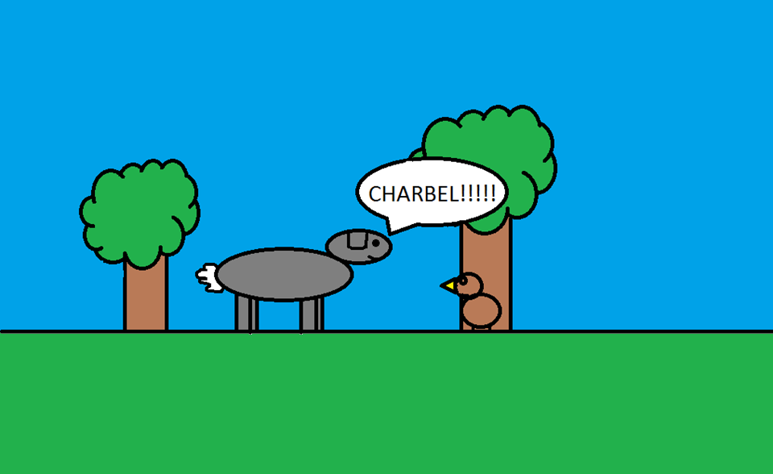
They kept walking until they heard another noise. “Is that Charbel?” “No, that’s just Steve the squirrel.”

Slide 8
They heard another noise while walking through the woods and by a river “Is that Charbel?” “No, its just Lucas the turtle.”

Slide 9
Fred and Jacob continued to walk through the woods until they heard another noise “Is that Charbel?” “No, that’s just Caleb the Frog.”

Slide 10
The two friends continued to walk through the woods until they heard another noise “Is that Charbel?” “No, that’s just Xiander the Monkey”

Slide 11
They kept walking until they heard another noise “Is that Charbel?” “No, that’s just Mark the Snake.”

Slide 12
The two animals kept on searching for their lost friend but still couldn’t find him.

Slide 13
Jacob and Fred where getting really tired now and decided to yell Charbel’s name one last time. “CHARBEL!” screamed Jacob.

Slide 14
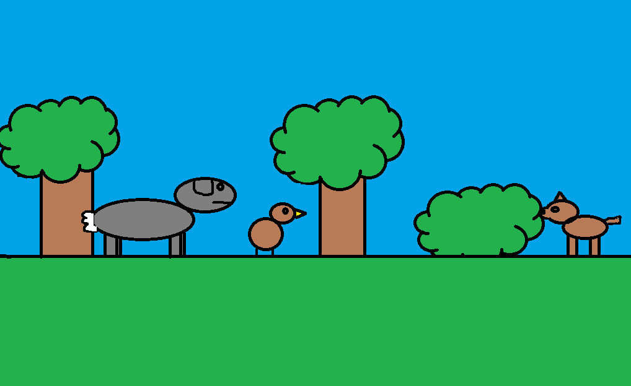
Jacob and Fred heard a rustling in the bush, Charbel came walking out of the bush. “Where were you?” “We were playing hide and seek weren’t we?” said Charbel.

Slide 15
About the Author
My name is Ryan Michael O’Callaghan, I am 12 years old and like to play sports like hockey, soccer, basketball and baseball. One of my major accomplishments was playing hockey for the Nova Scotia team in 2009 and 2010.

Slide 16
Comments
Lucas: It was funny.
Xiander: I like the book and think Charbel will like it too.☺
Peter: Charbel will like this book. AWESOME☺!!!!!!!!!!!!!!!!!!!!!!!!!!!!!!!!!!!!!!!!!!!!!!!!!!!!!!
Mason: You need more pages.
Isaac: Like a boss.

