Slide 1
Christmas in Mexico
BY:AARON DESCHAMP

Slide 2
Christmas is celebrate on
Christmas in Mexico is a religious holiday season with a series of ancient celebration in commemoration of the birthday of Jesus Christ. Mexicans prepare nine days of consecutive symbolic tribute called ‘Posadas’ starting on 16th December and ending on 24th December , a holy night.
The Posadas is a local cultural tradition which is basically a performance of small children recreating the scene when St.Joseph and virgin Mary were looking for accommodation in Bethlehem at the time of Jesusbirth.
SANTA.NET

Slide 3
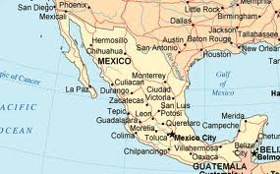
POPULATION
This is the population of Mexico. 112,336,538 – 2010 GOOGLE.CA

Slide 4
The main language
According to the Commission for the Development of Indigenous Peoples (CDI) and National Institute of Indigenous Languages (INALI), while 10–14% of the population identifies as belonging to an indigenous group, only around 6% speak an indigenous language.
If they did they and they wanted to say Merry Christmas they would say Felix Naiad a . GOOGLE.CA

Slide 5
The food they eat on Christmas
Special treat of “Roscade Reyes” which is a crown shaped sweet bread decorated with candies and fruit is served on this day.
After the prayers, party time starts. The children are sev
ed with pinata a type of ballon that releases peanuts, saNTA net

Slide 6
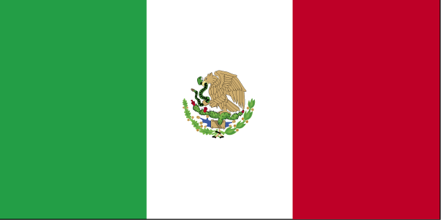
Flag of Mexico GOOGLE.CA

Slide 7
bibliography
medicaltourismco.com
bestcountryreports.com
urban in urbanministry.org istry.org
answers.ask.com › All › Society
ehow.com
en.wikipedia.org/wiki/Languages_of_Mexico
Google.ca

Slide 8
bibliography
http://www.mexconnect.com/articles/633-a-christmas-tree-in-mexico
coopernundrums.com

Slide 9
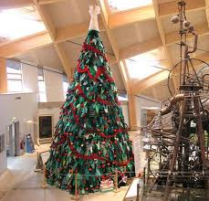
When we first came to Mexico, I couldn't imagine any substitute for a real Christmas tree. Even 30 years ago. Google.ca

Slide 10
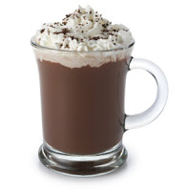
CHRISTMAS RECIPES
Start your Christmas morning with a warm mug of Mexican hot chocolate, a richer, spicier version of the American package of hot cocoa. Traditional Mexican hot chocolate is made with Mexican chocolate, a spicy type of chocolate that exudes cacao, almond and cinnamon flavors. Whisking melted Mexican chocolate with milk or cream and flavoring it with a pinch of cayenne or chili powder makes one eye-opening Christmas morning treat. Google.ca

Slide 11
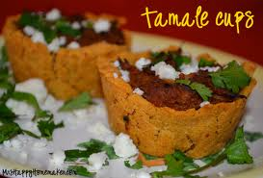
Tamales
Succulent, spicy pork tamales were a Christmas tradition in my family. We gathered together and made dozens of them assembly-line style as a way to celebrate the holidays and spend delicious quality time together. Tamales can be made savory or sweet. Savory tamales can be filled with pork, chicken or beef, while sweet tamales are irresistible when made with nuts, dried fruit and chocolate. Goole.ca

Slide 12
Christmas is celebrated
In Mexico Christmas is not just a single day, but a whole season of Christmas-related celebrations which stretches from December 16th through February 2nd. Gift-giving is done on January 6th (the day which marks the visit of the three kings to Jesus in the manger), and is not as important as time spent with family and religious celebrations. Goole.ca

