Slide 1
CHRISTMAS IN HONG KONG
BY TAYLOR GOODICK

Slide 2
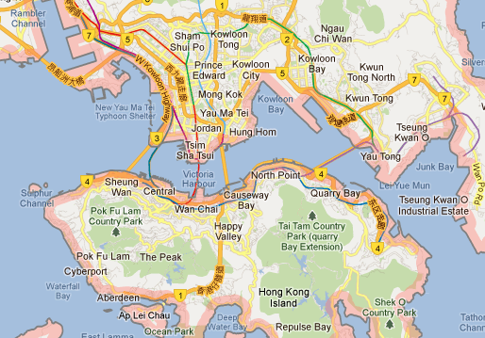
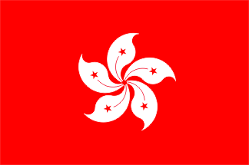
HONG KONG FLAG, POPULATION,MAP
POPULATION: 7.1 MILLION IN 2011.
The map of HONG KONG The flag of Hong
The map of Hong Kong The flag of Hong
Kong
http://www.tradingeconomics.com/hong-kong/population : population
http://www.crwflags.com/fotw/flags/hk.html: flag
http://www.google.ca/imgres?q=hong+kong+maps+2012&um=1&hl=en&safe: Map

Slide 3
Main Language
The main languages in Hong Kong are English and Chinese.
How to say merry Christmas in Hong Kong:
sing dan fiy loc
http://en.wikipedia.org/wiki/Main_Page : language
Did You Know?: How to say Merry Christmas in Different Languages: say merry Christmas.

Slide 4
Christmas tree
They have their Christmas tree decorated it with toys. They have tree a spruce .
http://1.bp.blogspot.com/-2zY_LhvMCzI/TvdtnQj2bOI/AAAAAAAAA0o/SVYrJx1Hqjc/s1600/Toy+Story+Christmas+Tree+Hong+Kong.jpg

Slide 5
Santa Claus
He the is same as here, fat and jolly with a white beard, loves cookies and milk.
http://www.luxury-insider.com/events/276/pacific-place-presents-photo-taking-with-santa-claus

Slide 6
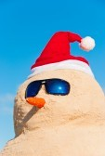
Christmas Characters
The only character is Santa Claus/ father Christmas and a snowman.
http://www.whychristmas.com/cultures/hongkong.shtml character
http://www.123rf.com/photo_9948412_birds-eye-view-on-snowman-with-sunnglasses-and-carrot-nose-on-beach.html picture

Slide 7
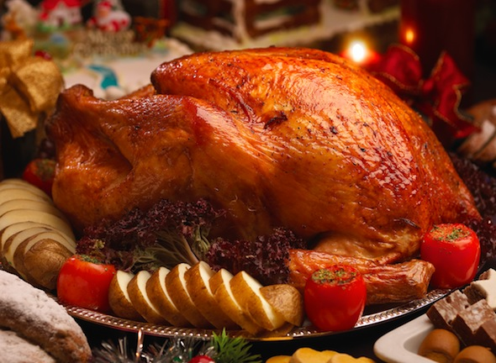
Traditional food
The Christmas food in Hong Kong is turkey and potatoes.
http://sassyhongkong.com/christmas-dinner-in-hk-eating-in-2012/-food.

Slide 8
Good and Bad
I couldn’t find anything for this.

Slide 9
What are some things about how Christmas is celebrated In Hong Kong
In Hong Kong, Chinese Christians celebrate
Christmas with Church services in Chinese.
http://www.whychristmas.com/cultures/hongkong.shtml

Slide 10
Bibliography
http://www.whychristmas.com/cultures/hongkong.shtml
ht http://www.whychristmas.com/cultures/hongkong.shtml tp://s
http://www.123rf.com/photo_9948412_birds-eye-view-on-snowman-with-sunnglasses-and-carrot-nose-on-beach.html assyhongkong.com/christmas-dinner-in-hk-eating-in-2012
http://www.luxury-insider.com/events/276/pacific-place-presents-photo-taking-with-santa-claus
http://en.wikipedia.org/wiki/Main_Page
Did You Know?: How to say Merry Christmas in Different Languages
http://www.tradingeconomics.com/hong-kong/population
http://www.crwflags.com/fotw/flags/hk.html
http://www.google.ca/imgres?q=hong+kong+maps+2012&um=1&hl=en&safe
http://1.bp.blogspot.com/-2zY_LhvMCzI/TvdtnQj2bOI/AAAAAAAAA0o/SVYrJx1Hqjc/s1600/Toy+Story+Christmas+Tree+Hong+Kong.jpg

