Slide 1
Christmas in England
By: Matthew Hicks
http://tcdsbstaff.ednet.ns.ca/scroache/homework_for_mr.htm

Slide 2
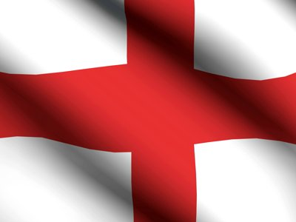
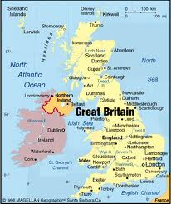
Population, flag and map.
The population of England is 53 013 000 (as of 2011).
The flag of England. →
This is a map of England.→
http:/www.google.ca/imgres?q=flag+of+England&num=10&hl=en&tbo=d&biw=1024&bih=571&tbm=isch&tbnid=DF_OnGCuhyYkSM:&imgrefurl=http://footage.shutterstock.com/clip-1090876-stock-footage-national-flags-england.html&docid=LeQpYN-V2YMDkM&imgurl=http://ak6.picdn.net/shutterstock/videos/775492/preview/stock-footage-flag-of-england-in-the-wind.jpg&w=400&h=300&ei=zcHIULWyEu-n0AGglYCQBw&zoom=1&iact=hc&vpx=718&vpy=242&dur=219&hovh=194&hovw=259&tx=142&ty=149&sig=104564242458030780668&page=2&tbnh=146&tbnw=195&start=15&ndsp=20&ved=1t:429,r:24,s:0,i:227
/
http://www.google.ca/imgres?q=map+of+England&num=10&hl=en&safe=active&biw=1024&bih=571&tbm=isch&tbnid=Wn9dmm3D6YaCoM:&imgrefurl=http://powayusd.sdcoe.k12.ca.us/online/Britlit/pages/march_31.htm&docid=IIjZ6WlsJCy1IM&imgurl=http://powayusd.sdcoe.k12.ca.us/online/Britlit/images/map_england.jpg&w=364&h=432&ei=8C2lUNuHComy0QGNhIHYAQ&zoom=1&iact=hc&vpx=88&vpy=191&dur=1766&hovh=245&hovw=206&tx=79&ty=273&sig=103013752813533206908&page=1&tbnh=125&tbnw=106&start=0&ndsp=22&ved=1t:429,r:14,s:0,i:114
← Map

Slide 3
Day that the is celebrate Christmas.
The day that people celebrate Christmas in England is December 25.
http://tcdsbstaff.ednet.ns.ca/scroache/homework_for_mr.htm

Slide 4
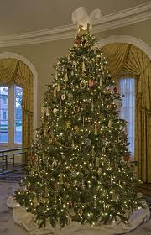
Christmas trees.
In England most families put up a Christmas tree (or two!)They enjoy decorating there Christmas trees and trimming the tree.
hl=en&sa=N&tbo=d&biw=1024&bih=571&tbm=isch&tbnid=fWJ00WK_YJwKkM:&imgrefurl=http://www.happywink.org/christmas-day/christmas-tree-decorations.html&docid=VX6O3unOPqYNyM&imgurl=http://www.happywink.org/christmas-day/gifs/christmas-tree-decor.jpg&w=175&h=243&ei=Noe_UOmKK5GH0QGT64DQAQ&zoom=1&iact=rc&dur=94&sig=104564242458030780668&page=1&tbnh=

Slide 5
Food.
In England most family’s have a Christmas dinner around midday on Christmas day. For the dinner they have Bacon, Pigs in a blanket(sausages rapped in bacon) Chestnut stuffing, Turkey, Roast Potatoes , Bread sauce, gravy, Roasted chestnuts, Cranberry sauce, Brussel Sprouts, Parsnips.
http://resources.woodlands-junior.kent.sch.uk/customs/xmas/dinner.html

Slide 6
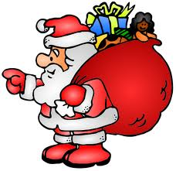
Santa Claus.
In England they call Santa Santa Claus or St Nick. He wears a red suit and has a big red bag full of toys for the good kids.
http://www.webweaver.nu/clipart/christmas-santa2.shtml

Slide 7
Christmas characters in England
The main Christmas character in England is Santa Claus.
http://www.webweaver.nu/clipart/christmas-santa2.shtml

Slide 8
What do kids get for Christmas in England?
In England Bad kids get a lump of coal.
In England the good kids get presents.
http://henrythefrog.blogspot.ca/2008/12/to-pile-on-or-not-to-pile-on.html

Slide 9
Unique things about Christmas in England
Did you know that most family’s put one or two Christmas trees.
Did you know that the kids in England don’t just call Santa Claus they call him St.Nick also.

Slide 10
bibliography
http://www.google.ca/imgres?q=England+flag&um=1&hl=en&safe=active&rls=com.microsoft:en-us&biw=1024&bih=571&tbm=isch&tbnid=2xjkQPZtdHe8QM:&imgrefurl=http://addickschampionshipdiary.blogspot.com/2010_06_01_archive.html&docid=-NmAinGA79TnBM&imgurl=http://2.bp.blogspot.com/_VCV8ElAP6xE/TCbzOAG9AuI/AAAAAAAAAag/oTP8CGk-RUA/s1600/england-flag-wallpaper.jpg&w=800&h=600&ei=EhSlULzqK8ur0AHI8YCwBw&zoom=1&iact=rc&dur=250&sig=105690093393943070599&page=1&tbnh=113&tbnw=157&start=0&ndsp=15&ved=1t:429,r:10,s:0,i:99&tx=86&ty=45
docid=9XEUhPMf9jHl2M&imgurl=http://epltalk.com/wp-content/uploads/2010/04/england-flag2.jpg&w=401&h=400&ei=qTOlUImKMeWC0QGZxoDgBA&zoom=1&iact=hc&vpx=499&vpy=199&dur=1438&hovh=224&hovw=225&tx=100&ty=251&sig=113956455064653782226&page=1&tbnh=115&tbnw=115&start=0&ndsp=16&ved=1t:429,r:13,s:0,i:108
http://www.whychristmas.com/cultures/uk.shtml
http://tcdsbstaff.ednet.ns.ca/scroache/homework_for_mr.htm
http:/www.google.ca/imgres?q=flag+of+England&num=10&hl=en&tbo=d&biw=1024&bih=571&tbm=isch&tbnid=DF_OnGCuhyYkSM:&imgrefurl=http://footage.shutterstock.com/clip-1090876-stock-footage-national-flags-england.html&docid=LeQpYN-V2YMDkM&imgurl=http://ak6.picdn.net/shutterstock/videos/775492/preview/stock-footage-flag-of-england-in-the-wind.jpg&w=400&h=300&ei=zcHIULWyEu-n0AGglYCQBw&zoom=1&iact=hc&vpx=718&vpy=242&dur=219&hovh=194&hovw=259&tx=142&ty=149&sig=104564242458030780668&page=2&tbnh=146&tbnw=195&start=15&ndsp=20&ved=1t:429,r:24,s:0,i:227
http://henrythefrog.blogspot.ca/2008/12/to-pile-on-or-not-to-pile-on.html

