Slide 1
CHRISTMAS IN RUSSIA
By: KOBE JACKLYN

Slide 2
Flag Of Russia
The Russian flag is red on bottom , blue in the middle and white on top. It was first made in 1923
http://toptravellists.net/russian-flag-wallpaper.html

Slide 3
Map Of Russia
http://www.google.ca/imgres?q=map+of+russia&um=1&hl=en&safe=active&sa=N&rls=com.microsoft:en-

Slide 4
Date That Christmas Is Celebrated
In Russia Christmas is celebrated on either December 25th or January 7th .
https://www.cia.gov/search?q=russian+population&site=WORLD_FACTBOOK&btnG=Search&output=xml_no_dtd&client=CIA&myAction=%2Fsearch&proxystylesheet=CIA&submitMethod=get&x=16&y=7&sort=date%3AD%3AL%3Ad1&oe=UTF-8&ie=UTF-8&ud=1&exclude_apps=1
http://www.soon.org.uk/en/articles/christmas/around-the-world.html

Slide 5
POPULATION
The population in Russia in 2012 is 300,0000 .
https://www.cia.gov/search?q=russian+population&site=WORLD_FACTBOOK&btnG=Search&output=xml_no_dtd&client=CIA&myAction=%2Fsearch&proxystylesheet=CIA&submitMethod=get&x=16&y=7&sort=date%3AD%3AL%3Ad1&oe=UTF-8&ie=UTF-8&ud=1&exclude_apps=1

Slide 6
LANGUAGE IN RUSSIA AND HOW TO SAY MERRY CHRISTMAS IN RUSSIAN
The language spoken In Russia is Russian
S RazhdеstvOm! IS HOW TO SAY MERRY CHRISTMAS IN RUSSIAN
http://www.meighan.net/alexander/Chapter16.htm

Slide 7
TREES
In Russia there are no trees because trees got banned by the communist regime.
http://www.the-north-pole.com/around/russia.html

Slide 8
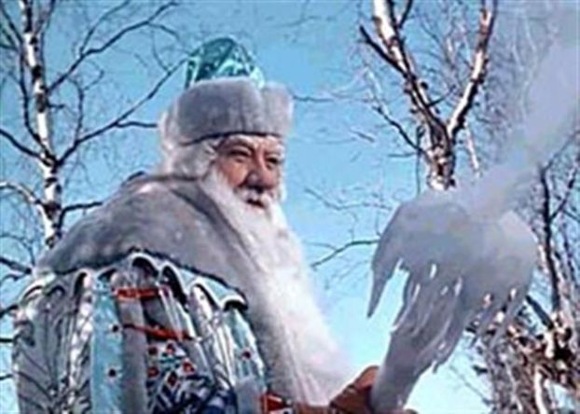
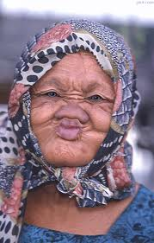
Santa Claus
Father frost
Babushka is a traditional Christmas figure in Russia who gives presents to children. Her partner is Father Frost.
http://www.sanVtas.net/russianchristmas.htm
http://www.google.ca/imgres?q=russian+santa+claus&hl=en&sa=X&tbo=d&rls=com.microsoft:en-
BABUSHKA

Slide 9
IMPORTANT CHRISTMAS CHARACTERS IN RUSSIA
important Christmas characters in Russia are Babushka and grandfather frost.
Babushka is a traditional Christmas figure who distributes presents to children. Her name means grandmother and the legend is told that she declined to go with the wise men to see Jesus because of the cold weather
During the communist years St. Nicholas was transformed into Grandfather Frost.
http://www.sanVtas.net/russianchristmas.htm
http://www.google.ca/imgres?q=russian+santa+claus&hl=en&sa=X&tbo=d&rls=com.microsoft:en-

Slide 10
Traditional food eaten at Christmas
The most important ingredient is a special porridge called kutya. It is made of wheat berries or other grains which symbolize hope and immortality, and honey and poppy seeds which ensure happiness, success, and untroubled . The kutya is eaten from a common dish to symbolize unity
People then eat 'sochivo' or 'kutia' a porridge made from wheat or rice served with honey, poppy seeds, fruit (especially berries and dried fruit like raisins), chopped walnuts or sometimes even fruit jellies!
http://www.whychristmas.com/cultures/russia.shtml

Slide 11
Good And Bad List
The good and bad kids all get the same things
http://www.whychristmas.com/cultures/russia.shtml

Slide 12
Unique Things
Some unique things in at Christmas are….
That some people celebrate Christmas on January 7th instead of December 25th
Another unique thing is that they have basically two Santa Clauses, there names are grand father Christmas
http://www.the-north-pole.com/around/

Slide 13
bibliography
http://toptravellists.net/russian-flag-wallpaper.html
http://www.google.ca/imgres?q=map+of+russia&um=1&hl=en&safe=active&sa=N&rls=com.microsoft:en-
https://www.cia.gov/search?q=russian+population&site=WORLD_FACTBOOK&btnG=Search&output=xml_no_dtd&client=CIA&myAction=%2Fsearch&proxystylesheet=CIA&submitMethod=get&x=16&y=7&sort=date%3AD%3AL%3Ad1&oe=UTF-8&ie=UTF-8&ud=1&exclude_apps=1
http://www.google.ca/imgres?q=map+of+russia&um=1&hl=en&safe=active&sa=N&rls=com.microsoft:en-
http://www.meighan.net/alexander/Chapter16.htm
http://www.the-north-pole.com/around/russia.html
http://www.sanVtas.net/russianchristmas.htm
http://www.google.ca/imgres?q=russian+santa+claus&hl=en&sa=X&tbo=d&rls=com.microsoft:en-
http://www.whychristmas.com/cultures/russia.shtml

