Slide 1
Christmas in Australia
Brandon Strang
Christmas around the world project
Date : November 14 ‘ 2012

Slide 2
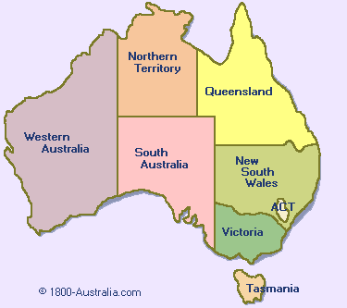
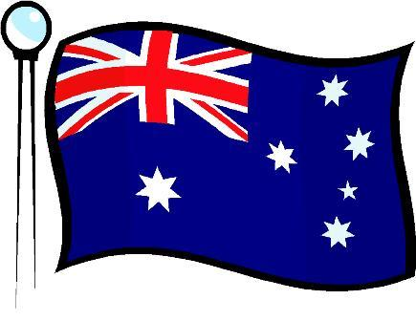
The flag of Australia and map
Map of Australia flag of Australia

Slide 3
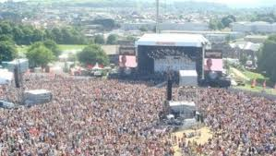
Population
In 2011 Australia had an estimated population of 21 766 711 people
http://alldownunder.com/

Slide 4
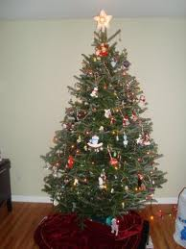
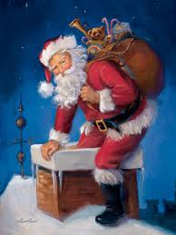
Australian Christmas tree/ Santa
The Australian Christmas tree is pretty much the same as ours. The date is on December 24th for our time because they’re one day ahead of us and there Santa is the same, big beard, red suit, an kind of chubby.
http://www.timeanddate.com/

Slide 5
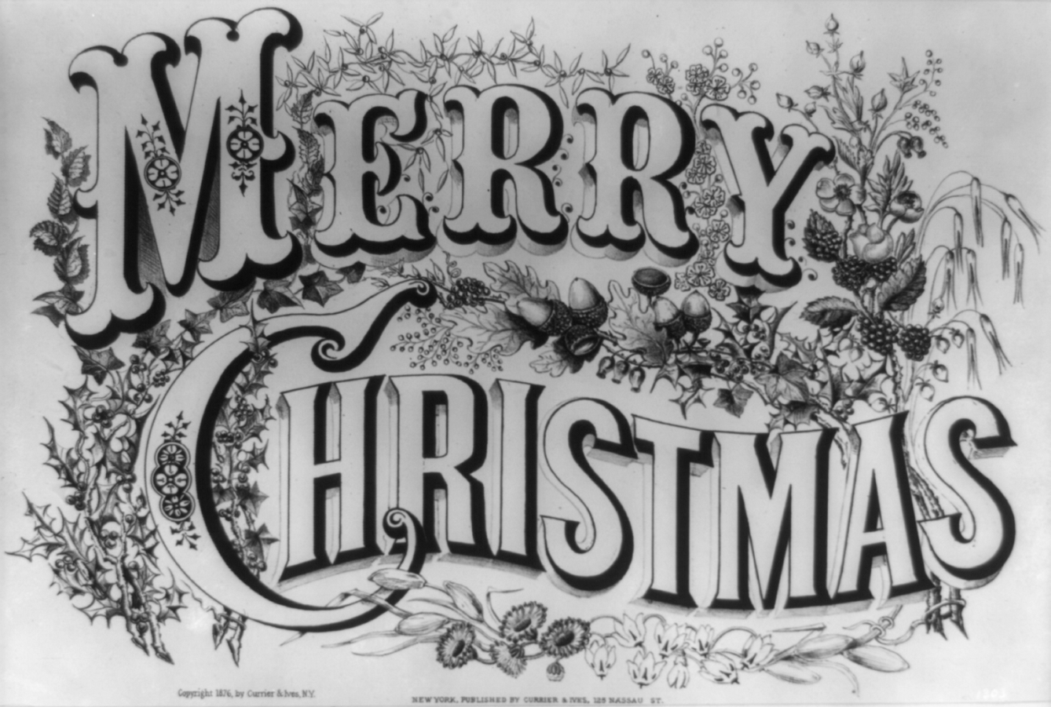
Language
In Australia the primary language is English and merry Christmas is said the same way there as it is here.
http://www.timeanddate.com/

Slide 6
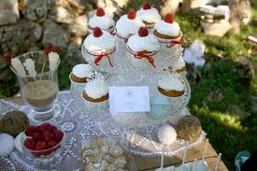
Christmas desert in Australia
Gail's cherry pom poms
Ingredients: 50g red cherry’s, 1/3 of condensed milk, coconut 2t, cherry mariner or cherry essence, 220g dark chocolate, process the first 4 ingredients till combined in food processer, melt chocolate and dip each pom pom so only half is coated, then refrigerate till ready

Slide 7
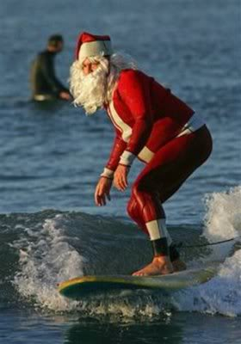
Unique things about Christmas in Australia
In Australia it is usually very hot at Christmas time, it would not be unusual to be at least 30 degrees Celsius. Some people surround themselves with a little native plant which has little red flowered leaves. Sometimes Santa will arive on a surf board.
Australia also rarely gets any
snow at Christmas time.
http://www.santas.net/welcome.htm
http://www.theholidayspot.com/christmas/worldxmas/australia.htm

Slide 8
Bibliography
ALL DOWN UNDER.com, Kwintessential, time and date.com, Santa’s net
http://www.santas.net/welcome.htm
http://www.timeanddate.com/
http://alldownunder.com/
http://www.theholidayspot.com/christmas/worldxmas/australia.htm

