Slide 1
Christmas in Austria
By Brennan Labrador

Slide 2
The population of Austria
In Austria the population was during 2011 is 8 430 558
http://worldpopulationreview.com/population-of-austria/

Slide 3
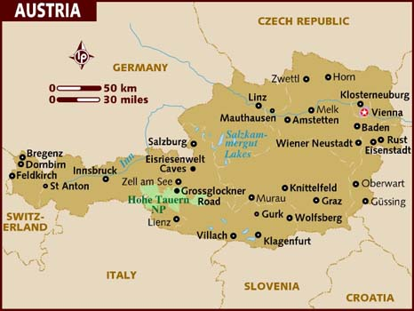
Austria's flag and map
http://en.wikipedia.org
/wiki/File:Flag_of_Austria_(state).svg
http://www.lonelyplanet.com/maps/europe/austria/

Slide 4
The date of Christmas is celebrated is on in Austria
It is the same day. This year it will be Tue Dec 25 2012

Slide 5
The language that is spoken in Austria and how to say merry Christmas
This is how you say merry Christmas in Austria
FROLICHE WEIHNACHTEN! They speak German.
http://answers.yahoo.com/question/index?qid=20071020084547AAwhXmX
http://www.santas.net/austrianchristmas.htm

Slide 6
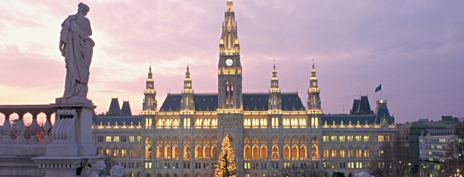
Christmas tree and how it’s decorated
The Christmas tree plays a very important part
There is a tree.
In families the tree is decorated with gold and silver ornaments or stars made our of straw, sweets and candy wrapped in tinfoil, gilded nuts, etc
http://www.austria.info/us/culture-art/christmas-season-in-austria-1084204.html

Slide 7
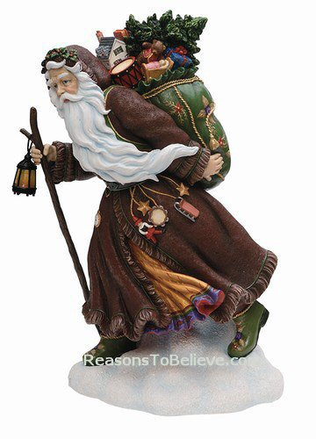
Santa in Austria
Christkind – a little angel with blond curls who brings presents to boys and girls. Although, unlike Santa, Christkind has no helpers in his workshop.
Santa pic
http://www.calgaryjournal.ca/index.php/calgaryvoices/my-story/428-exchange-student-reveals-there-is-no-santa-claus-in-austria

Slide 8
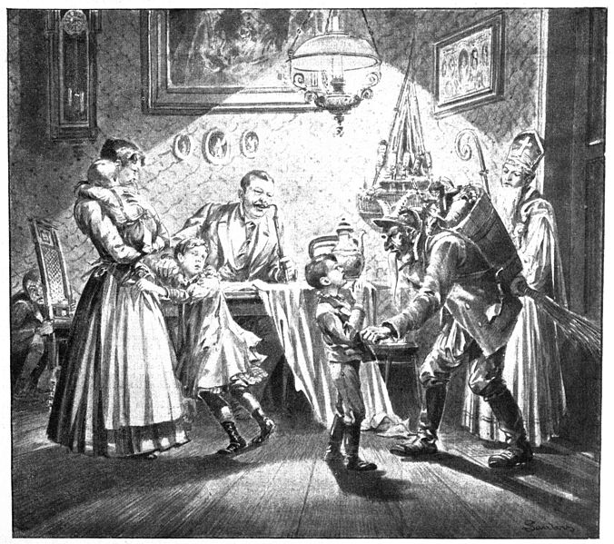
Important characters
Krampus is represented as a beast-like creature, generally demonic in appearance. The creature has roots in Germanic folklore. Traditionally young men dress up as the Krampus in Austria, southern Bavaria, South Tyrol, Hungary, Slovenia and Croatia during the first week of December, particularly on the evening of 5
Dechttp://en.wikipedia.org/wiki/File:Nikolaus_krampus.jpgber, and roam the streets frightening children with rusty chains and bells.

Slide 9
Traditional food
Weihnachtsbaeckerei (Christmas cookies)
4 ½ cups flour 1 ½ cups sugar Pinch of salt 1/4 cup milk 1 egg yolk 5 eggs http://www.californiamall.com/holidaytraditions/traditions-austria.htm
3 tsp. baking powder 1 ½ tsp. vanilla 1 ½ cups butter
Sift flour, baking powder, and salt onto a board. Cream butter and sugar. Add eggs, vanilla, and milk to butter and sugar. Mix lightly. Pour the moist ingredients into a depression in the flour and work ingredients into a dough with a knife. Divide the dough into 4 parts. Roll out and cut into desired shapes with cookie cutter. Place on a greased baking sheet and brush with egg yolk.
Bake in a moderate oven, at 300-350, until golden brown.

Slide 10
What, traditionally, do good boys and girls get? Bad ones?
Saint Nicholas, who rewards nice ones with gifts. Krampus is said to capture particularly naughty children in his sack and carry them away to his lair.
http://en.wikipedia.org/wiki/Krampus

Slide 11
Unique things about Christmas in Austria
In Austria some people come around that are called the shelter seekers putting on a play about Mary and Joseph.
http://www.kwintessential.co.uk/articles/austria/christmas-in-austria/1438

Slide 12
bibliography
http://en.wikipedia.org/wiki/Krampus
http://en.wikipedia.org
/wiki/File:Flag_of_Austria_(state).
http://www.santas.net/austrianchristmas.htm
http://answers.yahoo.com/question/index?qid=20071020084547AAwhXmX
Dechttp://en.wikipedia.org/wiki/File:Nikolaus_krampus.jpgber, and roam the streets frightening children with rusty chains and bells.
http://www.austria.info/us/culture-art/christmas-season-in-austria-1084204.html
http://worldpopulationreview.com/population-of-austria/
http://www.calgaryjournal.ca/index.php/calgaryvoices/my-story/428-exchange-student-reveals-there-is-no-santa-claus-in-austria
http://www.timeanddate.com/holidays/austria/christmas-day
http://www.lonelyplanet.com/maps/europe/austria/
santa pic http://www.google.ca/imgres?imgurl=http://www.reasonstobelieve.com/Merchant2/graphic
s/00000001/pk13993.jpg&imgrefurl=http://www.reasonstobelieve.com/Merchant2/merchant.mvc?Screen%3DPROD%26Product_Code%3Dpk13993%26Category_Code%3Dpipka&h=500&w=360&sz=39&tbnid=l79sCvIGJkIu8M:&tbnh=97&tbnw=70&prev=/search%3Fq%3Dpicture%2Bof%2Bsanta%2Bin%2Baustria%26tbm%3Disch%26tbo%3Du&zoom=1&q=picture+of+santa+in+austria&usg=__EN0nV3DKsiGzyq5s7HZS2C6LjKw=&docid=xDCNaKDmCBXgqM&sa=X&ei=mM3IUOukNam90AGnxYCgAw&ved=0CDAQ9QEwAA&dur=
3047

Slide 13
Bibliography
http://en.wikipedia.org/wiki/Krampus
http://www.kwintessential.co.uk/articles/austria/christmas-in-austria/1438
http://www.californiamall.com/holidaytraditions/traditions-austria.htm

