Slide 1
Christmas in Belgium
By Jasmine

Slide 2
Bibliography
http://www.google.ca/search?hl=en&sugexp=les%3B&cp=14&gs_id=1f&xhr=t&q=the+flag+of+belgium&safe=active&bav=on.2,or.r_gc.r_pw.&bpcl=38625945&biw=1024&bih=571&wrapid=tljp1099731208078030&um=1&ie=UTF-8&tbm=isch&source=og&sa=N&tab=wi &ei=kRKlUK-KL6Hk0gGInYCICQ (flag) chritmas-tree-and-decoration . Html http://www.santas.net/belgianchristmas.htm
http://belgianpearls.blogspot.ca/2009/12/my-

Slide 3
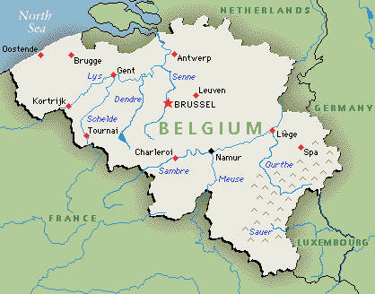
Belgium
The Population for Belgium is 11 000 800

Slide 4
What Santa leaves for the good kids and what he leaves for the bad kids
there are two Santa's there's st. nilkalls and pere nole he visits them twice the frist time is decemeder the 4th he does this so he can find out which where bad the next time is Decemeder 6th if a childern is good he retures if the bad kids he leaves the twigs inside their shoes or in a small basket that are left just inside the doorway.

Slide 5
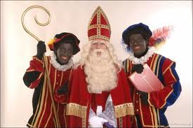
Their Sinterklaas
Santa is the one who puts the gives under the tree and there Santa is a boy and there Christmas is on the 25th

Slide 6
Main languages
The main languages are: French and German and Dutch.
How they say merry Christmas is: Wallon

Slide 7
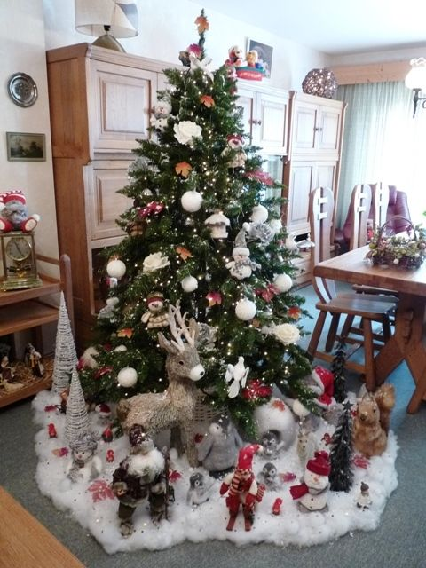
Yes they do have a tree.
They use lights, they put joy into it and they put a star on top to show the birth of Jesus.

Slide 8
Sweet Apples in the Oven
Recipes >> Belgium Recipes >> Sweet Apples in the Oven
Ingredients
4 firm apples such as Matsu, McIntosh, or Granny Smith
4 tablespoons dark brown sugar
4 tablespoons (1/2 stick) unsalted butter
pinch of ground cinnamon or ginger (optional)
Procedure
1Preheat the oven to 400F. Butter a gratin dish just large enough to hold the apples. Using a sharp paring knife or an apple corer, core each apple without cutting all the way through to the bottom. Arrange the apples in the buttered gratin dish and fill each one with 1 tablespoon sugar and 1 tablespoon butter. Sprinkle with cinnamon if using. Add a little water, to make a thin layer, to the bottom of the dish. Bake until the apples are soft but still hold their shape, 30 to 35 minutes. Serve warm or lukewarm.

Slide 9
Unique things
they have a chocolate Christmas log
And it has on the outside of it cream
Covered with chocolate bark-covered loge and butter cream and they wear customs
On Christmas day December 25th
An aunt or uncle will wear a black glove and throw treats through the door unto the floor.
http://tluif.home.xs4all.nl/sinterklaas.html

