Slide 1
CHRISTMAS IN BRAZIL By: Sophie Goulden

Slide 2
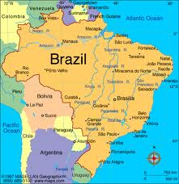
Brazil
The population of Brazil is 196,655,014 - 2011
http://www.infoplease.com/atlas/country/brazil.html
http://fc01.deviantart.net/fs71/i/2011/062/4/f/brazil_flag_by_xumarov-d3av9e8.jpg
http://www.google.ca/#hl=en&sugexp=les%3B&gs_nf=3&gs_rn=0&gs_ri=hp&pq=the%20population%20of%20

Slide 3
Christmas in Brazil
The date of Brazil is December 25 is the same day as Canada celebrates Christmas.
http://en.wikipedia.org/wiki/Christmas_worldwide

Slide 4
Brazil’s Language
How they speak-
The language of Brazil is Portuguese. Some do
speak English, some people from Brazil need to
Learn how to speak English language because
they might meet someone who speak English
and not Portuguese.
How they say Merry Christmas-
The language of Brazil is Portuguese. Some do
speak English, some people from Brazil need to
Learn how to speak English language because
they might meet someone who speak English
and not Portuguese.
http://answers.yahoo.com/question/index?qid=20061027201554AAiLVmi

Slide 5
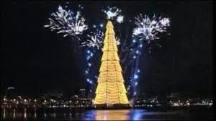
Brazil’s Christmas tree
Yes, Brazil does have a
Christmas Tree, and
this is what it looks like.
They put Christmas
Lights on the tree.
http://news.bbc.co.uk/cbbcnews/hi/newsid_7750000/newsid

Slide 6
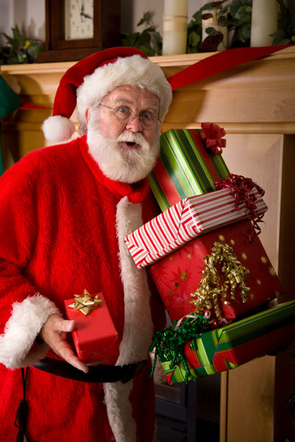
Santa Claus in Brazil
Here is a picture of Santa Claus in Brazil…
http://www.life123.com/holidays/christmas/santa-claus/different-names-for-santa-claus.shtml
This is a picture of Santa
bringing presents to the good
kids!

Slide 7
Brazil’s important Christmas characters
Here are the special Christmas characters
Baby Jesus
Mary
Joseph
Papai Noel (Father Noel)
The Shepherds
http://www.the-north-pole.com/around/brazil.html

Slide 8
What is the traditional food that is eaten
Chicken, turkey, ham, rice, salad, pork and fresh and dried fruits.
This is what they usually have on Christmas day.
http://www.the-north-pole.com/around/brazil.html

Slide 9
What do good boys and girls get and what do they bad girls and boys get?
Boys and girls get good toys when they are very
Good.
Boys and girls get Bad boys and Girls get coal for
Christmas.
Black Coals. They get black coal and fruit.
http://wiki.answers.com/Q/What_do_bad_boys_and_girls_get_for_Christ
mas#ix
zz3R5RB1RQY

Slide 10
How Brazil celebrates Christmas
How Brazil celebrates Christmas
They have a huge Christmas dinner, unusual in the hot summertime, includes turkey, ham, colored rice, and wonderful vegetable and fruit dishes.
http://www.the-north-pole.com/around/brazil.html

Slide 11
Bibliography
http://news.bbc.co.uk/cbbcnews/hi/newsid_7750000/newsid_7757500/7757565.stm
http://www.afterdawn.com/news/article.cfm/2012/07/http://www.afterdawn.com/n
ews/article.cfm/2012/07/01/amazon_to_expand_digital_store_to_brazil01/amazon_t
o_expand_digital_store_to_brazil
http://fc01.deviantart.net/fs71/i/2011/062/4/f/brazil_flag_by_xumarov-d3av9e8.jpg
http://www.infoplease.com/atlas/country/brazil.html
http://www.life123.com/holidays/christmas/santaclaus/differentnamesforsantaclaus.shtml
http://en.wikipedia.org/wiki/Christmas_worldwide
http://wiki.answers.com/Q/What_do_bad_boys_and_girls_get_for_Christmas#ix
zz3R5RB1RQY
http://www.the-north-pole.com/around/brazil.html
http://answers.yahoo.com/question/index?qid=20061027201554AAiLVmi

