Slide 1
Christmas in Costa Rica
By: Lyndi Goulden

Slide 2
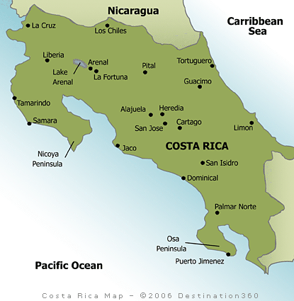
Costa Rica Population of Costa Rica 2011 census:4 301 712
http://www.mapsofworld.com/flags/costa-rica- flag.html
http://www.destination360.com/central-america/costa-rica/costa-rica-map
http://www.indexmundi.com/costa_rica/

Slide 3
Main Language
The main language spoken in Costa Rica is Spanish.
Feliz Navidad is how they say Merry Christmas.
http://knowaboutcostarica.com/Costa_Rica_Language.html
http://www.debwebonline.com/Mercy_in_Jesus/merry.html

Slide 4
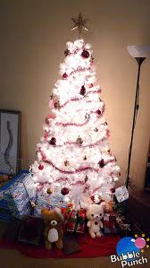
Christmas tree
They do have a Christmas tree.
Traditionally it is decorated with small figurines, lights and lace ornaments. In some households the tree is painted white.
http://bubblepunch.wordpress.com/category/christmas/
http://gocentralamerica.about.com/od/costaricaguide/p/CRChristmas.htm

Slide 5
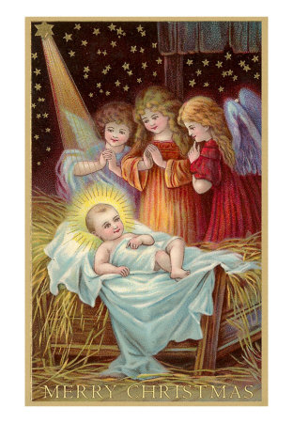
Santa’s Replacement Santa’s Replacement
http://yougotjesus.com/baby_jesus_2.htm
They have Nino dios (Christ child or Jesus). Nino dios (Jesus) is the son of Mary and Joseph, the holy child.
http://www.whychristmas.com/cultures/costa_rica.shtml
http://www.amcostarica.com/120604.htm

Slide 6
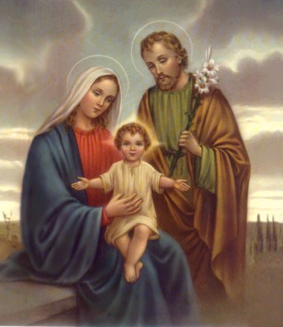
Christmas Characters
Some of their important characters are Mary and Joseph, the Wise men and baby Jesus.
http://www.churchnewssite.com/portal/?p=11453
http://gocentralamerica.about.com/od/costaricaguide/p/CRChristmas.htm
http://wiki.answers.com/Q/Does_Costa_Rica_have_a_figure_like_other_Santa_Claus

Slide 7
Traditional food
Costa Rican Christmas dinners are just as elaborate as American ones. Tamales are a big part of the meal as well as pastries and other deserts like Tre Leches cake.
http://gocentralamerica.about.com/od/costaricaguide/p/CRChristmas.htm

Slide 8
Good and bad
The Costa Rican kids get candy and small gifts in their shoes left by Nino Dios (baby Jesus).
http://www.reindeerland.org/christmas-traditions/christmas-traditions-in-costa-rica.htm

Slide 9
Christmas uniqueness
The night before Christmas the children will place their shoes outside to be filled with treats. The next morning they will be asked what did the baby bring you. The people sometimes decorate with dried branches of coffee shrubs
. http://www.family-christmas-traditions.com/Christmas-traditions-in-Costa-Rica .html

Slide 10
Bibliography
http://www.churchnewssite.com/portal/?p=11453
.
http://www.amcostarica.com/120604.htm
http://www.whychristmas.com/cultures/costa_rica.shtml
http://gocentralamerica.about.com/od/costaricaguide/p/CRChristmas.htm
http://wiki.answers.com/Q/Does_Costa_Rica_have_a_figure_like_other_Santa_Claus
http://www.indexmundi.com/costa_rica/
http://knowaboutcostarica.com/Costa_Rica_Language.html
http://www.debwebonline.com/Mercy_in_Jesus/merry.html
http://bubblepunch.wordpress.com/category/christmas/
http://gocentralamerica.about.com/od/costaricaguide/p/CRChristmas.htm
http://www.mapsofworld.com/flags/costa-rica-flag.html
http://gocentralamerica.about.com/od/costaricaguide/p/CRChristmas.htm
http://www.reindeerland.org/christmas-traditions/christmas-traditions-in-costa-rica.htm

Slide 11
Bibliography
http://www.family-christmas-traditions.com/Christmas-traditions-in-Costa-Rica .html
http://www.destination360.com/central-america/costa-rica/costa-rica-map
http://yougotjesus.com/baby_jesus_2.htm

