Slide 1
Christmas in Finland
By: Ian Fitzgerald

Slide 2
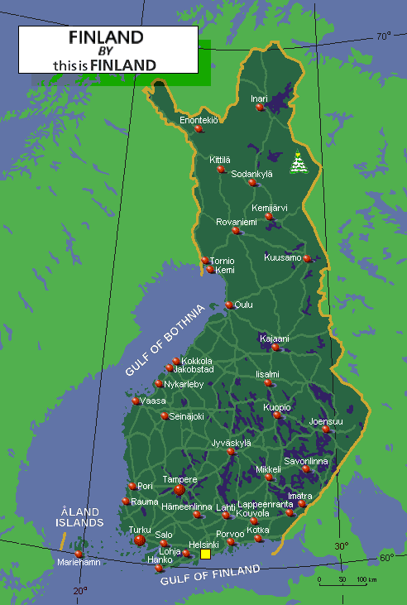
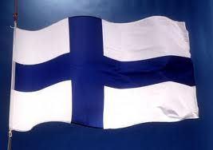
The population, flag and map
http://www.google.ca/imgres?q=finland+flag&num=10&hl=en&safe=active&biw=1024&bih=571&tbm=isch&tbnid=E35pTA8vkZ7lgM:&imgrefurl=http://www.ishabaydhaba.com/%3Fattachment_id%3D5521&docid=_ndcJxbCQJH1AM&imgurl=http://www.ishabaydhaba.com/wp-content/uploads/2011/09/Finland-flag-2.jpg&w=400&h=282&ei=_yilULWANZSB0AGe2IGICw&zoom=1&iact=hc&vpx=358&vpy=243&dur=13500&hovh=188&hovw=267&tx=102&ty=85&sig=114000714448285661648&page=3&tbnh=127&tbnw=177&start=36&ndsp=20&ved=1t:429,r:12,s:36,i:229www.evi.com/q/population_of_finland_2011

Slide 3
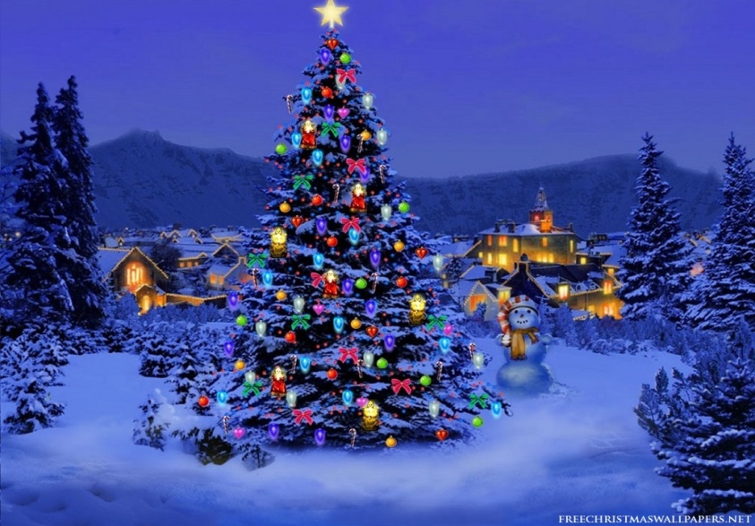
Christmas day
In Finland Christmas is celebrated on December 25th in memory of Jesus Christ’s birth.
http://www.google.ca/search?num=10&hl=en&safe=active&site=imghp&tbm=isch&source=hp&biw=1024&bih=571&q=christmas&oq=christmas&gs_l=img.1.0.0l5j0i3j0l4.4156.10343.0.12781.9.6.0.3.3.0.297.1062.0j2j3.5.0...0.0...1ac.1.JBXM3Y7LOtA#hl=en&safe=active&site=imghp&tbm=isch&sa=1&q=christmas+in+finland&oq=christmas+in+finland&gs_l=img.3..0j0i24l3j0i5i24l2.2406.6453.0.7484.11.10.0.0.0.0.391.2330.2-8j1.9.0...0.0...1c.1.dj3vuroI96E&bav=on.2,or.r_gc.r_pw.&fp=9168ffc1b4d21d5f&bpcl=38625945&biw=1024&bih=571

Slide 4
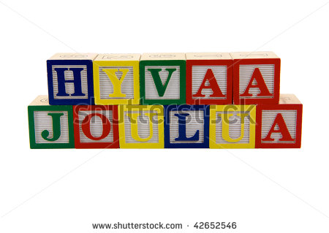
Finland Language
Finland’s main language is called Finnish. They say Merry Christmas like: Hyvää Joulua
http://goscandinavia.about.com/od/christmastraditions/qt/xmasfinland.htm
http://www.google.ca/imgres?q=how+do+the+finland+people+merry+christmas&um=1&hl=en&safe=active&sa=N&biw=1024&bih=571&tbm=isch&tbnid=U5b35j_QQOraSM:&imgrefurl=http://www.shutterstock.com/pic-42652546/stock-photo-green-red-and-blue-wood-toy-alphabet-blocks-spelling-hyvaa-joulua-or-merry-christmas-in-finnish.html&docid=6--zwY-28_8lZM&imgurl=http://image.shutterstock.com/display_pic_with_logo/332329/332329,1260597434,1/stock-photo-green-red-and-blue-wood-toy-alphabet-blocks-spelling-hyvaa-joulua-or-merry-christmas-in-finnish-42652546.jpg&w=450&h=319&ei=1jOlUNvsHrKs0AHOiIH4Ag&zoom=1&iact=hc&vpx=710&vpy=132&dur=421&hovh=189&hovw=267&tx=178&ty=83&sig=111346932021872155625&page=1&tbnh=112&tbnw=167&start=0&ndsp=19&ved=1t:429,r:5,s:0,i:85

Slide 5
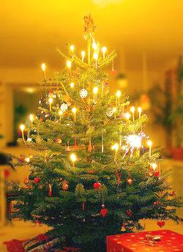
The tree and decorations
The Finnish people used fir trees for Christmas. The trees are cut down and put on sleds and dragged to their house. Finnish trees are decorated with candles and lights with a gold or silver star also with gold ribbons and colored glass balls.
ahttp://www.shttp://www.dlc.fi/~marianna/gourmet/xmas_4.htm antas.net/finnishchristmas.htm

Slide 6
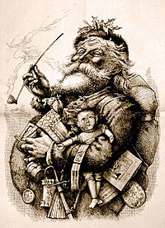
Finnish Santa Claus
Santa Claus is called Father Christmas in Finland. Wearing a red coat, white beard, sometimes spectacles, red trousers, black leather boots and belt.
http://en.wikipedia.org/wiki/Santa_Claus red trousers, black leather belt and boots.
http://www.google.ca/imgres?q=finnish+santa+claus&um=1&hl=en&sa=N&tbo=d&biw=1024&bih=571&tbm=isch&tbnid=-4ECIgG9Y1yaQM:&imgrefurl=http://en.wikipedia.org/wiki/Santa_Claus&docid=QsFqIsnhGnn6eM&imgurl=http://upload.wikimedia.org/wikipedia/commons/thumb/4/42/MerryOldSanta.jpg/200px-MerryOldSanta.jpg&w=200&h=276&ei=-CHGUK3EOdGF0QG2zYD4Aw&zoom=1&iact=hc&vpx=2&vpy=105&dur=532&hovh=220&hovw=160&tx=67&ty=120&sig=104564242458030780668&page=1&tbnh=139&tbnw=92&start=0&ndsp=18&ved=1t:429,r:6,s:0,i:102

Slide 7
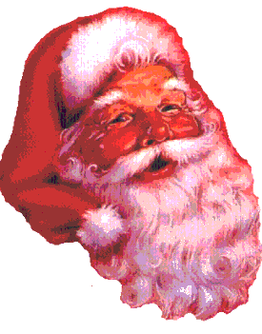
An important Christmas character is Santa Claus and Joulupukki which is a Christmas figure which means Christmas goat or Yule goat.
http://en.wikipedia.orkg/wiki/Joulupukkimeans Christmas goat or Yule goat.

Slide 8
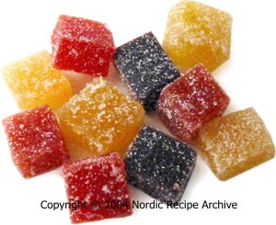
Finnish Christmas food
One of a special Christmas foods is marmalades
60 ml thick berry or fruit puree, see instructions below 200 ml water 0,6 tsp (about 1,6 g) agar-agar powder or 6 g agar-agar strands 200 g sugar (a few drops of lemon juice) extra sugar for coating
http://www.dlc.fi/~marianna/gourmet/xmas18.htm

Slide 9
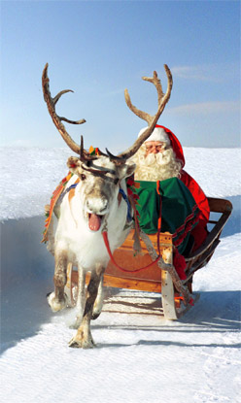
Bad kids, Good kids
Santa Claus rewards good kids with gifts and captures bad kids and brings them to his lair.
http://www.google.ca/imgres?q=finnish+christmas+bad+kids+and+good+kids&um=1&hl=en&sa=N&tbo=d&biw=1024&bih=571&tbm=isch&tbnid=RrTwbEpVpzdauM:&imgrefurl=http://www.bbc.co.uk/worldservice/learningenglish/communicate/blog/student/archive/2008/12.shtml&docid=pDVJ4rjR17iDvM&imgurl=http://www.bbc.co.uk/worldservice/learningenglish/communicate/blog/student//images/santa_in_finland.jpg&w=248&h=415&ei=gHjHUJPWJsLL0AHA0IGADQ&zoom=1&iact=hc&vpx=321&vpy=144&dur=2953&hovh=291&hovw=173&tx=100&ty=220&sig=104564242458030780668&page=2&tbnh=152&tbnw=88&start=15&ndsp=22&ved=1t:429,r:17,s:0,i:135

Slide 10
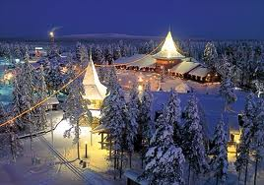
A Finnish tradition is families go to cemeteries and remember the dead and eat porridge
http://www.google.ca/#sclient=psy-ab&hl=en&tbo=d&q=unique+christmas+celebrations+in+Finland&oq=unique+christmas+celebrations+in+Finland&gs_l=serp.3..33i29.2531.5937.4.8515.11.9.0.0.0.0.625.3577.2-4j1j1j3.9.0.les%3B..0.0...1c.1.ud78Hiu_4Wo&pbx=1&bav=on.2,or.r_gc.r_pw.&fp=8fc68a86385e9f8e&bpcl=39650382&biw=1024&bih=571

Slide 11
Bibliography
http://www.google.ca/imgres?q=finland+flag&num=10&hl=en&safe=active&biw=1024&bih=571&tbm=isch&tbnid=E35pTA8vkZ7lgM:&imgrefurl=http://www.ishabaydhaba.com/%3Fattachment_id%3D5521&docid=_ndcJxbCQJH1AM&imgurl=http://www.ishabaydhaba.com/wp-content/uploads/2011/09/Finland-flag-2.jpg&w=400&h=282&ei=_yilULWANZSB0AGe2IGICw&zoom=1&iact=hc&vpx=358&vpy=243&dur=13500&hovh=188&hovw=267&tx=102&ty=85&sig=114000714448285661648&page=3&tbnh=127&tbnw=177&start=36&ndsp=20&ved=1t:429,r:12,s:36,i:229www.evi.com/q/population_of_finland_2011
www.timeanddate.com › Calendar › Holidays › Finland
hhttp://www.google.ca/imgres?q=christmas+in+finland&um=1&hl=en&safe=active&biw=1024&bih=571&tbm=isch&tbnid=PRS8FtNKCRxaVM:&imgrefurl=http://www.esphoneblog.com/2010/12/24/merry-christmas-2010/&docid=sPg4rix8mkM_aM&imgurl=http://cdn.esphoneblog.com/wp-content/uploads/2010/12/Christmas-Tree-Nature102-226431.jpeg&w=1024&h=768&ei=HzClUM2MLMeY0QGPq4CQCQ&zoom=1&iact=rc&dur=156&sig=103437694698914830868&page=2&tbnh=119&tbnw=158&start=17&ndsp=22&ved=1t:429,r:8,s:17,i:150&tx=80&ty=67ttp://www.google.ca/search?num=10&hl=en&safe=active&site=imghp&tbm=isch&source=hp&biw=1024&bih=571&q=christmas&oq=christmas&gs_l=img.1.0.0l5j0i3j0l4.4156.10343.0.12781.9.6.0.3.3.0.297.1062.0j2j3.5.0...0.0...1ac.1.JBXM3Y7LOtA#hl=en&safe=active&site=imghp&tbm=isch&sa=1&q=christmas+in+finland&oq=christmas+in+finland&gs_l=img.3..0j0i24l3j0i5i24l2.2406.6453.0.7484.11.10.0.0.0.0.391.2330.2-8j1.9.0...0.0...1c.1.dj3vuroI96E&bav=on.2,or.r_gc.r_pw.&fp=9168ffc1b4d21d5f&bpcl=38625945&biw=1024&bih=571
http://goscandinavia.about.com/od/christmastraditions/qt/xmasfinland.htm
http://www.google.ca/imgres?q=how+do+the+finland+people+merry+christmas&um=1&hl=en&safe=active&sa=N&biw=1024&bih=571&tbm=isch&tbnid=U5b35j_QQOraSM:&imgrefurl=http://www.shutterstock.com/pic-42652546/stock-photo-green-red-and-blue-wood-toy-alphabet-blocks-spelling-hyvaa-joulua-or-merry-christmas-in-finnish.html&docid=6--zwY-28_8lZM&imgurl=http://image.shutterstock.com/display_pic_with_logo/332329/332329,1260597434,1/stock-photo-green-red-and-blue-wood-toy-alphabet-blocks-spelling-hyvaa-joulua-or-merry-christmas-in-finnish-42652546.jpg&w=450&h=319&ei=1jOlUNvsHrKs0AHOiIH4Ag&zoom=1&iact=hc&vpx=710&vpy=132&dur=421&hovh=189&hovw=267&tx=178&ty=83&sig=111346932021872155625&page=1&tbnh=112&tbnw=167&start=0&ndsp=19&ved=1t:429,r:5,s:0,i:85
http://en.wikipedia.org/wiki/Santa_Claus red trousers, black leather belt and boots.

Slide 12
Bibliography pg2
http://www.google.ca/imgres?q=finnish+santa+claus&um=1&hl=en&sa=N&tbo=d&biw=1024&bih=571&tbm=isch&tbnid=-4ECIgG9Y1yaQM:&imgrefurl=http://en.wikipedia.org/wiki/Santa_Claus&docid=QsFqIsnhGnn6eM&imgurl=http://upload.wikimedia.org/wikipedia/commons/thumb/4/42/MerryOldSanta.jpg/200px-MerryOldSanta.jpg&w=200&h=276&ei=-CHGUK3EOdGF0QG2zYD4Aw&zoom=1&iact=hc&vpx=2&vpy=105&dur=532&hovh=220&hovw=160&tx=67&ty=120&sig=104564242458030780668&page=1&tbnh=139&tbnw=92&start=0&ndsp=18&ved=1t:429,r:6,s:0,i:102
http://en.wikipedia.orkg/wiki/Joulupukkimeans Christmas goat or Yule goat.
http://www.dlc.fi/~marianna/gourmet/xmas18.htm
http://www.google.ca/#sclient=psy-ab&hl=en&tbo=d&q=unique+christmas+celebrations+in+Finland&oq=unique+christmas+celebrations+in+Finland&gs_l=serp.3..33i29.2531.5937.4.8515.11.9.0.0.0.0.625.3577.2-4j1j1j3.9.0.les%3B..0.0...1c.1.ud78Hiu_4Wo&pbx=1&bav=on.2,or.r_gc.r_pw.&fp=8fc68a86385e9f8e&bpcl=39650382&biw=1024&bih=571

