Slide 1
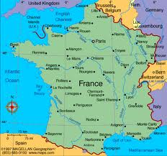
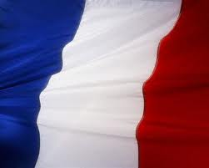
Christmas in France
By Angela

Slide 2
Population of France
The population of France is 65.4366 million 2011
http://www.google.ca/publicdata/explore?ds=d5bncppjof8f9_&met_y=sp_pop_totl&idim=country:FRA&dl=en&hl=en&q=the%20population%20of%20france

Slide 3
The date
The France people celebrate Christmas is Tuesday December 25, 2012 and Wednesday 25,2013
http://www.timeanddate.com/holidays/france/christmas-day

Slide 4
They speak French
They speak French and they call Christmas noel
http://www.timeanddate.com/holidays/france/christmas-day

Slide 5
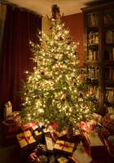
A TREE IN FRANCE
How they decorated the tree with old way with ribbons and real white wax candles fir tree in the garden are often decorated too. with lights on all night
http://www.frenchpropertylinks.com/essential/christmas-france.html

Slide 6
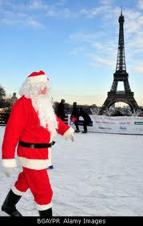
Santa Claus
In France there is a Santa Claus. In France father Christmas is called pe`re noel.
Fickr . Com

Slide 7
CHRISTMAS CHARACTERS
SANTA
Joseph
Mary
Jesus
http://www.indobase.com/holidays/christmas/world/christmas-in-france.html

Slide 8
Traditional food
The Christmas meal is an important family gathering with good meat and the best wine
The traditional Christmas is chocolate log.
Once dinner is over and the family has retired to bed, they leave a fire burning and food and drink on the table in case the Virgin Mary calls in. Children leave their shoes or wooden clogs called sabots in the hearth for the Christ Child or Pere Noel to fill. In the north of France, children are given gifts on December 6, which is St. Nicholas' Day, instead of Christmas Day. The adults give each others presents on New Year's Day
http://www.santas.net/frenchchristmas.htm

Slide 9
Good or bad
On Christmas eve children leave theirs shoes by the fireplace to be filled with gifts from pere noel. In the morning they also find that sweets,fruit,nuts,and small toys have been hung on the tree.
French children set out their shoes in hopes that le petit Jesus will fill them during the night with small gifts.
http://www.santas.net/frenchchristmas.htm

Slide 10
Unique
Many things are unique about France the language and culture so fiercely protected by its people for a start
The food of France also exported all over the who else produces foie gras like them?
People of France celebration it deep religious
devotion
http://www.blurtit.com/q522313.html

Slide 11
Recipes for France
18 sweet biscuits 1 teaspoon cocoa powder small pot double cream 1 teaspoon icing sugar knife and fork whisk basin foil plate
1. Put the cream, sugar and cocoa in a basin. Whisk cream until it is just stiff enough to stand in peaks. 2. Spread the cream on the biscuits. Sandwich them together in a long roll. Use about half the cream. 3. Wrap the roll of biscuits in foil. Put it in the fridge with the rest of the cream. 4. Next day, unwrap the roll, put it on a plate and cover it with the rest of the cream. 5. Drag a fork over the cream to make a 'bark' on the 'log'. Decorate it with icing sugar snow and holly. 6. This cake is rich so serve small slices.
http://www.santas.net/christmaschocolatelogs.htm

Slide 12
bibliography
Ct imag cfm
OB- VG335 11 06 12 J 20121106141
Columbusmmug. com
http://www.blurtit.com/q522313.html
http://www.thehistoryofchristmas.com/traditions/france.htm

