Slide 1
Christmas in Ireland
By Audrey

Slide 2
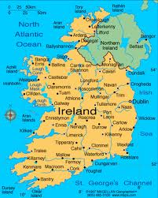
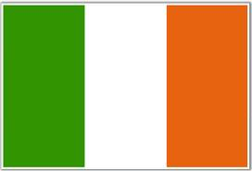
Ireland
The population in Ireland is 4,487,000
http://www.mapsofworld.com/flags/ireland-flag.html
http://www.infoplease.com/atlas/country/ireland.html
http://www.google.ca/#hl=en&sugexp=les%3B&gs_nf=3&cp=11&gs_id=11&xhr=t&q=ireland+population&pf=p&sclient=psy-ab&site=&source=hp&oq=ireland+pop&gs_l=&pbx=1&bav=on.2,or.r_gc.r_pw.&fp=eb3e0d6b9c2e7a91&bpcl=38625945&biw=1024&bih=571

Slide 3
The dates they celebrated Christmas in Ireland.
Christmas in Ireland lasts from Christmas eve to January 6.
http://www.santas.net/irishchristmas.htm

Slide 4
Ireland Language
Irish is the main language spoken in Ireland. Nollaig (Santa Claus) San Nicolas (saint Nicholas) Daidí na Nollag (Father Christmas)
http://www.whychristmas.com/cultures/ireland.shtml

Slide 5
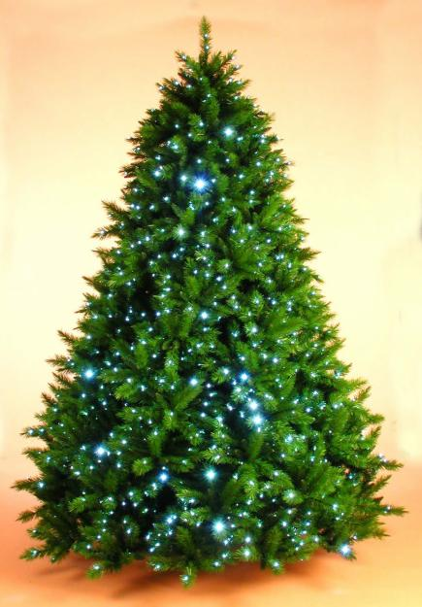
The Christmas tree in Ireland
Yes they have a Christmas tree in Ireland. They decorate the Christmas tree the same way we do in Canada. They use lights and glass balls.
http://dublincity.olx.ie/artificial-christmas-trees-dublin-iid-43151949

Slide 6
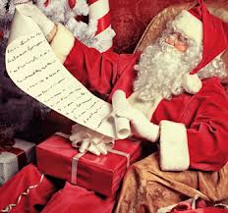
Who is there Santa clause
Santa in Ireland is the same as Santa here in Canada.
http://myletterfromsantaclaus.com/

Slide 7
Important Christmas characters
Santa Claus Saint Nicholas Father Christmas
http://www.whychristmas.com/cultures/ireland.shtml

Slide 8
The traditional food and recipe
The traditional food is a round cake full of caraway seeds recipe : Bring butter and eggs to room temperature.
Grease and flour a 9 x 5 x 3 inch loaf pan.
Crush caraway seeds; set aside.
In a mixing bowl, stir together flour, baking powder and salt.
In a mixer bowl beat butter with an electric mixer on medium speed for 30 seconds.
Gradually add sugar; beat for 6 minutes.
Add vanilla.
Add eggs, one at a time; beat 1 minute after each, scraping bowl constantly.
Gradually add dry ingredients.
Beat on low speed until well combined.
Stir in caraway seeds.
Turn batter into pan.
Bake at 325 degrees for 60 to 70 minutes.
Cool ten minutes on rack.
Remove from pan; cool.
http://www.whychristmas.com/cultures/ireland.shtml

Slide 9
What good and bad kids get
Only good kids get the gifts, bad kids get nothing
http://www.irish-genaelogy-toolkit.com/christmas-in-Ireland.html

Slide 10
Some unique things about how Christmas is celebrated
Christmas in Ireland is the largest celebration of the year.
http://en.wikipedia.org/wiki/Christmas_in_Ireland

Slide 11
bibliography
http://www.google.ca/#hl=en&sugexp=les%3B&gs_nf=3&cp=11&gs_id=11&xhr=t&q=ireland+population&pf=p&sclient=psy-ab&site=&source=hp&oq=ireland+pop&gs_l=&pbx=1&bav=on.2,or.r_gc.r_pw.&fp=eb3e0d6b9c2e7a91&b pcl=38625945&biw=1024&bih=571 http://www.infoplease.com/atlas/country/ireland.html http://www.mapsofworld.com/flags/ireland-flag.html http://www.santas.net/irishchristmas.htm http://dublincity.olx.ie/artificial-christmas-trees-dublin-iid-43151949 http://en.wikipedia.org/wiki/Languages_of_Ireland http://www.worldofchristmas.net/christmas-world/ireland.html
http://myletterfromsantaclaus.com/

Slide 12
Bibliography
http://www.whychristmas.com/cultures/ireland.shtml
http://www.irish-genealogy-toolkit.com/Christmas-in-Ireland.html http://en.wikipedia.org/wiki/Christmas_in_Ireland

