Slide 1
Christmas in Italy
By kiara Nickerson

Slide 2
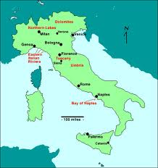
Italy's population
Italy's population in 2009 was about 60 million.
http://www.mapsofworld.com
/Italy/italy-population.html
http://www.italyso sfsgeography.wikispaces.com urce.com/italymap.html

Slide 3
language
In Italy they mostly speak Italian. In the Italian language they say buone feste natalize, but in the English language we say merry Christmas.
http://www.santas.net/howmerrychristmasissaid.htm

Slide 4
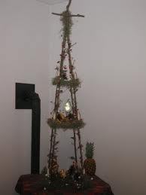
Christmas tree
In Italy they do not use a Christmas tree. In Italy they use a ceppo. A ceppo is a tall wooden frame in a pyramid shape which they place presents under.
mohawkvalleyguide.com
http://italian.about.com/library/weekly/aa120600f.htm

Slide 5
Date celebrated
In Italy they celebrate Christmas from December 24 to January 6.
http://www.santas.net/italianchristmas.htm

Slide 6
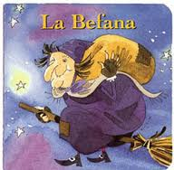
Santa Claus
In Italy instead of Santa they have befana. Befana is a kind ugly witch on a broom stick. She slides down chimneys and fills stockings and shoes with good things for good children.
Christmas in Italy

Slide 7
Important Christmas characters.
Important Christmas characters from Italy is la Befana only.

Slide 8
Recipes
http://www.santas.net/tortevigiliadinatale.htm
The recipe
1 cup water 1 cup sultanas 1/4 cup chopped walnuts 1/4 cup chopped almonds 1 cup sugar 1/2 cup butter/margarine 1 egg 2 teaspoons vanilla 1 teaspoon baking powder 1/2 cup sifted flour
For the preparations
1. Mix together water, sultanas, walnuts and almonds in a saucepan and bring to boil. 2. Reduce heat simmer for 5 minutes. Cool 3. Cream butter and sugar. 4. Add egg. Beat well. 5. Add vanilla. Add sifted flour and baking powder to creamed mixture. 6. Add fruit mixture. Blend Thoroughly. 7. Pour into well buttered 20cm square tin. 8. Bake at 180 degrees celcius for 30 minutes.
they eat it on Christmas eve.

Slide 9
Good and bad girls and boys
In Italy la Befana brings good boys and girls a nice present.
in Italy bad boys and girls get charcoal.
http://www.santas.net/italianchristmas.htm

Slide 10
Unique things about Christmas in Italy
1. in the week before Christmas children go from house to house dressed as shepherds, playing pipes, singing and reciting Christmas poems and are given money to buy presents.
2 .presents and boxes are drawn from the urn of fate lucky dip which always contains 1 gift per person by twilight candles are lighted around the family crib known as presepio, prayers are said and children read poems.
3. people believed that the 1st church bell ever used in a Christian service was Italian.

Slide 11
Bibliography
Book – title – Christmas in Italy – by Ross Corrine
-Found interesting facts
http://www.mapsofworld.com
-
The map
/Italy/italy-population.html
-
the population
http://www.italyso sfsgeography.wikispaces.com
urce.com/italymap.html
-
the flag
http://www.santas.net/howmerrychristmasissaid.htm
-
How merry Christmas is said in Italian
mohawkvalleyguide.com
-
ceppo
http://italian.about.com/library/weekly/aa120600f.htm
- What a ceppo is
http://www.santas.net/italianchristmas.htm
-
Date of an Italian Christmas
-
found replacement Santa Claus
-
Found recipe
-
Good boys and girls and bad boys and girls
-
Notes:
-Found interesting facts

