Slide 1
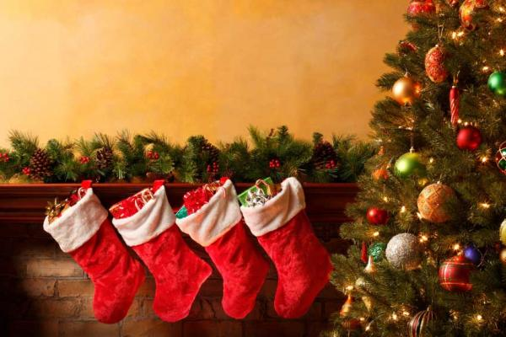
Christmas in Philippines
By Shamara Foote

Slide 2
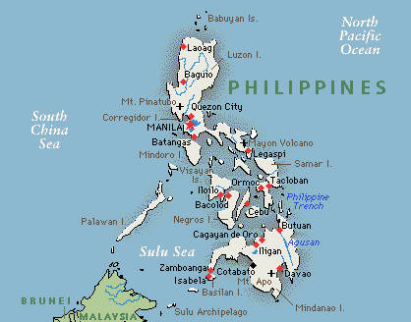
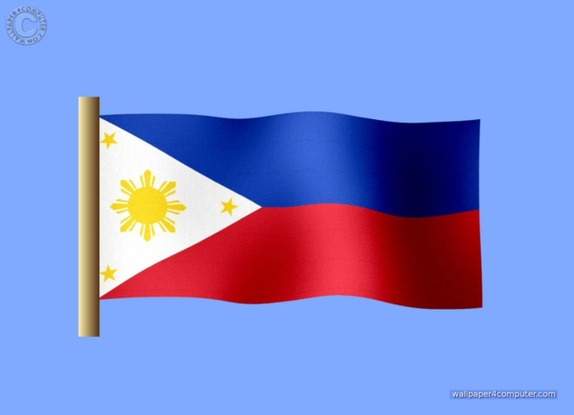
The population in Philippines, flag and map
The population of Philippines is 94,852,030 , 2011
http://www.google.ca/publicdata/explore?ds=d5bncppjof8f9_&met_y=sp_pop_totl&idim=country:PHL&dl=en&hl=en&q=the%20population%20of%20phttp://www.google.ca/search?q=philippines+map&rls=com.microsoft:en-us&ie=UTF-8&oe=UTF-8&startIndex=&startPage=1&safe=active&redir_esc=&ei=lS6lUKWYCsmE0QGzmoFohilippines (population)
http://www.google.ca/search?q=philippines+map&rls=com.microsoft:en-us&ie=UTF-8&oe=UTF-8&startIndex=&startPage=1&safe=active&redir_esc=&ei=lS6lUKWYCsmE0QGzmoF (map)
http://www.google.ca/search?q=philippines+flag&rls=com.microsoft:en-us&ie=UTF-8&oe=UTF-8&startIndex=&startPage=1&safe=active&redir_esc=&ei=0zGlUIW2DO3p0QHKyYCgCQ (flag)

Slide 3
Philippine language
The language they spoke was Spanish
How they said Merry Christmas in Philippines Maligayang pasko !
http://www.google.ca/search?q=what+is+the+main+language+spoken&rls=com.microsoft:en-us&ie=UTF-8&oe=UTF-8&startIndex=&startPage=1&safe=active&redir_esc=&ei=ITOlUKXhL_Ot0AGy7YGwDA#hl=en&sugexp=les%3B&gs_nf=3&pq=
how%20they%20say%20merry%20christmas%20in%20spanish%20&cp=47&gs_id=4p&xhr=t&q=how+they+say+merry+christmas+in+spanish++(&pf=p&sclient=psy-ab&safe=active&rls=cm.microsoft:us&oq=how+they+say+merry+christmas+in+spanish++(+phin&gs_l=&pbx=1&bav=on.2,or.r_gc.r_pw.&fp=eb3e0d6b9c2e7a91&bpcl=38625945&biw=1024&bih=571

Slide 4
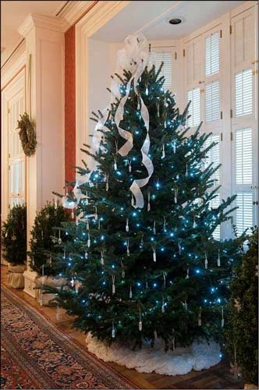
The tree and the decorations
Christmas Trees seem to have been hung upside down from the ceiling using chains (hung) from chandeliers/lighting hooks)
The tree was traditionally
decorated with edibles such as apples, nuts or dates
http://www.seasite.niu.edu/Tagalog/Cynthia/festivals/philippine_christmas.htm

Slide 5
What is their Santa Claus
Santa Claus though visible in displays and believed by most Filipino children to exist seldom comes bearing gifts !
http://www.seasite.niu.edu/Tagalog/Cynthia/festivals/philippines

Slide 6
Important Characters !
The Filipino version of Secret Santa is called or Monita or Kris Kringle students .
Monhttp://tagaloglang.com/Filipino- Culture/Holiday-Celebrations/ filipino-christmas- traditions. Hotmlio

Slide 7
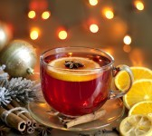
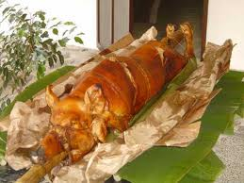
Good food !!!
A traditional drink during this season is a warm ginger tea called Salabat and a traditional treat is a flat but thick yellow rice cake called Bibingka
http://tagaloglang.com/Filipino-Culture/Holiday-Celebrations/filip ino-christmas-traditions.html

Slide 8
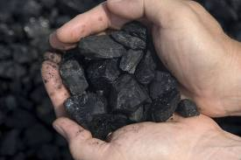
Bad Boys And Girls
Bad boys and girls get coal and good kids get presents , just like every girl and boy.
http://wiki.answers.com/Q/what

Slide 9
Unique Christmas Things !
Filipinos go to church at four o’clock in the morning and afterward have breakfast together.
Sana maligaya ang Pasko mo. (I hope your Christmas is merry)

Slide 10
Bibliography
http://www.google.ca/search?q=philippines+flag&rls=com.microsoft:en-us&ie=UTF-8&oe=UTF-8&startIndex=&startPage=1&safe=active&redir_esc=&ei=0zGlUIW2DO3p0QHKy
startPage=1&safe=active&redir_esc=&ei=UvmsUJPrEeOU0QHf_oHwAw
http://www.seasite.niu.edu/Tagalog/Cynthia/festivals/philippin
http://www.whychristmas.com/customs/trees.shtml
Http://www.google.ca/search?q=philippines+map&rls=com.microsoft:en-us&ie=UTF-8&oe=UTF-
http://www.google.ca/search?q=www.christmas+around+the+world&rls=com.microsoft:en-us&ie=UTF-8&oe=UTF-8&startIndex
http/www.whychristmas.com/customs/trees.shtml
Monhttp://tagaloglang.com/Filipino- Culture/Holiday-Celebrations/ filipino-christmas- traditions. htmlito

