Slide 1
Christmas in Spain
By. Tanner Swim
Christmas around the world project

Slide 2
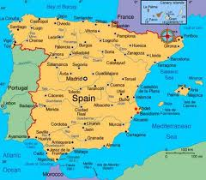
Maps and flags of Spain
The map of Spain The flag of Spain
http://www.northpole.net/world.htm

Slide 3
Population
The population of Spain is about 47 190 493. On November 7, 2011.
www.populationspain.ca/publicdata

Slide 4
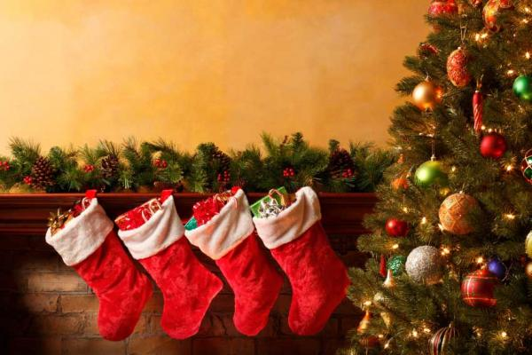
Date Christmas is on.
Spain celebrate Christmas on December 25. The same as Christmas in Canada. Kid and parents wake up when ever they feel.
http://christmas.com/pe/1427

Slide 5
Spain's language
In Spain the main language is Spanish. Feliz navidad is merry Christmas in Spanish.
http://en.wikipedia.org/wiki/Languages_of_Spain

Slide 6
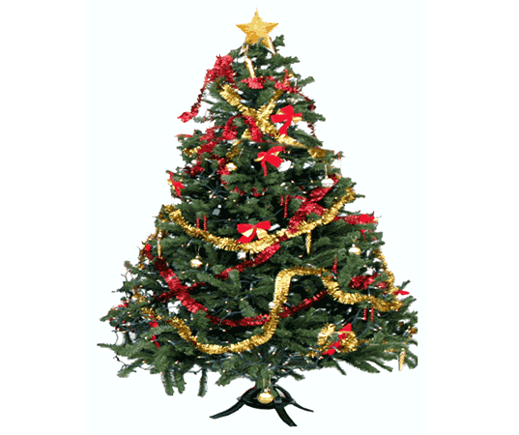
Tree and decoration
In Spain they put trees up in their house. Just like what they do in Canada.
They sometimes make their Christmas ornaments or go out to the stores and buy some ornaments to put on their tree.
 | http://www.henry.k12.ga.us/pges/xmas_around.htm

Slide 7
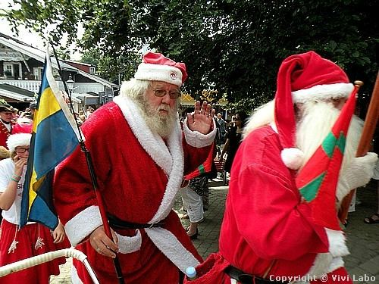
Santa Claus
In Spain Santa claus is called papa noel. Santa claus is dressed in a red coat, black boots, red and white hat and a white beard. He also looks like a old man.
http://www.santas.net/spanishchristmas.htm

Slide 8
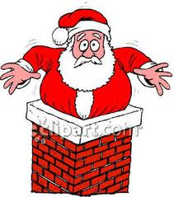
Who’s important in Christmas
The most important character in Spain on Christmas day is papa noel. ( Santa claus )
The children believe that santa claus comes to your house and slides down the chimney. That’s the only thing they believe in on Christmas eve.
http://wiki.answers.com/Q/What_is_Santa_Claus_called_in_Spain

Slide 9
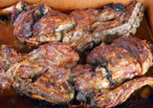
Food
In Spanish, Christmas Eve is called "La Noche Buena," literally translated as "The Good Night." In Spain it is celebrated with a large family feast, which is eaten late in the evening and can last a couple hours. Some families attend midnight mass before or after, although many families are still finishing dinner around the table at midnight In Spain. 1 pc or ½ k Beef shank with meat 2 tsp Salt 1 pc Chorizo be bilbao 1tsp Pepper, ground ½ c Green onions, cut into 5cm length 1 c Green beans, cut into 5 cm length ½ c Kintsay, cut ½ c Garbanzos, cooked 8 c Water 1 small Head cabbage, quartered 2 Tbsp Cooking oil 3 pcs Potatoes, quartered, boiled 1 tsp Garlic, minced 6 pcs Saba, sliced, boiled 2 Tbsp Onion, sliced 12 leaves Pechay ½ c Tomato sauce
www.christmas feats.sapinchristmas

Slide 10
Unique ways
1. Most people in Spain go to Midnight Mass or 'La Misa Del Gallo' (The Mass of the Rooster). It is called this because a rooster is supposed to have crowed the night that Jesus was born. Most parents celebrate christmas and take christmas very seriously like pray on christmas eve before going to bed or before eating their meal.

Slide 11
Bibliography
http://www.henry.k12.ga.us/pges/xmas_around.htm
www.christmas feats.sapinchristmas
http://wiki.answers.com/Q/What_is_Santa_Claus_called_in_Spain
http://www.santas.net/spanishchristmas.htm
http://www.santas.net/spanishchristmas.htm
http://en.wikipedia.org/wiki/Languages_of_Spain
http://christmas.com/pe/1427
www.populationspain.ca/publicdata
http://www.northpole.net/world.htm

