Slide 1
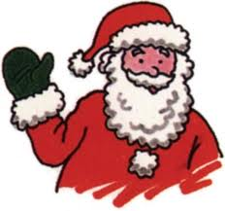
Christmas in Switzerland

Slide 2
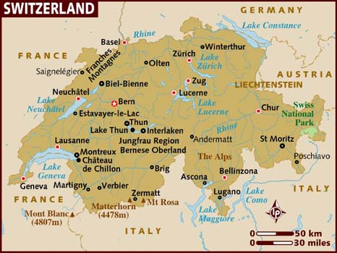
Switzerland
Population- 7 954 662 as of 2011

Slide 3
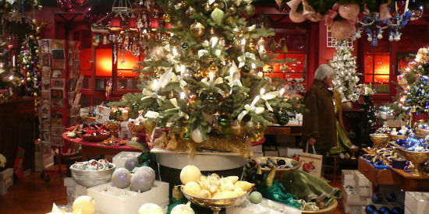
Language
The main language of Switzerland is German.
Merry Christmas in Switzerland is frohe weihnachten
Christmas is celebrated on Dec.25 (our Christmas date) and 26th (boxing day)

Slide 4
The Christmas tree
The tree is decorated with glass ornaments lights and a bow with ribbons that decorate the whole tree.(sometimes with real candles)

Slide 5
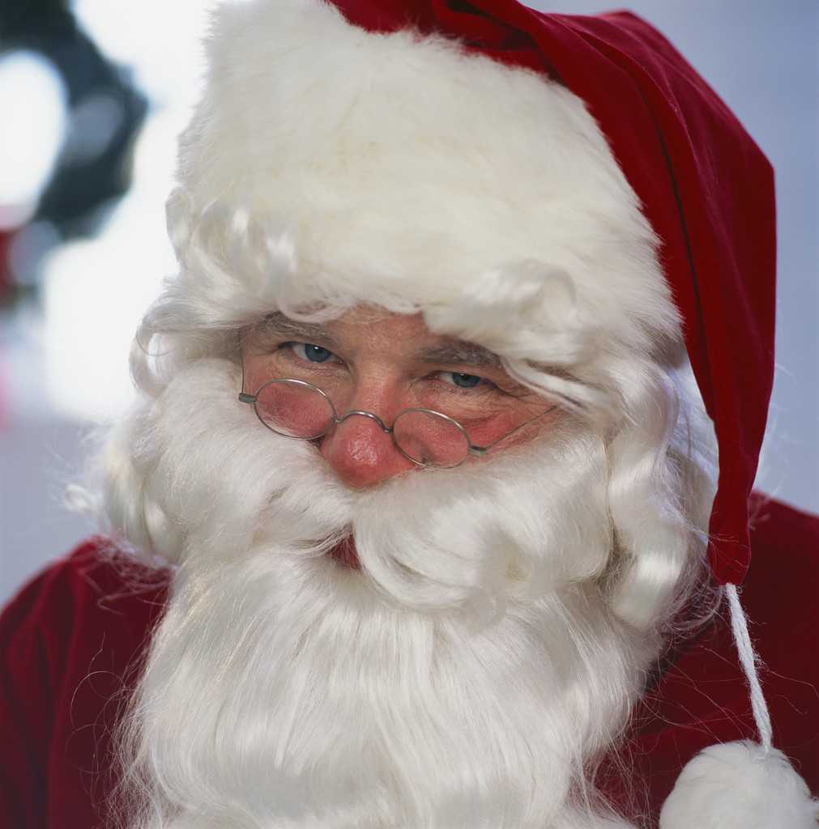
Santa Clause
This is what the Swiss Santa Clause looks like and in Switzerland he is called Klausjagen.

Slide 6
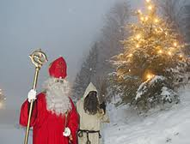
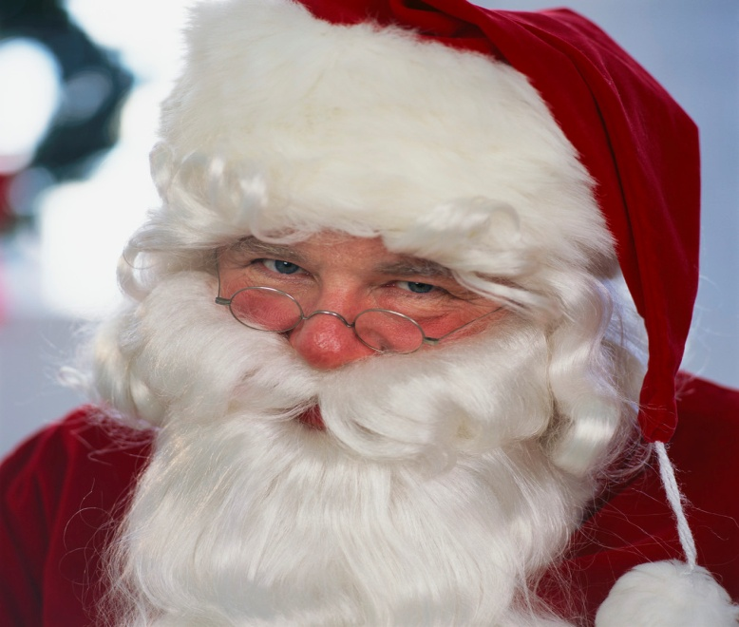
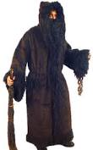
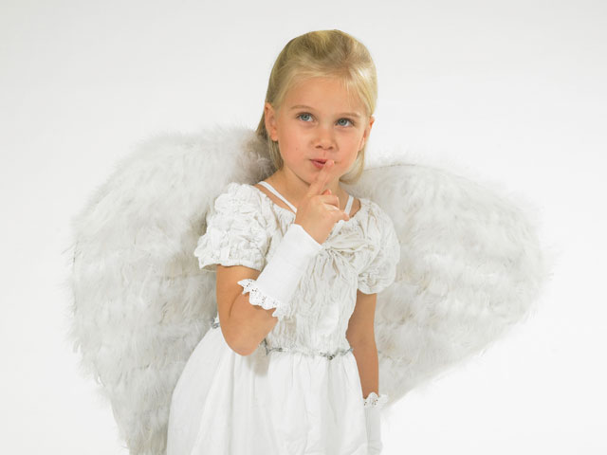
The main Swiss Christmas characters
. The important Christmas characters are Santa ( Klausjagen)
Schmutzli is Santa`s helper, he carries a broom of twigs and Christkind.(a childlike spirit)

Slide 7
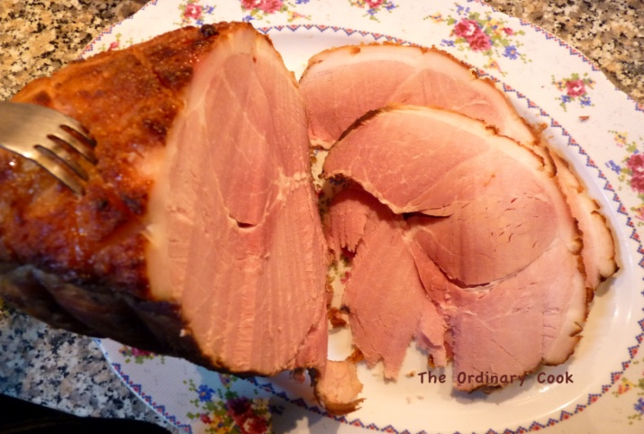
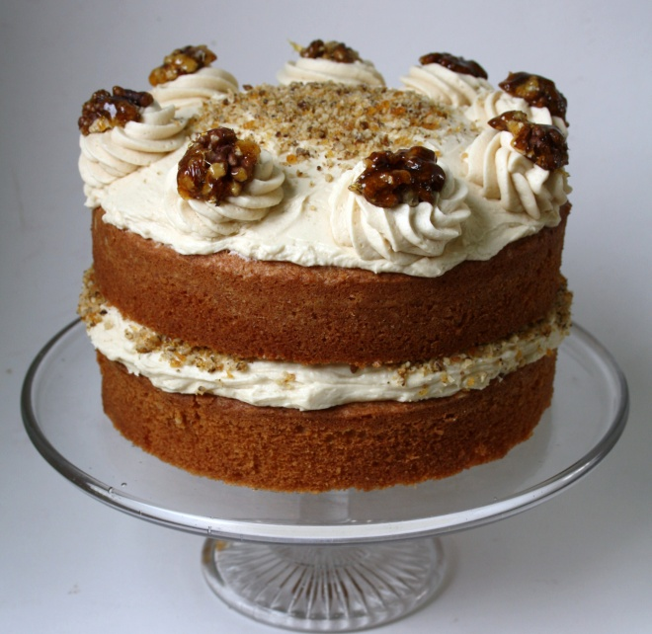
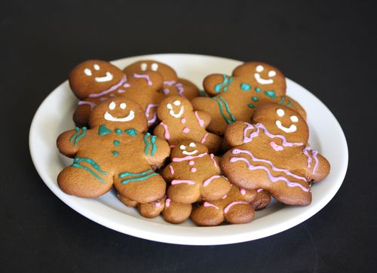
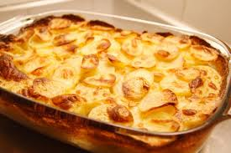
Traditional food
There are lots of traditional Christmas foods such as: scalloped potatoes with melted cheese and milk, boiled ham, walnut cake, and decorated gingerbread cookies.
Sexy tits

Slide 8
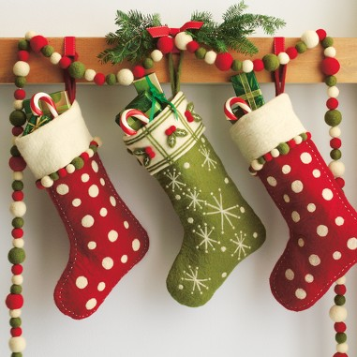
Naughty and Nice
Good girls and boys in Switzerland get some sweets in their stocking and bad girls and boys get nothing but a big lump of coal!

Slide 9
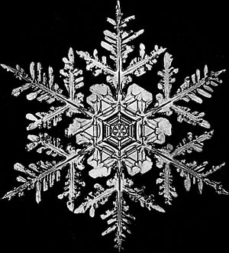
Interesting facts about Christmas in Switzerland
Did you know that the Christmas caroling is sung in 4 languages?
The tree is decorated by Christkind.
Befana, Christkind, Samichlaus, and Le Petit Jesus put the gifts under the tree.
There is a Christmas tradition that people go to midnight mass on Christmas Eve.

Slide 10
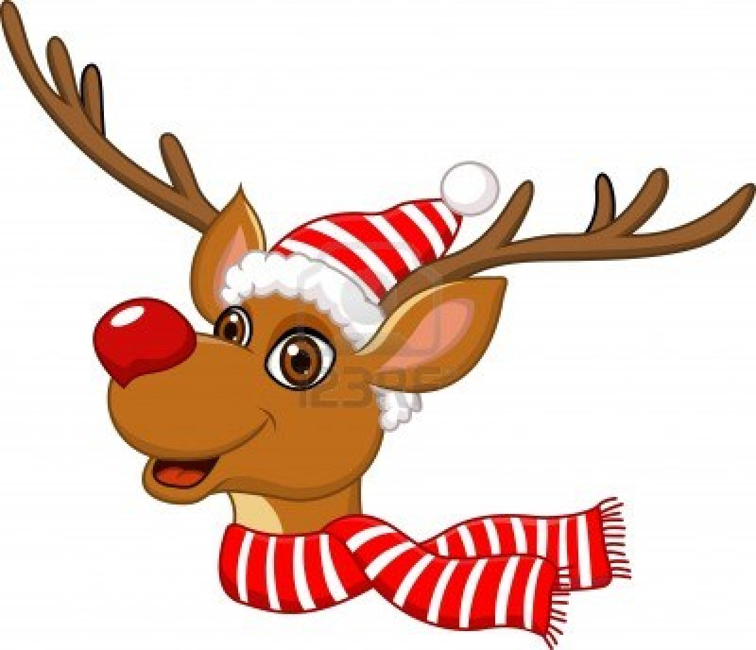
Bibliography
http://www.kidsdomain.com/holiday/xmas
http://www.google.ca/search?=images

