Slide 1
Christmas in turkey
By: Ethan O'Connor

Slide 2
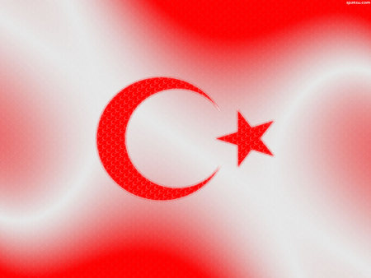
The flag of turkey

Slide 3
The map of turkey

Slide 4
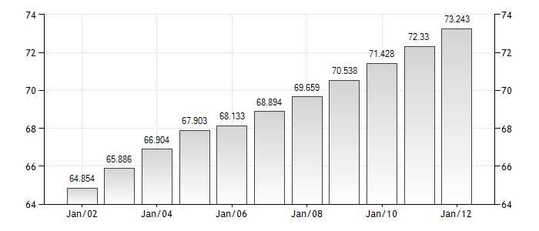
Population of turkey
The population of turkey is 73,639,596.

Slide 5
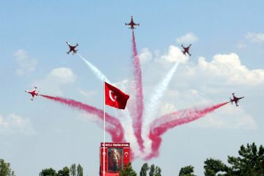
Celebrate
In turkey Santa Claus is celebrated every year during the three-day festival held in December.
http://www.santas.net/aroundtheworld.h

Slide 6
Main language
The main language in turkey is Turkish. And they say merry Christmas they said merry Christmas is noelinz kutlu olsun

Slide 7
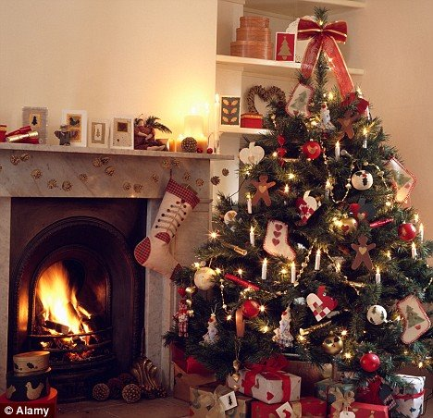
Is there a tree
Yes there is a Christmas tree Santa clauses lit up the whole nine.

Slide 8
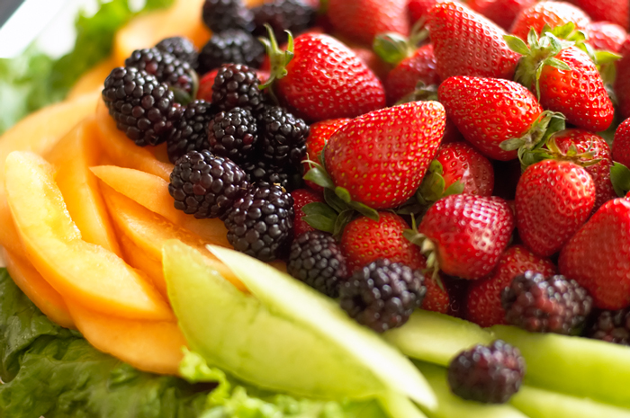
what do they get
The bad boys and girls get coal and fruit for christmas

Slide 9
Unique facts about turkey
The first church built by man St. Peter’s Church is in Antioch Antakya,Turkey.
also known as Santa Claus, was born in patara and became the bishop of demre , on Turkey’s mediterranean coast.
The last meal on Noah’s Ark, a pudding of sweet and sour taste asureis still served throughout Turkey .

Slide 10
Bibliography
www.allaboutturkey.com › Tourist Info
http://www.Santa.netallaroundtheworld
Google.com
taste.com.au

Slide 11
recipes
Santa's punch 1 quart pineapple juice 1 pkg (2 qt) lime Kool-aid 1 qt lime sherbet 2 qts ginger ale Mix Kool-aid in punch bowl. Add pineapple juice. Just before serving, add sherbet by spoonfuls. Add ginger ale. For red punch, use raspberry Kool-aid and sherbert.

Slide 12
snow candy
1 lb white bark candy 1 lb salted nuts 2 cups crispy rice cereal Melt candy in a double boiler. Add nuts and cereal. Mix well. Spoon onto waxed paper. Refrigerate until firm. Break into pieces and store in air tight container.

