Slide 1
Christmas in Vietnam
By Travis Nickerson

Slide 2
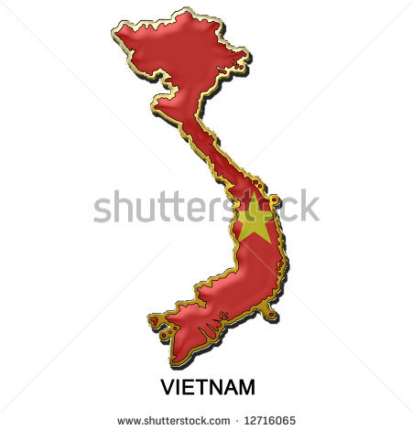
The Flag and map of Vietnam
Unimaps.com shutterstock.com

Slide 3
Population
The population of Vietnam is 91,519,289 in 2011

Slide 4
language
Chuc Mung Giang Sinh is how you say merry Christmas in Vietnam

Slide 5
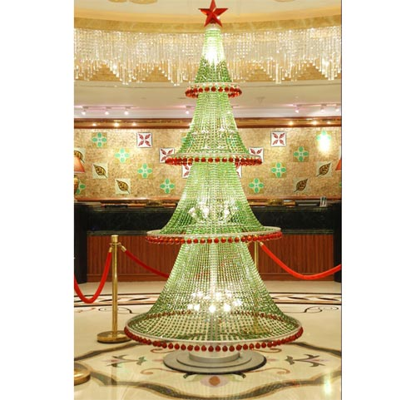
The Santa and Christmas tree of Vietnam
brihung-399696.jpgng-gifts-children-photo-http://talkvietnam.com/uploads/2008/12/santa-claus-takes-boat-
The Santa looks like ours
myvietnamnews.com

Slide 6
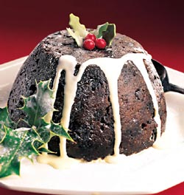
Traditional Christmas Pudding
This recipe makes one large pudding in a 2 pint (1.2 litre) basin. If you have any left over it will re-heat beautifully, wrapped in foil, in the oven next day. If you want two smaller puddings, use two 1 pint (570 ml) basins, but give them the same steaming time. If you can't get barley wine (pubs usually have it), use extra stout instead. The best way to use what's left over, if you don't want to drink it, is to add it to my Beef in Designer Beer recipe to give it a beautiful rich sauce.
http://blog.sousvidesupreme.com/2012/10/sous-vide-christmas-pudding/

Slide 7
Bad kids get a lump coal
Good kids get lots of gifts
www.kaboodle.com
http://museumsofcanada.com/product/CategoryPage.aspx?categoryId=113

Slide 8
Biblilgraphy
2520Saigon%252http://www.google.ca/imgres?q=santa+in+vietn2520Saigon%252520Cancer%252520Hospitalam&hl=en&sa=X&tbo=d&rls=com.microsoft:en-us&biw=1024&bih=550&tbm=isch&tbnid=AJq7-YYgROh4qM:&imgrefurl=http://www.dirtypierre.com/&docid=zgSeEI0zsbhtnM&imgurl=http://www.dirtypierre.com/images/Santa%252520Claus%252520visits%252520Saigon%252520Cancer%252520Hospital.jpg&w=567&h=723&ei=MH3HUMTuFcmw0AHj-4GIDQ&zoom=1&iact=hc&vpx=216&vpy=198&dur=6375&hovh=254&hovw=199&tx=148&ty=144&sig=104564242458030780668&page=1&tbnh=145&tbnw=113&start=0&ndsp=15&ved=1t:429,r:11,s:0,i:.com
www.kaboodle.com
myvietnamnews.com
http://museumsofcanada.com/product/CategoryPage.aspx?categoryId=113
brihung-399696.jpgng-gifts-children-photo-http://talkvietnam.com/uploads/2008/12/santa-claus-takes-boat-
Unimaps.com shutterstock.com

