Slide 1
Christmas in Greenland
By Alex

Slide 2
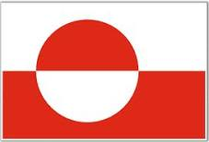
The flag of Greenland
This is the flag
Google

Slide 3
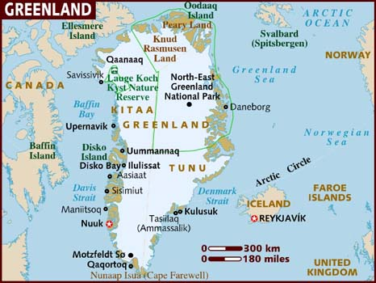
Population of Greenland
IS 56,744 Google

Slide 4
Date of Christmas
24th December.
25th December.
Google

Slide 5
How Christmas was said and what language
Juullimi Ukiortaassamilu Pilluarit';
Inuit/Greenlandic and Danish.
The north pole, Christmas around the world

Slide 6
Greenland Christmas tree
It is decorate like Christmas trees around here
The north pole, Christmas around the world
Notes:
Yes and
It is decorated like our Christmas trees

Slide 7
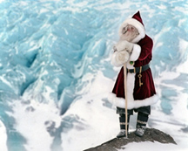
Santa Claus in Greenland
He looks like father Christmas
Google
Notes:
I couldn’t find his name

Slide 8
Decorations
People decorate their houses with glittering ornaments and string lights. They hang big Christmas stars over their windows to illuminate their houses and to reflect the festive occasion
The north pole, Christmas around the world

Slide 9
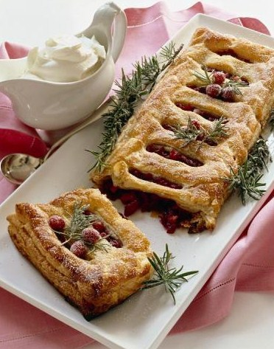
Traditional food
625g strong white flour
1 tbsp salt
85g sugar
30g fresh yeast
Water, to mix
500g butter, refrigerated
425 ml thick custard
125ml pureed raspberries
1 punnet of raspberries
100 g flaked almonds
1½ tbsp apricot jam
Google

Slide 10
Unique things
Men serve women their food and also pour them coffee. The dinner is followed by games and dancing throughout the night
Google

Slide 11
Bibliography
Christmas around the world
The north pole, Christmas around the world
Christmas.com, world view
Goole.com

