Slide 1
Lithuanian Christmas
By; Caleb Jacklyn☺

Slide 2
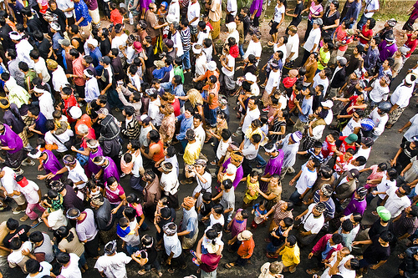
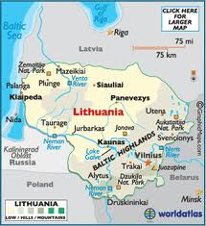
Map, population and flag
Map of Lithuania
Population and flag
Lithuania Is home the gates of dawn
The population of Lithuania is 3.32 Million in, 2010
www.Springhill.com/, goeasteurope. about .com
www.lithuanian.net/language/list.htm-flag

Slide 3
The date that Christmas is celebrated!
Christmas is celebrated on the 25 of December the same as here in Canada.
http://www.whychristmas.com/cultures/

Slide 4
Lithuanian language
The main language in Lithuania is Lithuanian
My source was Mr.McCallum
This is how to say merry Chris
http://www.whychristmas.com/cultures/tmas in
linksmų Kalėdų

Slide 5
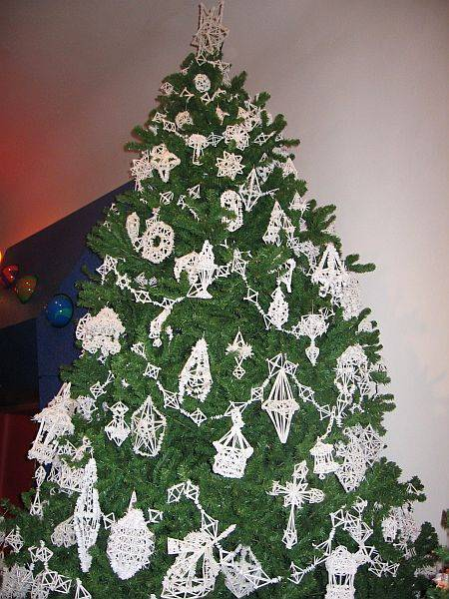
Is there a tree?
Yes there is, a tree it is often decorated with white paper straws in the shapes of snowflakes, stars and other shapes.
http://www.whychristmas.com/cultures/lithuania.shtml

Slide 6
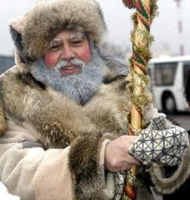
Santa Claus
There is a Santa Claus in Lithuania except they call him “father Christmas”
gvc1114.gvc11.virtualclassroom.org

Slide 7
Traditional foods
Traditional food
Recipe
One of the many foods they would eat on Christmas is a special potato dish!
On the next slide potato dish
http://www.whychristmas.com/cultures/lithuania.shtml

Slide 8
Lithuanian Potato Dish
Prep: 20 min. Bake: 1 hour
Yield: 8-10 Servings
Ingredients
1/2 pound sliced bacon, diced
1 large onion, chopped
1/2 cup butter, cubed
1/4 cup all-purpose flour
1/2 to 1 teaspoon salt
1/4 teaspoon pepper
2 eggs, beaten
1 can (5 ounces) evaporated milk
1/2 cup milk
2-1/2 pounds potatoes, peeled and shredded
Daisy Brand Sour Cream, optional
Directions
In a large skillet, cook bacon and onion; drain. Add butter and stir until melted. Remove from the heat. In a large bowl, whisk the flour, salt, pepper, eggs, evaporated milk and milk until smooth. Stir in the potatoes and bacon mixture.
Transfer to a greased 11-in. x 7-in. baking dish. Bake, uncovered at 350° for 60-65 minutes or until golden. Serve with sour cream if desired. Yield: 8-10 servings.
Nutritional Facts 1 serving (3/4 cup) equals 247 calories, 15 g fat (8 g saturated fat), 80 mg cholesterol, 365 mg sodium, 21 g carbohydrate, 1 g fiber, 7 g protein.
Originally published as Lithuanian Potato Dish in Casserole Cookbook , p289

Slide 9
Traditional good kids
Traditional bad kids
Traditionally good kids get a bottle of krupnika
Traditionally bad kids get?
http://thelithuanians.com/bookthelithuanians/node17.html

Slide 10
Unique facts !!!!
In Lithuania they would get a bottle of Krupnika if they were good!
In Lithuania they decorate the tree with straws in shapes of geometrical shapes!
http://www.whychristmas.com/cultures/lithuania.shtml

Slide 11
Bibliography
springhillfresh.com-people
goeasteurope.about.com-flag
www.lithuanian.net/language/list.htm-fla
g
http://www.whychristmas.com/cultures/
http://thelithuanians.com/bookthelithuanians/node17.html

