Slide 1
Christmas in Sweden By Connor Goodick

Slide 2
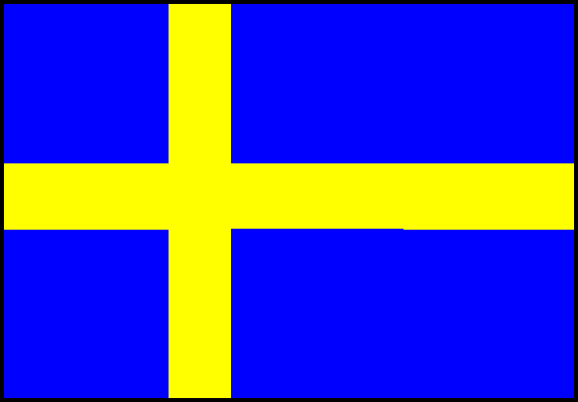
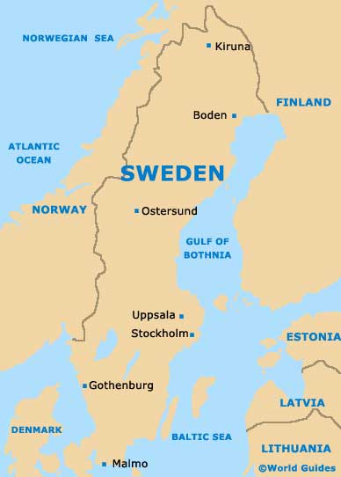
Flag of Sweden
The population in Sweden is 9 453 000 in 2011. this is a map of Sweden. This
Is the map of Sweden.
map of Sweden http://www.google.ca/search?q=map+ofsweden&rls=com.microsoft:en-us&oe=UTF-population of Sweden
8&startIndex=&startPage=1&redir_esc=&safe=active&um=1&ie=UTF- flag of Sweden 8&hl=en&tbm=isch&source=og&sa=N&tab=li&bw=1024&bih=571&sei=6xWlUJvbB8XJ0QGIxoH4BA

Slide 3
Christmas celebrations
Around Christmas time in Sweden, one of the biggest celebrations is St. Lucia's Day (or St. Lucy's Day on December 13th thousand years ago in Sweden, King Canute declared that Christmas would last a month, from December 13, the feast of St. Lucia until January 13, or Tjugondag Knut (St. Canute's he celebration comes from when Lucia's Day first became widely celebrated in Sweden in the late 1700s. St Lucia's Day is also celebrated in Denmark Norway, Finland, Bosnia, and Croatia. In Denmark it is more a of a children's day and in some part of Italy, children are told that St Lucy brings them presents. They leave out a sandwich for her and the donkey that helps carry the gifts!
is that were told by Monks who first brought Christianity to Sweden.christmas is celebrated on December 25 The Swedish Christmas jubilations are similar to the Norwegian Christmas festivities in that it starts with "Luciadagen", the Saint Lucia ceremony. As in Norway, on the morning of 13th December, the boys dress up as star boys in long white shirts and pointed hats and carry star wandsIn Sweden, Christmas Day is observed on 25th December.
Here, the Christmas celebrations begin with the first of Advent. The Swedish Christmas jubilations are similar to the Norwegian Christmas festivities in that it starts with "Luciadagen", the Saint Lucia ceremony.
Read more at http://www.theholidayspot.com/christmas/worldxmas/sweden.htm#jM5QGIHTx3i3EB2T.99
http://www.theholidayspot.com/christmas/worldxmas/sweden.htm#zsLUkhduSMQkWUKM.99
Chrishttp://www.google.ca/search?q=map+ofsweden&rls=com.microsoft:en-us&oe=UTF-8&startIndex=&startPage=1&redir_esc=&safe=active&um=1&ie=UTF-8&hl=en&tbm=isch&source=og&sa=N&tab=li&biw=1024&bih=571&sei=6xWlUJvbB8XJ0QGIxoH4BAtianity to Swedenhttp://www.the-north-pole.com/around/sweden.html

Slide 4
Swedish Language
God Jul! A Large number of people talk Swedish in Sweden. Of Sweden's roughly nine million people almost all speak Swedish.
http://goscandinavia.about.com/b/2008/12/15/how-to-say-merry-christmas-in-swedish.htm http://en.wikipedia.org/wiki/Languages_of_Sweden#Swedish

Slide 5
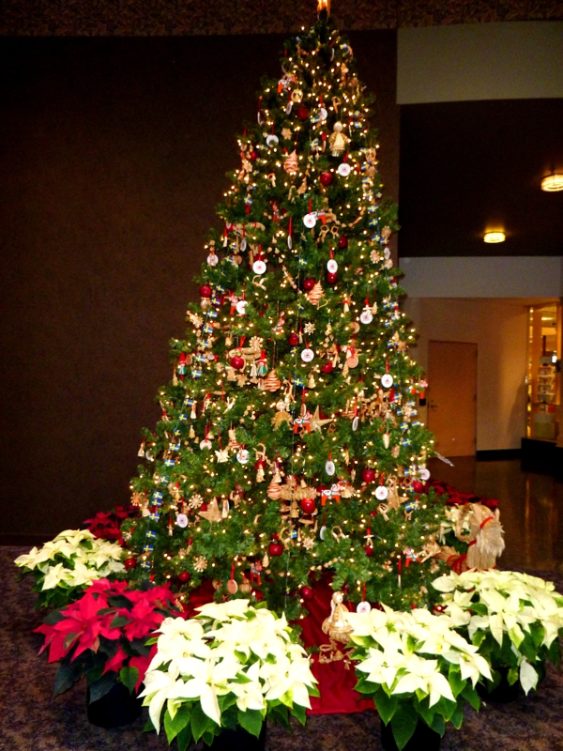
Christmas tree decorations
The tree was traditionally decorated with edibles such as apples, nuts or dates. In the 18th century, it began to be illuminated by candles which with could also be replaced by Christmas lights.
http://www.google.ca/imgres?imgurl=http://activerain.com/image_store/uploads/9/3/3/8/4/ar129201047348339.JPG&imgrefurl=http://activerain.com/blogsview/2013543/foto-friday-grand-rapids-michigan-christmas-traditions&h=800&w=600&sz=472&tbnid=1-8lbEkflWEv_M:&tbnh=92&tbnw=69&prev=/search%3Fq%3Dsweden%2Bchristmas%2Btrees%26tbm%3Disch%26tbo%3Du&zoom=1&q=sweden+christmas+trees&usg=__nW_3Sw2RorsesFQ74oXquhM6mS8=&docid=SYygaX5N_zBpmM&sa=X&ei=KIa_UI-8BJG60AHP2YC4DA&ved=0CEAQ9QEwBA&dur=78

Slide 6
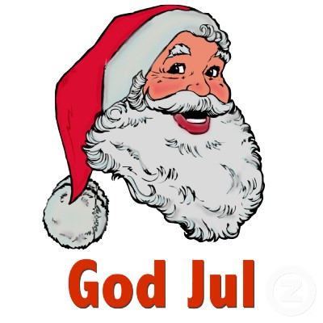
Santa Claus
Santa Claus, also known as Saint Nicholas, Father Christmas and simply "Santa", is a figure with legendary, mythical, historical and folkloric origins who, in many western cultures, is said to bring gifts to the homes of the good children during the late evening and overnight hours of Christmas he is big and he has as beard
Christmashttp://en.wikipedia.org/wiki/Santa_Claus

Slide 7
The Traditional food Ate On Christmas
With small variations, in all Scandinavian countries an almond is hidden in the porridge and good luck goes to the finder. Swedes say whoever gets the almond will marry during the coming year. this is the recipe for ham balls .
3 cups buttermilk baking mix 10 1/2 cups smoked ham 4 cups sharp cheddar cheese 1/2 cup Parmesan cheese 2 teaspoons parsley flakes 2 teaspoons spicy brown mustard 2/3 teaspoon milk 1.Heat oven to 350 Fahrenheit. 2.Lightly grease jelly roll pan, 15 1/2 x 10 1/2 inch. 3.Mix thoroughly the Bisquick, finely chopped, fully cooked ham, and remaining ingredients. 4.Shape mixture into 1 inch balls. 5.Place about 2 inches apart in pan. 6.Bake 20 to 25 minutes or until brown. Immediately remove from pan. Serve warm.
http://www.santas.net/holidayhamballs.htm

Slide 8
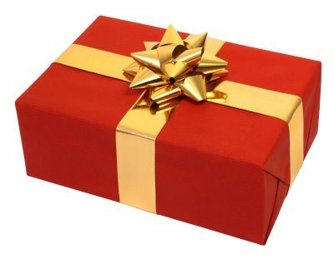
Presents
The bad boys and girls get nothing, good boys and girls get a lot of stuff.
http://wiki.answers.com/Q

Slide 9
Unique things about Christmas
Christmas trees are put up two days before Christmas. In Sweden , festivities usually begin with the lighting of the first of four Advent candles in homes across the country, followed by the annual must-see December 1 airing of a popular national television holiday entertainment special, "Julkalendar". Main Christmas Europe Christmas in Sweden
fish dishes.
Glögg
(mulled wine) is another festive part of the celebration. Also served is the traditional Jul grot or Christmas porridge containing one hidden almond, which promises good fortune to any family member lucky enough to find it!
http://www.chiff.com/christmas/christmas-sweden.htm

Slide 10
Bibliography
Sweden country map.ipg Sweden. Population. Best ourism .com http://www.whychristmas.com/cultures/sweden.shtmlhttp://www.google.ca/search?q=map+ofsweden&rls=com.microsoft:en-us&oe=UTF-8&startIndex=&startPage=1&redir_esc=&safe=active&um=1&ie=UTF-8&hl=en&tbm=isch&source=og&sa=N&tab=li&biw=1024&bih=571&sei=6xWlUJvbB8XJ0QGIxoH4BAhttp://goscandinavia.about.com/b/2008/12/15/how-to-say-merry-christmas-in-swedish.htm http://en.wikipedia.org/wiki/Languages_of_Sweden#Swedishhttp://www.the-north-pole.com/around/sweden.htmlhttp://en.wikipedia.org/wiki/Santa_Claus
http://www.santas.net/holidayhamballs.htm
http://www.chiff.com/christmas/christmas-sweden.htm

