Slide 1
Christmas in Greece
By: Haley Whiteway

Slide 2
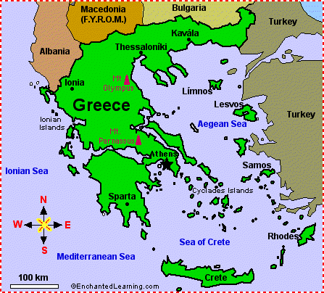
Map , Flag ,Population
10,787,690 according to 2011 census.
http://www.google.c/aimgres?q=greece+maps&um=1&hl=en&safe=active&rls=com.microsoft:en-us&biw=1024&bih=571&tbm=isch&tbnid=TObBL0uJ4VMmEM:&imgrefurl=http://www.enchantedlearning.com/europe/greece/map/&docid=iCsQ1ejEw7qygM&imgurl=http://www.enchantedlearning.com/europe/greece/map/big.GIF&w=447&h=404&ei=cimlUNvvCqfD0QH3-IG4CQ&zoom=1&iact=hc&dur=31&sig=118305584553736478278&page=1&tbnh=121&tbnw=134&start=0&ndsp=18&ved=1t:429,r:12,s:0,i:105&tx=161&ty=140&vpx=92&vpy=222&hovh=213&hovw=236
http://blogs.transparent.com/greek/greek-national-anthem-%CE%B5%CE%B8%CE%BD%CE%B9%CE%BA%CF%8C%CF%82-%CF%8D%CE%BC%CE%BD%CE%BF%CF%82-greek-flag/
http://wiki.answers.com/Q/What_is_the_population_of_Greece_2012

Slide 3
The day of Christmas
In Greece Christmas is celebrated on same day I celebrated Christmas on the 25 of December.

Slide 4
Language spoken in Greece
The language that spoken in Greece is Greek
This is how you say merry Christmas in Greek Καλά Χριστούγεννα (Kalá Christoúgenna.
http://translate.google.ca/translate_t?hl=en&biw=1024&bih=571&bav=on.2,or.r_gc.r_pw.&bvm=bv.1354675689,d.dmQ&bpcl=39650382&wrapid=tlif135532720824910&q=merry+christmas&um=1&ie=UTF-8&sl=en&tl=el&sa=X&ei=EKfIUKDOOeqW0QGSv4DIDA&ved=0CC4QrgYwAA

Slide 5
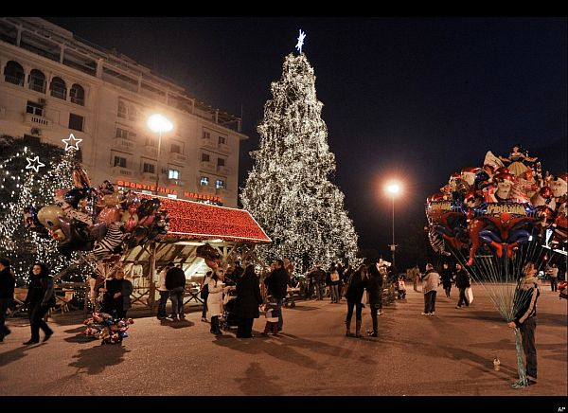
Tree and the way it`s Decorated
Christmas trees are not commonly used in Greece . Almost in every home in Greece the maim symbol of the season is a shallow wood bowl with a piece of wire rapped across the rim. But people that do get trees in Greece decorate it like we do now in Canada(raped around the tree is tinsel and on the very top of the tree is a star and don’t for get the ornaments on the tree to ).
http://www.santas.net/greekchristmas.htm
http://www.google.ca/imgres?q=christmas+trees+decorated+in+Greece&um=1&hl=en&tbo=d&biw=1024&bih=571&tbm=isch&tbnid=cA2OXa_OGEBI3M:&imgrefurl=http://interiorunity.com/category/christmas/&docid=H9UNibfVBECgyM&imgurl=http://interiorunity.com/wp-content/uploads/2011/12/Aristotelous-Square-Christmas-Tree-Thessaloniki-Greece.jpg&w=600&h=436&ei=hYe_UNLWKbSP0QGe6oHgBA&zoom=1&iact=hc&vpx=407&vpy=114&dur=4484&hovh=191&hovw=263&tx=173&ty=76&sig=104564242458030780668&page=1&tbnh=114&tbnw=152&start=0&ndsp=21&ved=1t:429,r:3,s:0,i:92

Slide 6
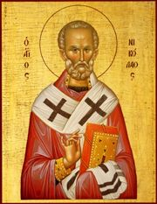
Greek Santa Claus
There Santa is a boy that doesn’t wears a hat but he wears a robe that looks like that it is made of silk he is not fat he is skinny and he doesn’t have a long beard he has a short one. He is almost like in away preacher the way they dresses the way they looks. In my picture I have of Santa he is holding a book like a preacher does.

Slide 7
Important Christmas characters in Greece
St. Nicholas aka Santa Claus is the most important character in all of Greece
http://www.the-north-pole.com/around/greece.html.

Slide 8
Traditional Food Recipe for Greece Kourabiethes
Greek shortbread is the traditional Christmas meal in Greece
450g flour
1 teaspoon vanilla 1 tablespoon ouzo 450g unsalted butter 2 egg yolks 175g sugar 2 teaspoons cinnamon 1 teaspoon baking powder 1/2 cup ground almonds or walnuts icing sugar and cloves 1. Sift flour with baking powder twice. 2. Cream butter and sugar, add ouzo, vanilla and egg yolks, nuts, and cinnamon. 3. Blend in flour to make soft but firm dough. If not enough liquid, add another egg yolk. 4. Break off small pieces, pat into biscuit shape, place on floured baking tray. Insert a clove in each biscuit and bake at 180 degrees celcius for 20 mins (cooked but not brown). 5. While still hot, sprinkle biscuits with icing sugar. 6. Each shortbread should be stuck with one clove to represent the three wise men who brought spices to the christ child.
http://www.santas.net/greekchristmas.htm

Slide 9
Gifts in Greece for the good and bad kids
I can’t find not one little thing

Slide 10
something Unique about Greece
What's unique about Greece at Christmas is that almost in every home in Greece the maim symbol of the season is a shallow wood bowl with a piece of wire rapped across the rim.
http://www.the-north-pole.com/around/greece.html

Slide 11
Bibliography
http://blogs.transparent.com/greek/greek-national-anthem-%CE%B5%CE%B8%CE%BD%CE%B9%CE%BA%CF%8C%CF%82-%CF%8D%CE%BC%CE%BD%CE%BF%CF%82-greek-flag/
http://www.google.ca/imgres?q=greece+maps&um=1&hl=en&safe=active&rls=com.microsoft:en-us&biw=1024&bih=571&tbm=isch&tbnid=TObBL0uJ4VMmEM:&imgrefurl=http://www.enchantedlearning.com/europe/greece/map/&docid=iCsQ1ejEw7qygM&imgurl=http://www.enchantedlearning.com/europe/greece/map/big.GIF&w=447&h=404&ei=cimlUNvvCqfD0QH3-IG4CQ&zoom=1&iact=hc&dur=31&sig=118305584553736478278&page=1&tbnh=121&tbnw=134&start=0&ndsp=18&ved=1t:429,r:12,s:0,i:105&tx=161&ty=140&vpx=92&vpy=222&hovh=213&hovw=236
http://www.the-north-pole.com/around/greece.html
http://www.santas.net/greekchristmas.htm

Slide 12
Bibliography #2
http://www.google.ca/imgres?q=christmas+trees+decorated+in+Greece&um=1&hl=en&tbo=d&biw=1024&bih=571&tbm=isch&tbnid=cA2OXa_OGEBI3M:&imgrefurl=http://interiorunity.com/category/christmas/&docid=H9UNibfVBECgyM&imgurl=http://interiorunity.com/wp-content/uploads/2011/12/Aristotelous-Square-Christmas-Tree-Thessaloniki-Greece.jpg&w=600&h=436&ei=hYe_UNLWKbSP0QGe6oHgBA&zoom=1&iact=hc&vpx=407&vpy=114&dur=4484&hovh=191&hovw=263&tx=173&ty=76&sig=104564242458030780668&page=1&tbnh=114&tbnw=152&start=0&ndsp=21&ved=1t:429,r:3,s:0,i:92
http://wiki.answers.com/Q/What_is_the_population_of_Greece_2012
http://www.sfakia-crete.com/sfakia-crete/christmas.html

Slide 13
Bibliography #3
http://translate.google.ca/translate_t?hl=en&biw=1024&bih=571&bav=on.2,or.r_gc.r_pw.&bvm=bv.1354675689,d.dmQ&bpcl=39650382&wrapid=tlif135532720824910&q=merry+christmas&um=1&ie=UTF-8&sl=en&tl=el&sa=X&ei=EKfIUKDOOeqW0QGSv4DIDA&ved=0CC4QrgYwAA
http://www.the-north-pole.com/around/greece.html.

